Slide 1
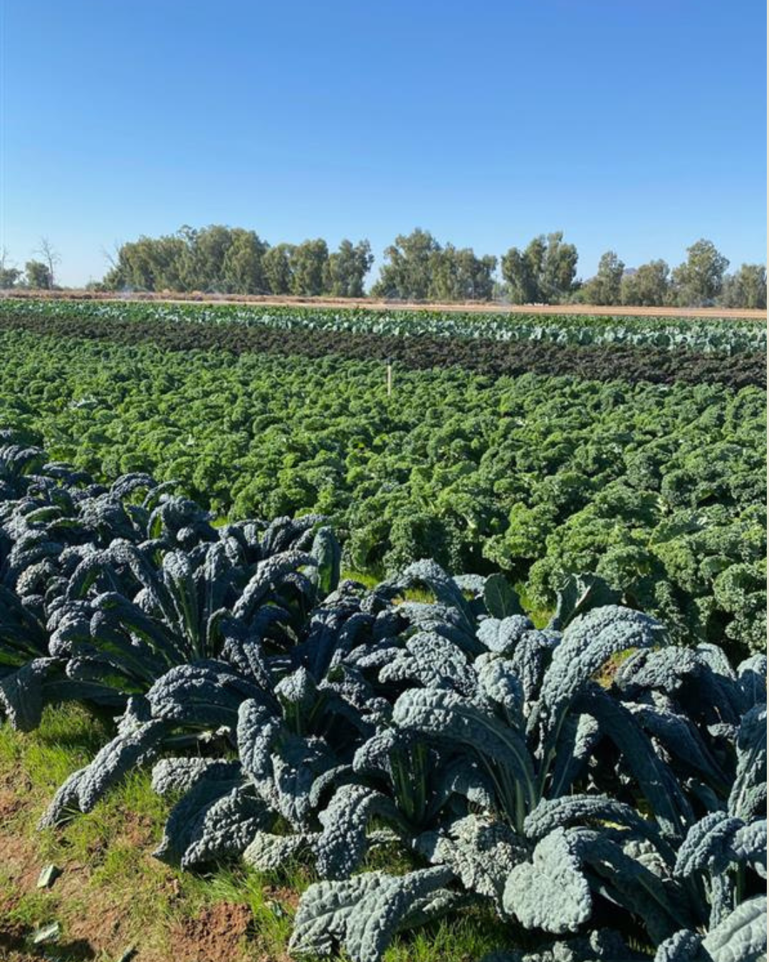

Grant Information Session: Food Systems Grant Funding Cycle 2026-2027
Friday, January 9, 2026 (Virtual)
Friday January 16, 2026 (Virtual)
Karen Ibarra & Maddie Mercer
Office of Environmental Programs
City of Phoenix

Slide 2
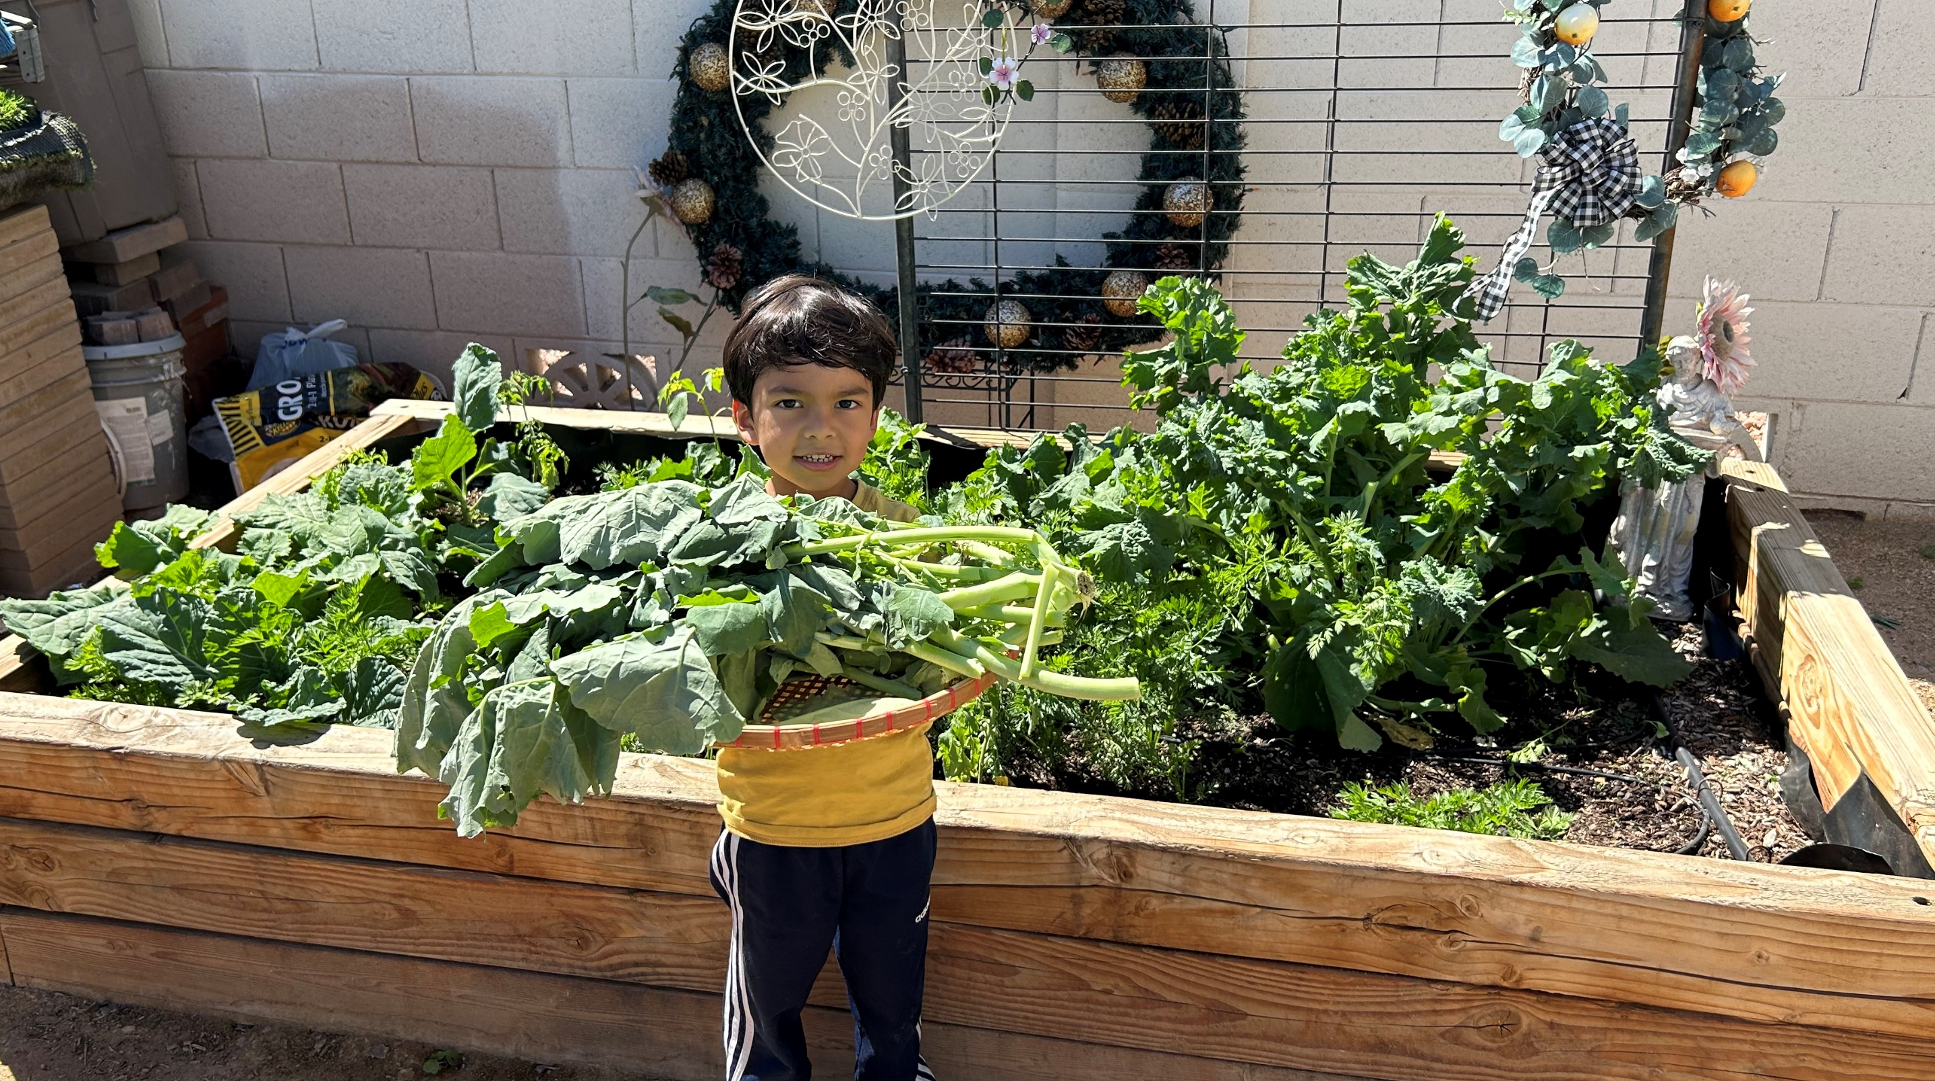
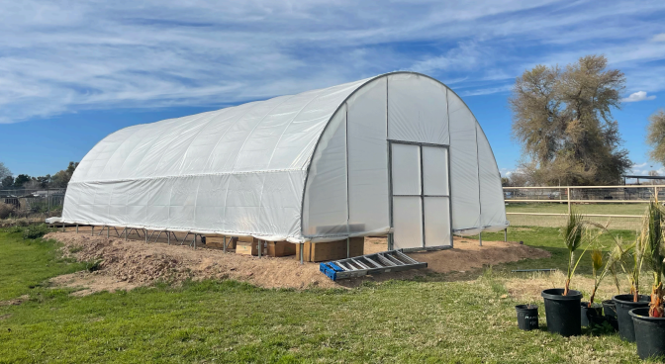
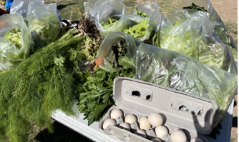
Agenda
Introductions
Food Systems Grant Overview
Questions

Slide 3
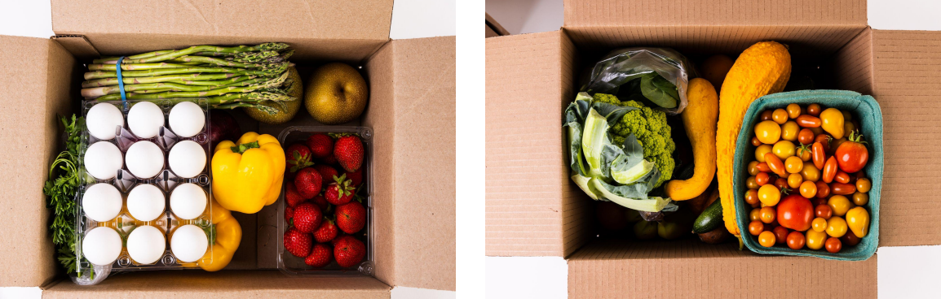
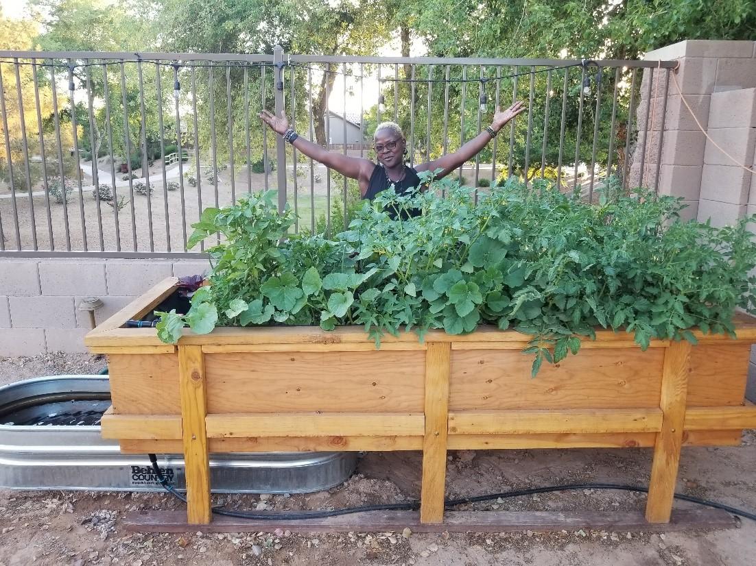
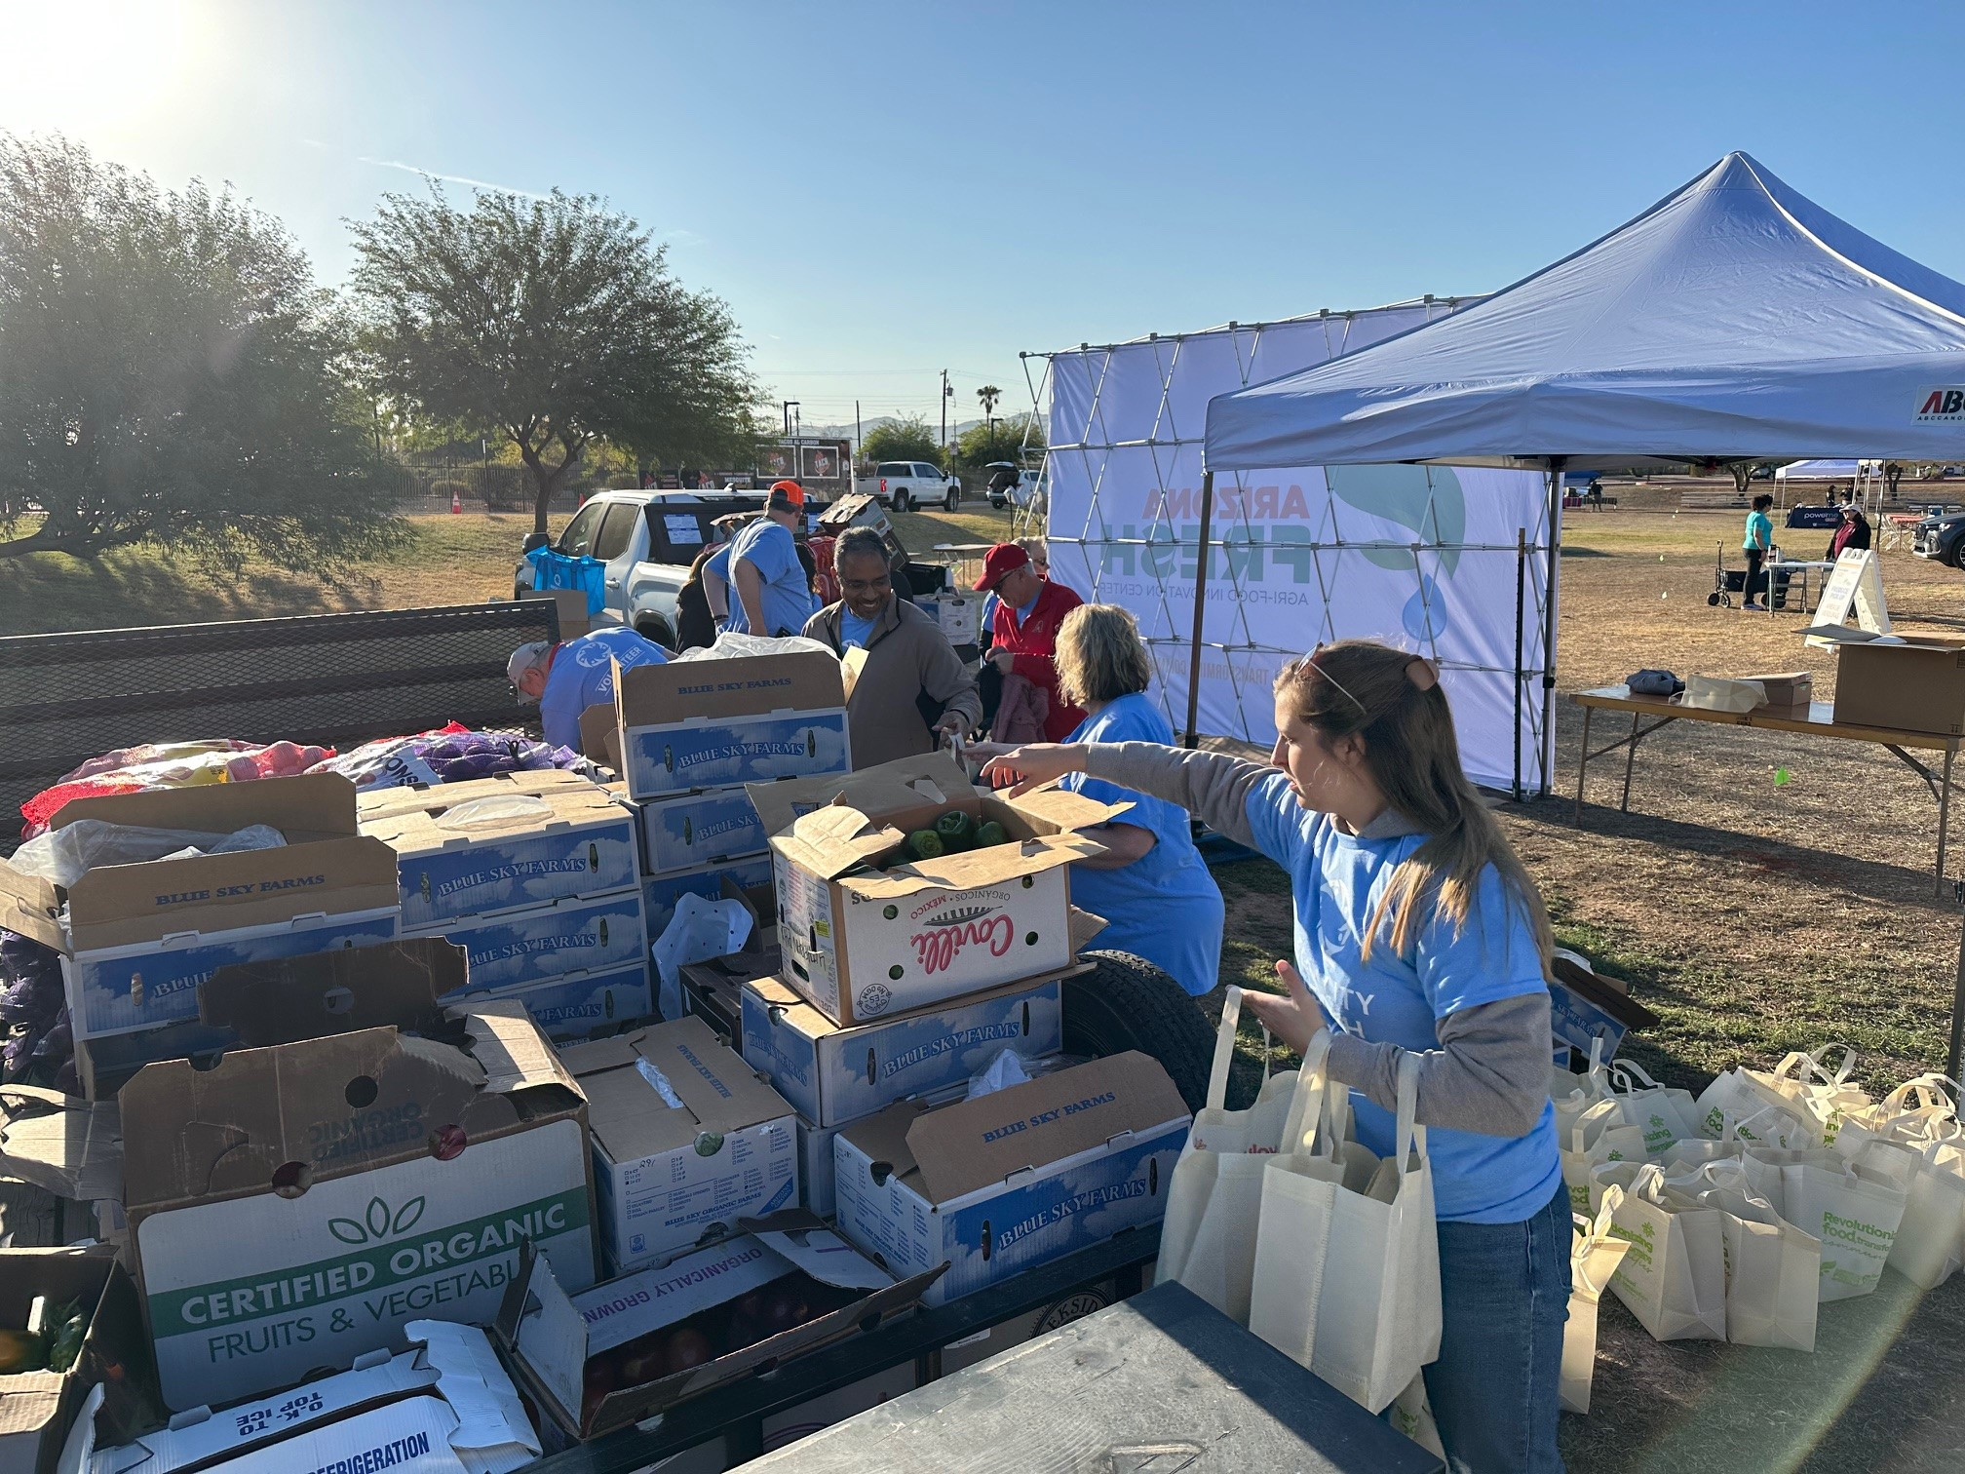
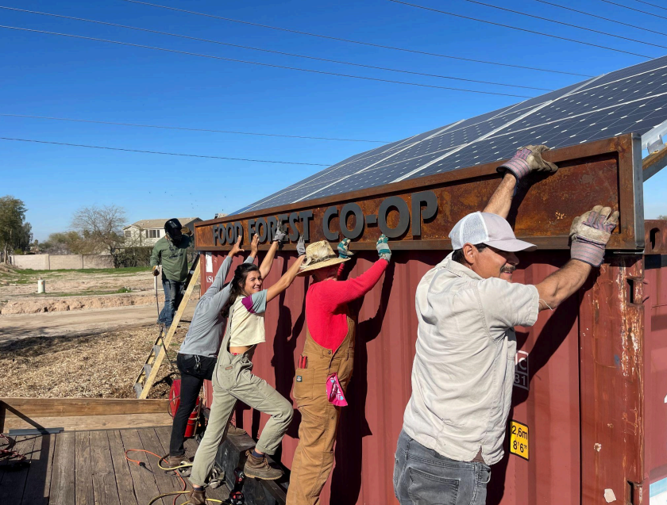
City of Phoenix Office of Environmental Programs
OEP Mission: Advance environmental protection and sustainability by promoting sound environmental policies and practices through leadership, education, and technical and regulatory assistance.
Food Systems Goal: Ensure all Phoenix residents have enough to eat and have access to healthy, affordable, and culturally relevant food.
Notes:
Promote the growth of a healthy, affordable, secure, and sustainable food system that makes healthy food available to all Phoenix residents.
Promover el crecimiento de un sistema alimentario saludable, asequible, seguro y sostenible que provee alimento saludable a todos los residentes de Phoenix.

Slide 4
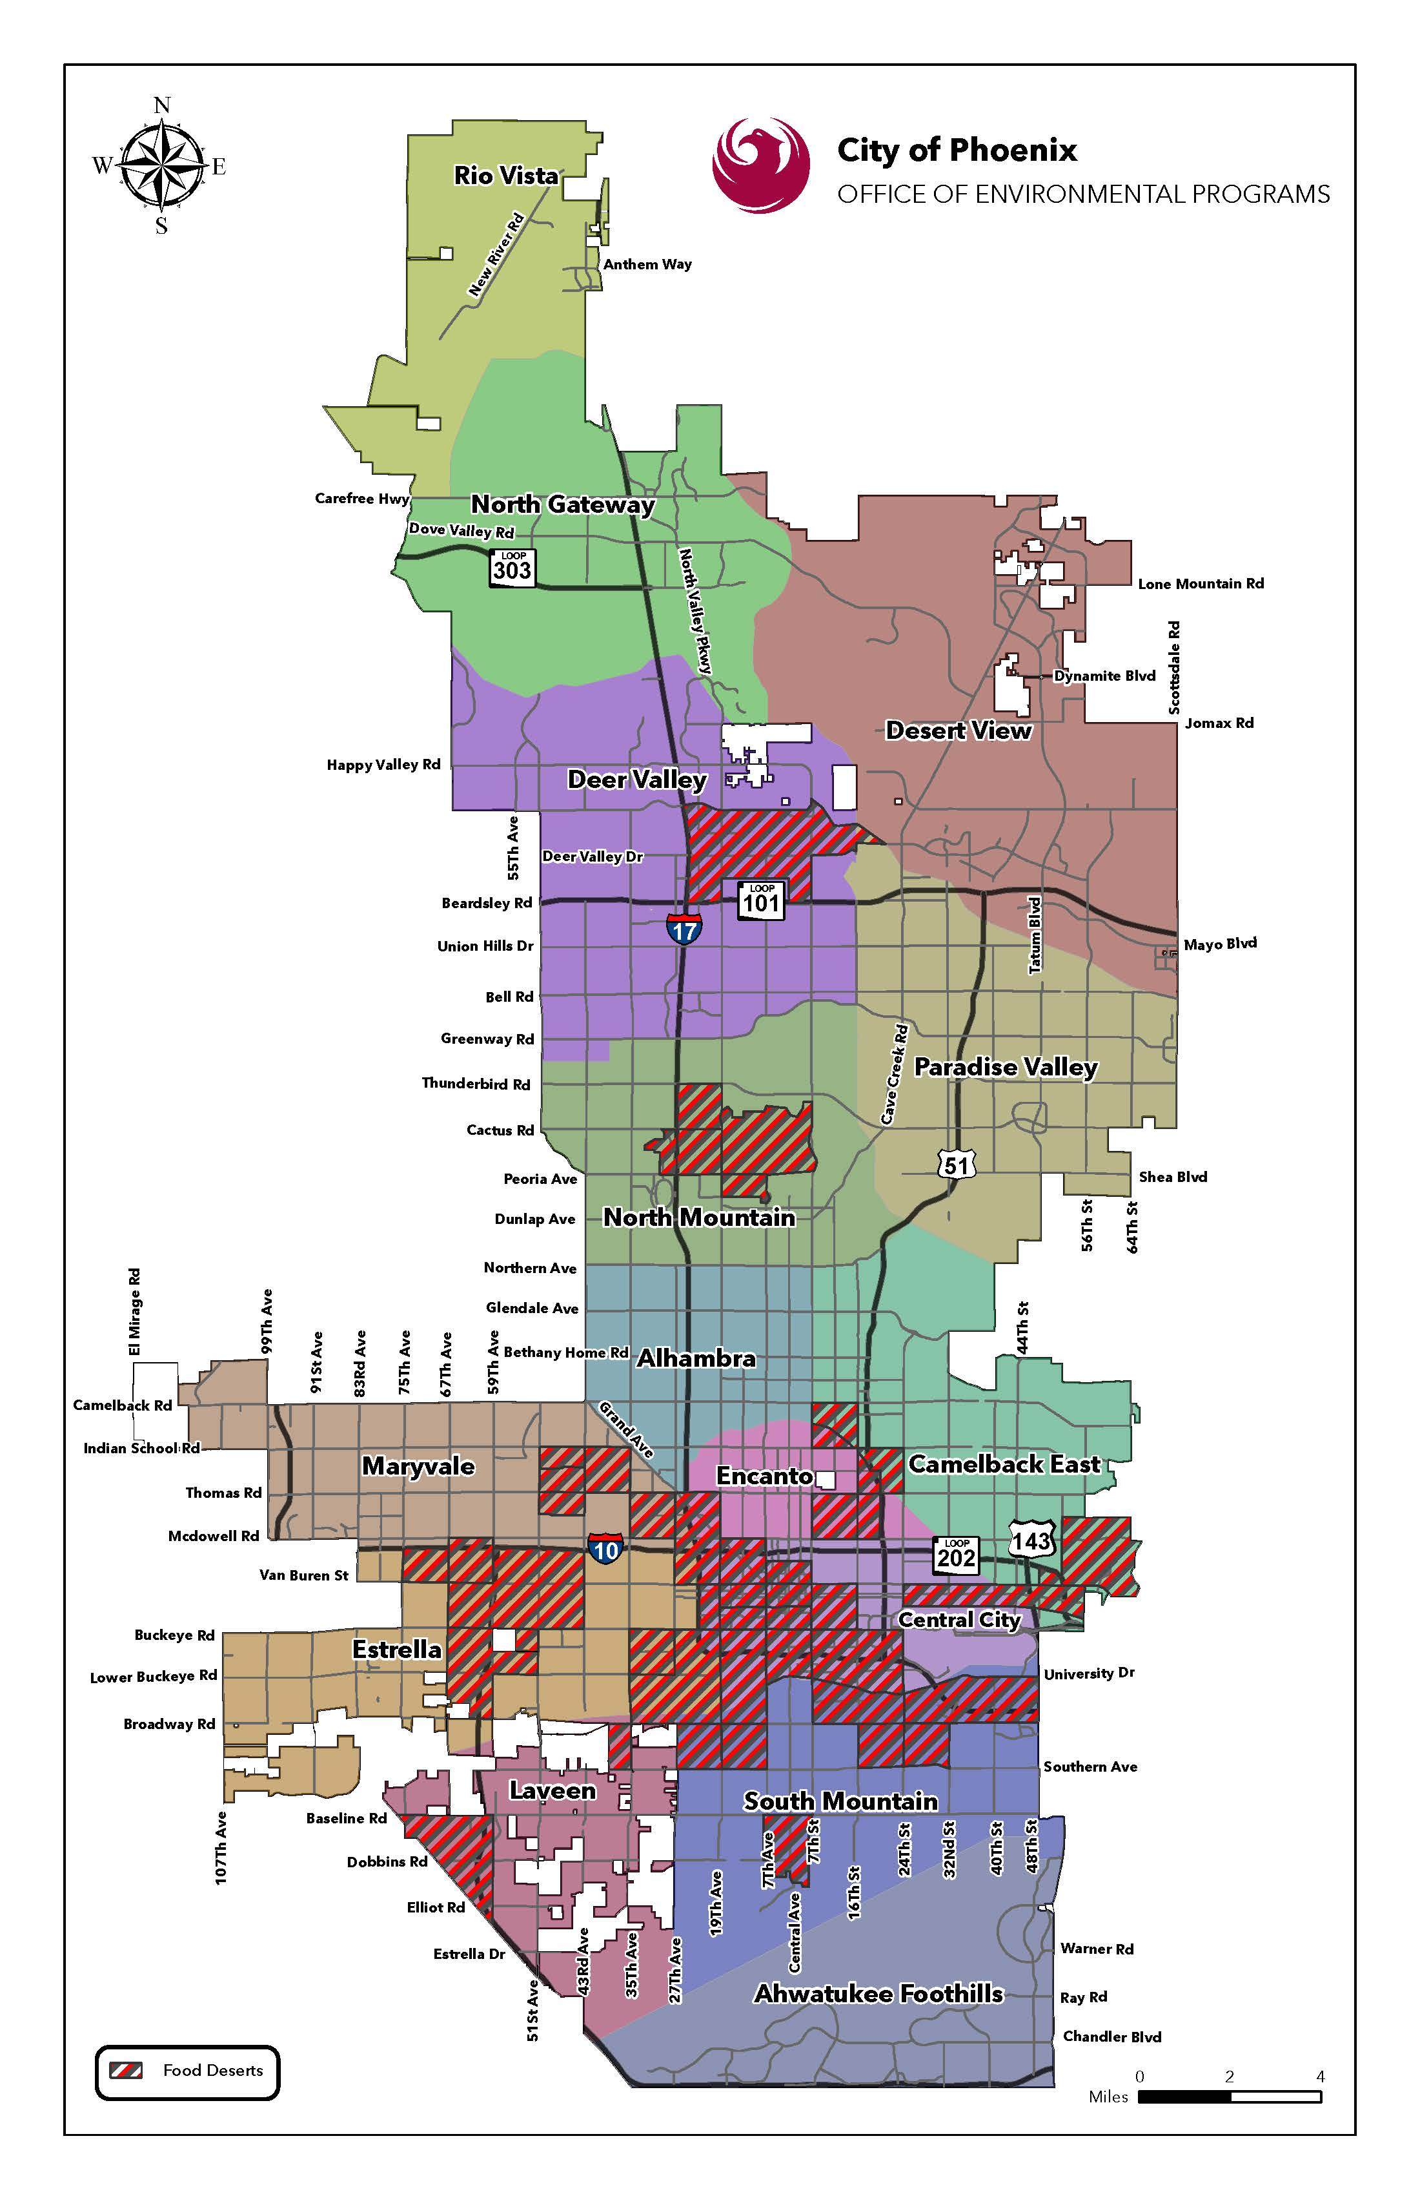
Background/Context
Food desert - an area without ready access to fresh, healthy and affordable food
Of the 55 food deserts in Maricopa County, 43 are in Phoenix, that encompass nearly half the Phoenix population.
The people most vulnerable in Phoenix often have limited time to cook, live far distances from grocers, and are on a tight budget.
Despite our agricultural capacity and national leadership in food production, our food system is not working for many people in Phoenix, especially low-income, ethnic minorities, seniors, and children.

Slide 5
Food Systems Grant
This grant intends to support projects at the community-level that foster a just, equitable, and resilient local food system and improve food access by helping Phoenix residents to grow, access, cook, share, and eat healthy, affordable, and culturally relevant food.

Slide 6
Grant Description
Will provide awards of $5,000 to $20,000 to implement projects community-level that foster a just, equitable, and resilient local food system
Aims to improve food access by helping Phoenix residents to grow, access, cook, share, and eat healthy, affordable, and culturally relevant food.
Grant term is maximum 12-months.

Slide 7
Grant Eligibility
Eligible entities and activities
Organizations that have 501(c)(3) nonprofit status.
Community groups that have a *fiscal sponsor with 501(c)(3) nonprofit status.
Locally owned businesses, social enterprises, and/or cooperative enterprises with less than 50 employees
Educational Institutions (community colleges, universities, public and/or charter schools)
Entities must be operating within the City of Phoenix boundaries to be eligible for funding through the Food Systems Grant.
Project activities must take place within the City of Phoenix boundaries.
Project activities must be accessible and benefit people who live, learn, and work in Phoenix.
Project activities must focus on contributing to a just, equitable, and resilient local food system.

Slide 8
Grant Ineligibility
Ineligible entities and activities:
Prior OEP grant awardees submitting duplicate or substantially similar projects previously funded by an OEP grant program.
Current OEP grant awardees with an active funded project that has not yet been completed or closed out.
Entities or individuals not meeting eligibility criteria outlined in this document (e.g., geographic restrictions, organizational type).
Organizations or individuals with outstanding reports, unresolved compliance issues, or unpaid obligations from prior OEP grants or to the City of Phoenix.
Projects primarily benefiting private interests rather than the broader community.
Applicants seeking retroactive funding for expenses incurred before the award date.
Projects that do not align with the program’s stated goals and objectives.

Slide 9
Desired Project Characteristics
Identifies a specific demonstrated need in the local food system, especially in historically underserved or marginalized areas.
Advances justice, equity, and access to healthy, affordable, and culturally relevant food within the local food system.
Enhances food and nutrition security and promotes community health.
Increases understanding of the local food system, food literacy, and community food resources.
Notes:
Project must connect with 3 or more project characteristics and this must be conveyed in the proposal

Slide 10
Desired Project Characteristics Continued..
Advances economic opportunities in the food system for urban growers, new and existing food businesses, and others to sell their food locally and creates opportunity for residents to affordably and easily acquire healthy food.
Improves access to healthy food (farmer’s markets, CSAs, healthy food retailers, neighborhood produce stands, mobile markets and food delivery projects) for the most vulnerable.
Adopts new and/or expands existing sustainable practices to produce, process, cook, transport, sell food, and/or prevent food loss and waste to create a strong community food network.

Slide 11
Project Examples
Urban farming and community gardening activities
Food programs for vulnerable populations such as elders, youth, unhoused individuals, or others
Food distribution site
Food pantry & meal services
Coalition building to advance food justice & food sovereignty
Capital project or physical improvement, such as new greenhouse, irrigation system, and/or commercial kitchen equipment
Food systems-related job training

Slide 12
Project Examples Continued…
Food systems leadership development
Food business development
Activities that advance economic opportunities in the food system
Food-related storytelling & cultural preservation
Composting and food waste prevention
Neighborhood food markets
Food systems education or trainings
“Food as medicine,” health, and nutrition programs

Slide 13
Allowable Expenses
The majority of the budget costs should go toward direct services to Phoenix residents.
All budget costs need to be clearly tied to project activities and goals.
Liability insurance is required for the duration of the grant period, costs associated may be included in the budget.
Details about the required coverage are included in the call for proposals.

Slide 14
Non-allowable Expenses
Expenses made before the organization is under contract
Lodging or hotel expenses
Organization’s overhead/indirect costs unrelated to the Food Systems Grant
Projects not easily accessible by the public
Purchase of land or buildings
Purchase of a vehicle
Capital project or physical improvements on a private residence

Slide 15
Funding Details
Total available Grant funding for 2026 is $100,000.
Funds will be paid on a monthly reimbursement basis.
City may consider one advance payment per grantee of no more than 20 percent of the total grant request, based on demonstrated need.
All funds awarded through this grant opportunity must be expended within 12 months. Any funds that are not spent at expiration of the Agreement, must be returned to the City.
Notes:
Note: Must have capital to cover grant expenses until reimbursement is received
Advance Payment
The grantee must provide written justification demonstrating the need for an advance payment and state how the advance will be spent.
The advanced amount must be expended within 60 days.
The grantee is required to submit documentation verifying the expenditure, along with supporting materials such as photos (e.g., if funds were used for supplies or equipment).
Once the documentation is approved, the project will transition to a monthly reimbursement process for subsequent expenses.
If the advance is not fully spent within 60 days and/or the required documentation is not provided, the grant will be terminated, and the grantee must repay the full amount of the advance payment.

Slide 16
Application Process
Deadline: 5:00 PM on Monday, February 2, 2026.
Application components
Online application form - Food Systems Grant Application | City of Phoenix
Note: no applications will be accepted by email.
Required attachments
Project narrative
Note: The total length should not exceed three pages.
Project budget
Optional attachments
Photos
Maps/design specs
Budget estimates/ invoice quotes

Slide 17
Evaluation and Selection Criteria
Proposal
Project plan
Project plan must clearly outline project activities and intended audience.
Project plan must include three or more of the desired project characteristics detailed in the previous section.
Project plan must include projected outcomes and key performance indicators (KPIs) to measure success.
Project plan must articulate how the project will create lasting benefits for residents living in historically underserved or marginalized areas, like food deserts.
Project plan must clearly outline strategies for sustaining outcomes and/or building community capacity beyond the grant period.
Project Schedule:
Project plan must outline how project will be completed within 12 months.
Outlines a realistic and achievable timeline with clear milestones.
Anticipated project start date – April 2, 2026.
Qualifications and experience of applicant(s)
Please outline relevant expertise, lived experience, and/or strong examples of successfully managing similar projects.
If applicable, please outline any prior work done in partnership with the City.
Note: Priority will be given to proposals that center equity, uplift community voice and demonstrate local benefit.

Slide 18
Evaluation and Selection Criteria Cont..
Project Budget
Project Budget is clear, detailed, and reasonable.
Budget is presented in the format in Exhibit A-Budget Template.
Demonstrates efficient use of funds, clear cost justifications, and leverages additional resources where possible.
See Exhibit A for Budget Template
See Exhibit B Budget Category Definitions
Optional Attachments
Photos
Maps
Design specs
Invoice quotes
Other
Notes:
Optional attachments will be reviewed but not scored

Slide 19
Timeline
Completed applications due by 5 PM on Monday, February 2, 2026
Select & notify winning applicants no later than March 4, 2026
Agreement development, signing, approval process by March 16, 2026
Project Length is maximum 12-months
Estimated project start date April 2, 2026
Estimated project end date no later than April 1, 2027

Slide 20
Timeline
Completed applications due by 5 PM on 2/02/202
Agreement development, signing, approval process by 3/15/2026
Project end date 4/1/2027
Project start date 4/2/2026
Select & notify winning applicants by 3/4/2026

Slide 21
Future Opportunities to Connect
Virtual Info Session:
Friday, January 9th at 9AM – 10AM
Friday, January 16th at 1PM – 2PM
Virtual Office Hours:
Wednesday, January 21st at 9:30AM – 10:30AM
Tuesday, January 27th at 12PM – 1PM

Slide 22
Questions?
Karen Ibarra
Karen.ibarra@phoenix.gov
602-534-0269
Maddie Mercer
madeline.mercer@phoenix.gov 602-534-5387

Slide 23
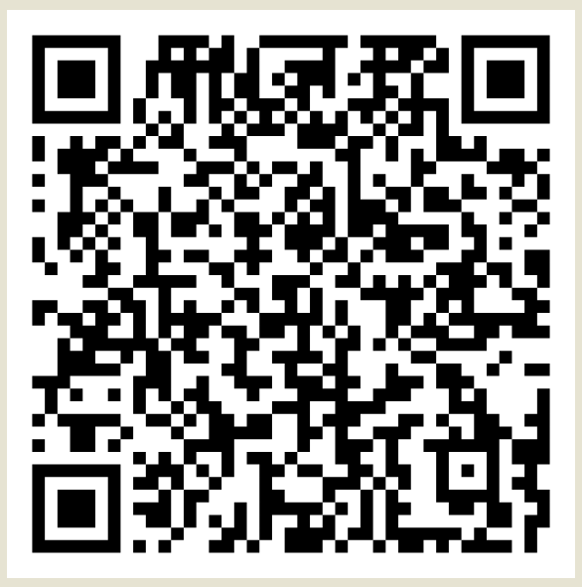
Grant Application
Food Systems Grants | City of Phoenix

