Slide 1

PlanPHX 2025
Leadership Committee
February 7, 2023
Staff Contacts:
Joél Carrasco, joel.carrasco@phoenix.gov, 602-262-6940
Tricia Gomes, tricia.gomes@phoenix.gov, 602-262-4870

Slide 2
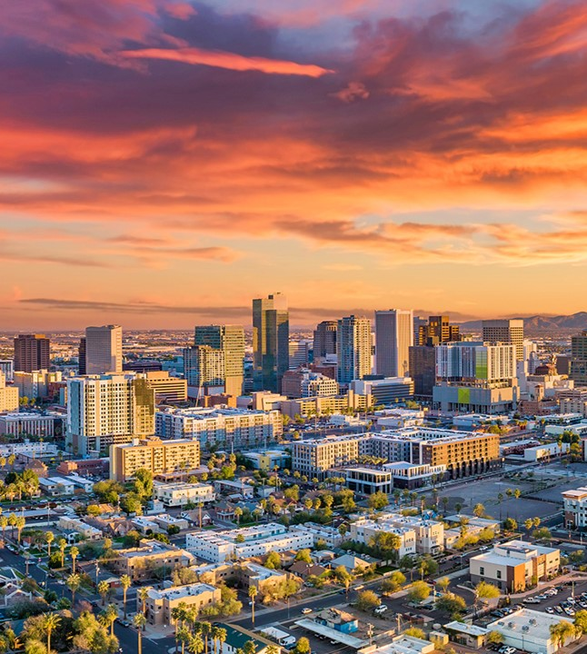
Agenda Item(s) 1-3: Chairperson
Slide 2
Call to Order, Introductions and Announcements by Chair.
    Roll Call
Public comments concerning items not on the agenda.
Not for Committee discussion or action
Presentation on 2025 vision and opportunity by Chair.

Slide 3
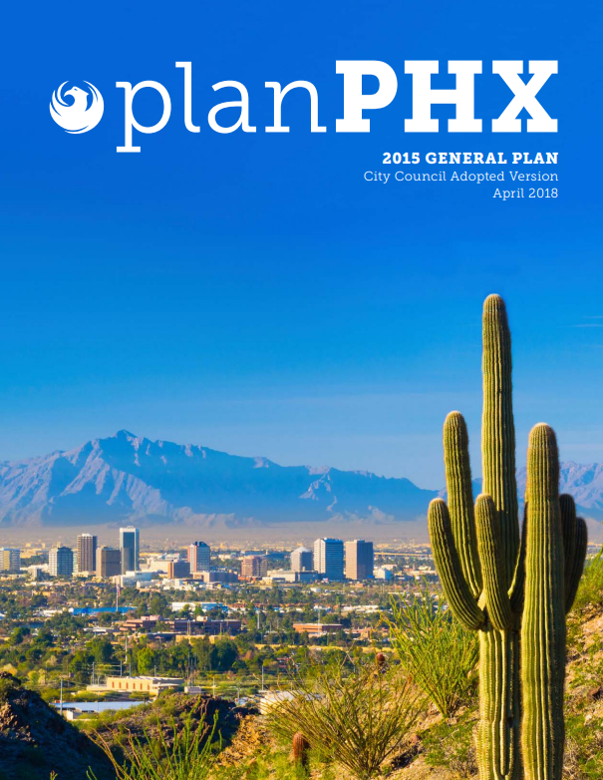
Agenda Item 4: connection of strategy and planning
Slide 3
Presentation regarding the connection of strategy and planning.
  Presentation by Dr. Carol Poore, President, Poore & Associates Strategic Planning; PlanPHX 2015 Leadership Committee Vice Chair.

Slide 4

Agenda Item 5: Work Program and Schedule
Slide 4
General Plan 2025 Update Work Program and Schedule Overview.
  Presentation by staff.

Slide 5
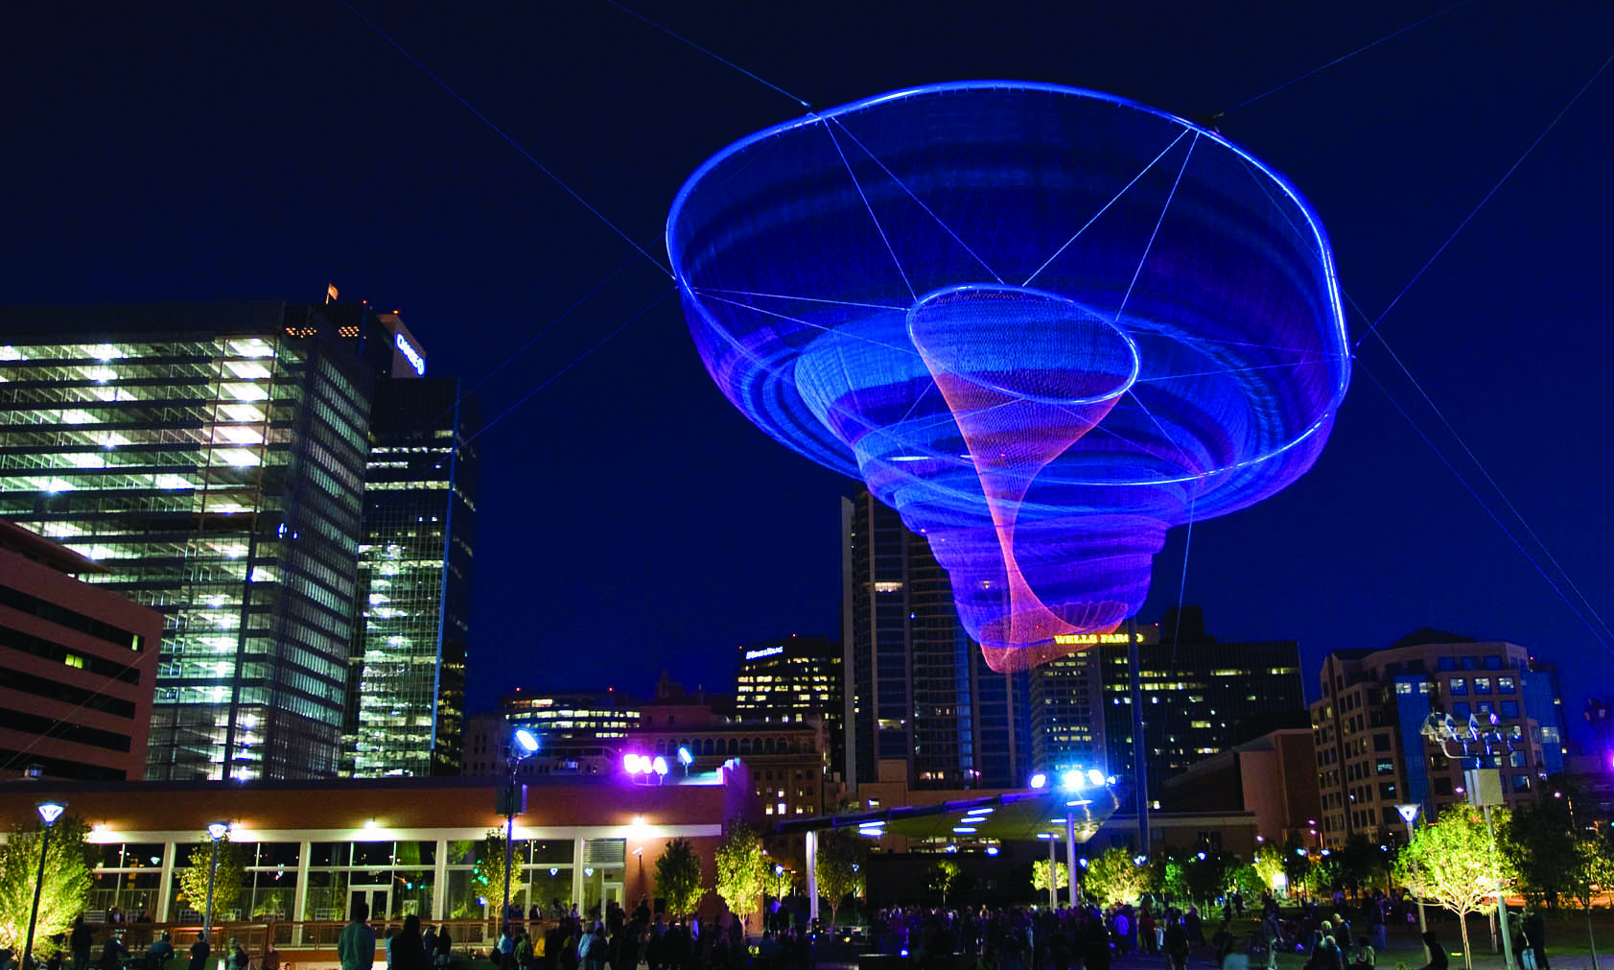

2025 General Plan Update
What will we do together?
Her Secret is Patience

Slide 6




A strategic and focused update (3 steps)
Execute a coordinated update building off the existing Phoenix General Plan that will create a unified policy framework for the entire city
Align
Emphasize
Focus

Slide 7
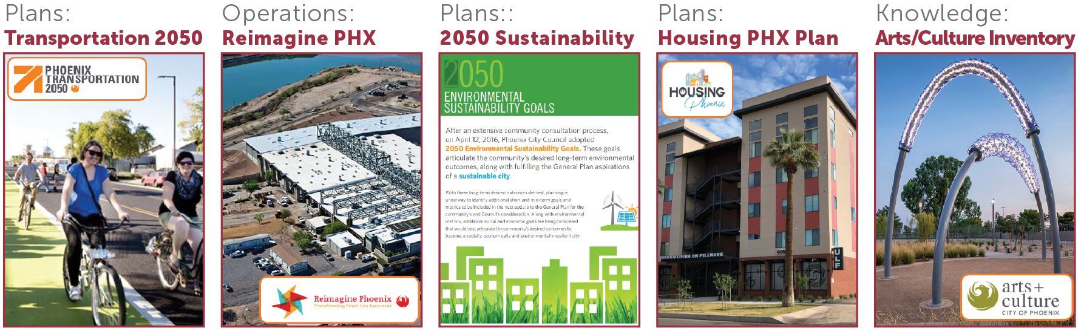

Step 1: Vision Alignment

Slide 8
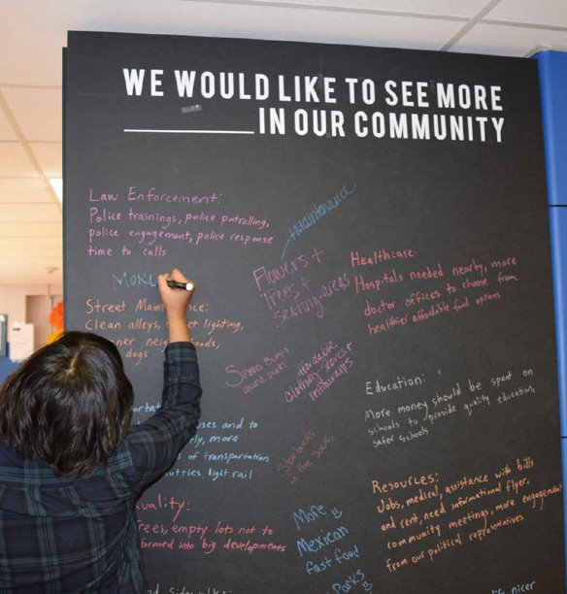
Step 2: What are we missing?
Emphasize, more clearly define the General Plan's goals and strategies based on other more recent vision, goals, and input

Slide 9

Step 3: Where do we focus next?
Outlining what we will be working on to accomplish goals for the next 10 years

Slide 10
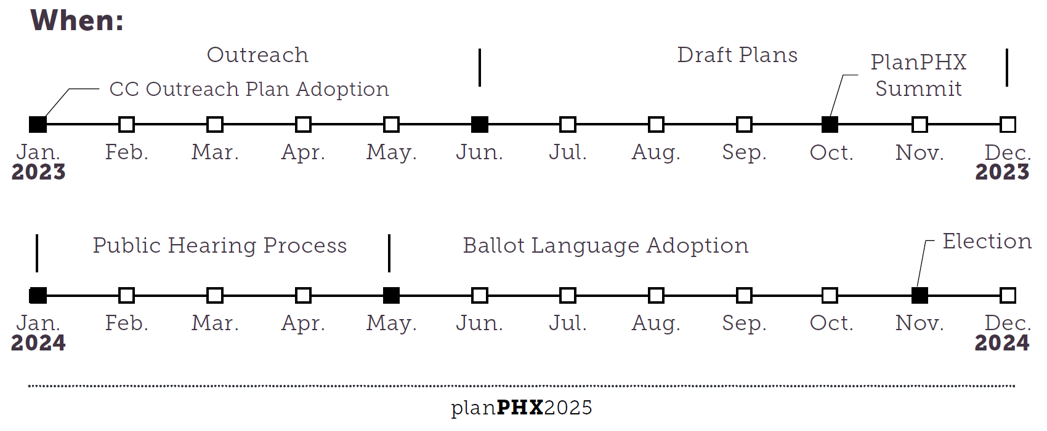
Timeline: 2023-2024
18

Slide 11
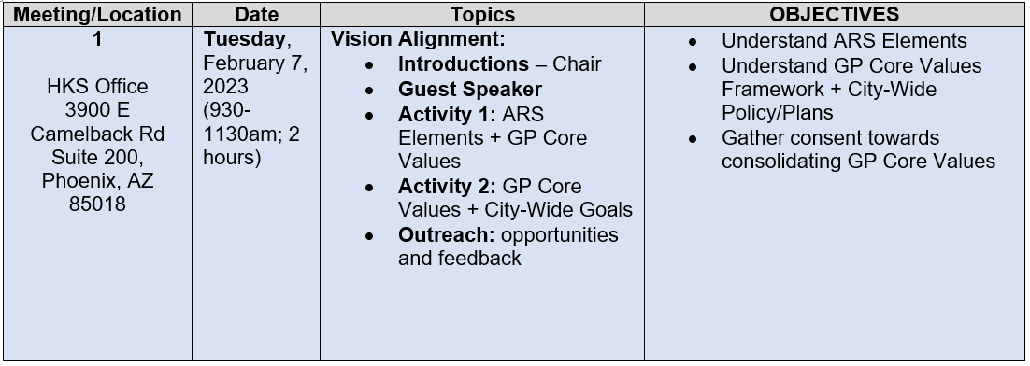
Work Program: February through May 2023
3 key steps: Vision Alignment (Today) , What are we missing (March-April), Where we focus next (April – May).

Slide 12
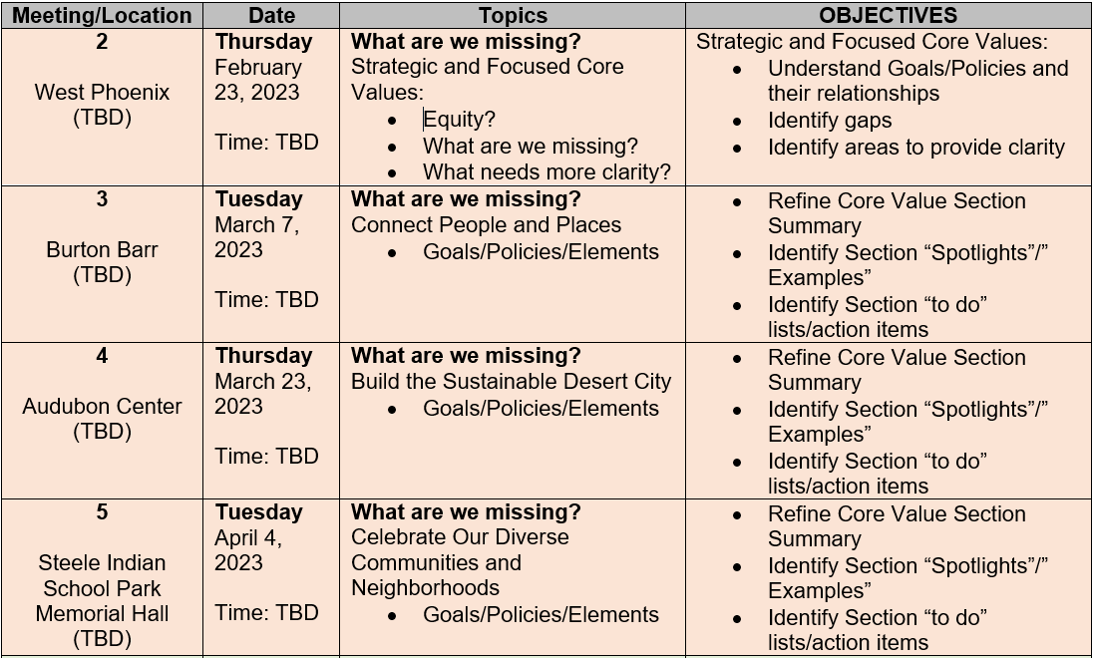
Work Program: February through May 2023
3 key steps: Vision Alignment (Today) , What are we missing (March-April), Where we focus next (April – May).

Slide 13
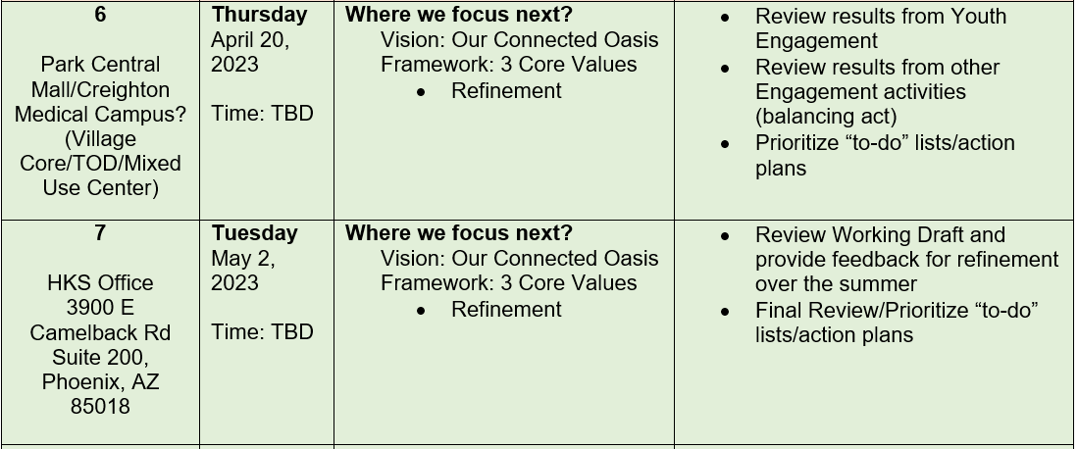
Work Program: February through May 2023
3 key steps: Vision Alignment (Today) , What are we missing (March-April), Where we focus next (April – May).

Slide 14
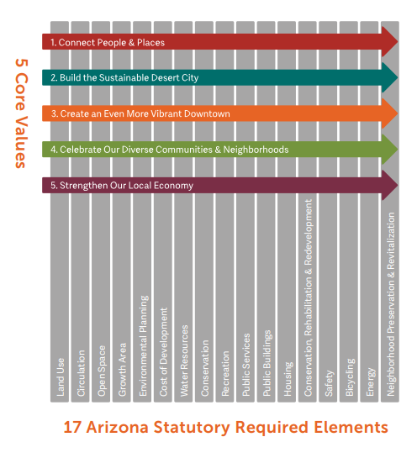
Agenda Item 6: Vision Alignment – ARS/Core Values
Slide 14
Vision Alignment Activity 1: Presentation, discussion, and prioritization activity results to understand the alignment of the Arizona Revised Statute (ARS) Planning Elements and the General Plan 2015 Core Values.
  Presentation by staff.

Slide 15
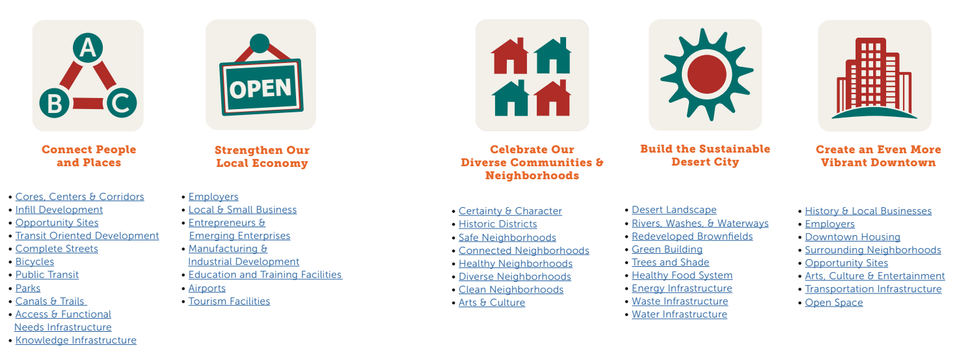
Agenda Item 6: Vision Alignment – ARS/Core Values
Slide 15
5 Core Values Overview

Slide 16
Agenda Item 6: Vision Alignment – ARS/Core Values
Slide 16
Vision Alignment Activity 1:
Which ARS Elements align to each of the 5 Core Values the most?
Check your email/inbox for links to the following (10 minutes):
https://phx_pdd.abalancingact.com/VisionAlignmentActivity1_1
https://phx_pdd.abalancingact.com/VisionAlignmentActivity1_2
https://phx_pdd.abalancingact.com/VisionAlignmentActivity1_3
https://phx_pdd.abalancingact.com/VisionAlignmentActivity1_4
https://phx_pdd.abalancingact.com/VisionAlignmentActivity1_5

Slide 17
Agenda Item 7: Vision Alignment – Core Values/Goals
Slide 17
Vision Alignment Activity 2: Presentation, discussion, and prioritization activity to understand the General Plan 2015 Core Values and more recent City-wide policies, plans and initiatives.
  Presentation by staff.

Slide 18
Agenda Item 7: Vision Alignment – Core Values/Goals
Slide 18
More recent planning efforts/initiatives:

Slide 19
Agenda Item 7: Vision Alignment – Core Values/Goals
Slide 19
Vision Alignment Activity 2: Which 5 Goals do you prioritize the most?
Check your email/inbox for links to the following (10 minutes):
https://phx_pdd.abalancingact.com/VisionAlignmentActivity2

Slide 20

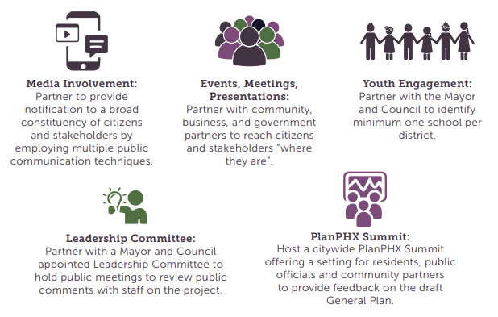
Agenda Item 8: Outreach
Slide 20
General Plan 2025 outreach methods, approach, and opportunities.
  Presentation by staff.

Slide 21
Agenda Item 8: Outreach
Slide 21
Sunnyslope event this Saturday! (table events)
Website –
  Prioritize tool
  videos/interviews
  Plans/project
  Other resources
ASU/Youth Engagement
Village Planning Committees (targeting April)
Any other Events, presentations, meetings, etc.

Slide 22
Thank you!
Next Meeting February 23, 2023
Staff Contacts:
Joél Carrasco, joel.carrasco@phoenix.gov, 602-262-6940
Tricia Gomes, tricia.gomes@phoenix.gov, 602-262-4870

