Slide 1
ADA Sensitivity and
Transit Policies for
Persons with Disabilities
July 25, 26 and 27, 2017

Slide 2
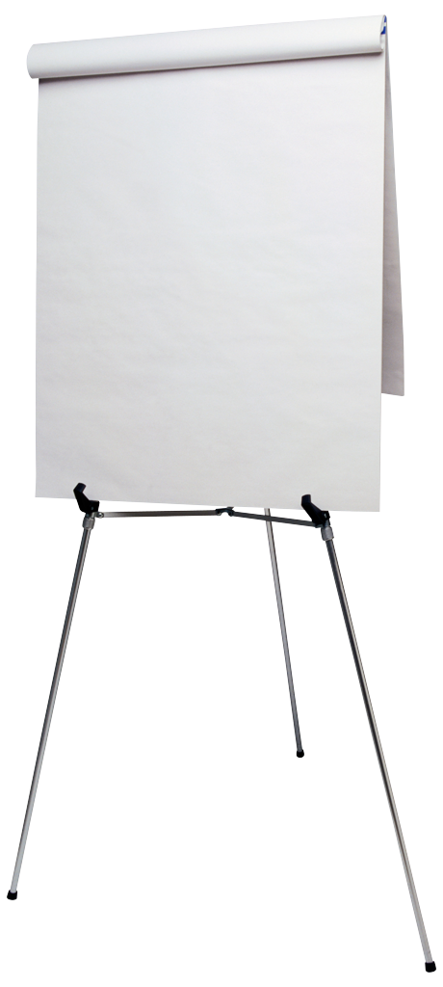
Introductions
Kristy Ruiz
City of Phoenix
Public Transit Department
ADA Coordinator
Peter Fischer
City of Phoenix
Equal Opportunity Department
City-wide ADA Coordinator
What do you hope to learn today?
Notes:
If you have any example to share with the class, do not disclose that person’s name, as disabilities are often related to private medical conditions.

Slide 3
Session Goal
Improve customer service through improved awareness of human disabilities and increase levels of comfort in working with diverse groups of people.

Slide 4
Session Objectives
Review ADA law.
Develop appropriate accessibility language within the workplace and with the public.
Build appropriate skills to interact with people with disabilities.
Understand Federal Transit Administration Policies related to serving customers with disabilities.

Slide 5

Knowledge Check
How many of you work with someone who has a disability?
How many of you know someone who has a disability?
How many have a disability now or may have at some point in life?
Notes:
5
Disability Survey- Approximately 8 minutes total
Ask “How many of you know someone who has a disability?”
Encourage participants to raise hands as you CLICK to enter objects onto page.
CLICK to next slide.

Slide 6
Knowledge Check
If you live to the age of 70, the chance of you having a disability is:
A. 12%
B. 28%
C. 55%
D. 82%
Notes:
6
Disability Survey- Approximately 8 minutes total
Ask “How many of you know someone who has a disability?”
Encourage participants to raise hands as you CLICK to enter objects onto page.
CLICK to next slide.

Slide 7

Definition of Disability
A physical or mental impairment
that substantially limits a major life activity
A record of such an impairment
Being regarded as having such an impairment
7

Slide 8
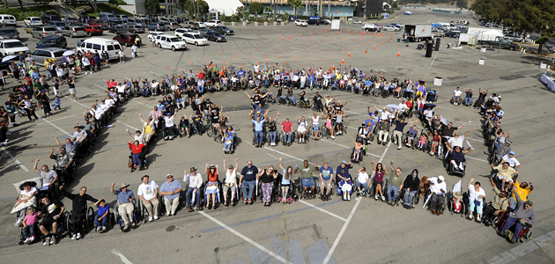
Americans with Disabilities Act
Notes:
8

Slide 9

ABCs of the ADA
Americans with Disabilities Act
  Enacted in 1990
  Amended in 2010
ADA is a wide-ranging civil rights law that prohibits discrimination based on disability.

Slide 10
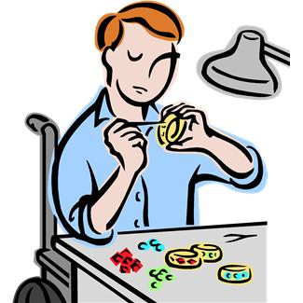
Local Government and the ADA
Focus of today’s training
ADA requires that we provide
  Equal access to
    Programs
    Facilities
    Activities
    Services

Slide 11
Five Titles of the ADA
Title 1. Employment
Prohibits disability discrimination in all employment processes.
Title 2. Accessibility in public entities
Physical and program access in State/local governments.
Title 3. Accessibility in businesses
Physical and program access in restaurants, hotels, stores, places of business, and transit facilities.

Slide 12


Five Titles of the ADA
Title 4. Telecommunications
Ensures accessibility to public telephone and communications systems.
Title 5. Miscellaneous

Slide 13
Title II of the ADA
The Americans with Disabilities Act, Title II, states that no otherwise qualified disabled individual shall, solely by reason of such disability, be excluded from the participation in, be denied the benefits of, or be subjected to discrimination in programs, services or activities sponsored by a public entity.
Notes:
Kristy

Slide 14
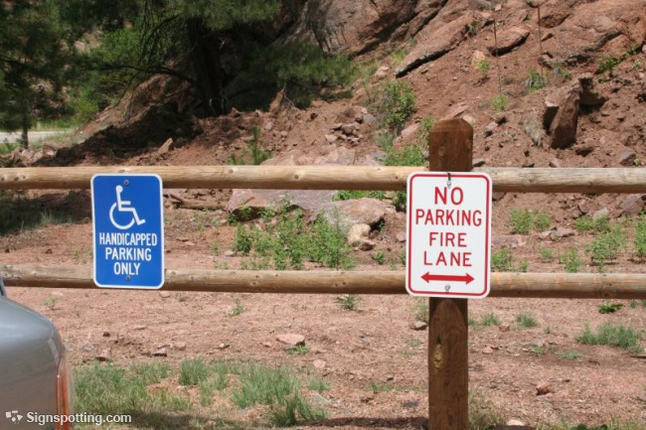
Title III of the ADA
Prohibits discrimination on the basis of disability in public accommodations, which includes transportation facilities.
Places of public accommodation and commercial facilities to be designed, constructed, and altered in compliance with accessibility standards.
Notes:
Title III covers building codes, compliance issues with relation to new construction, remodels, etc. It also applies to commercial entertainment facilities such as Theatres, Coliseums, etc.

Slide 15
Five (5) Criteria of Discrimination
  Was there a denial of benefits or services?
  Did we provide a different service or a service in a different way than we provided it to others?
  Did we segregate or separately treat individuals?
  Was there direct discrimination?
  Did the customer specifically mention that they were discriminated against?

Slide 16
Avoiding Discrimination and Harassment
USE COMMON SENSE
BE INCLUSIVE
ENSURE ACCESSIBILITY
MAKE ACCOMMODATIONS
PROTECT RIGHTS

Slide 17
Protection of Rights
DO relax and make people feel comfortable.
DO provide reasonable accommodations.
DO learn where to find and recruit people with disabilities.
City of Sacramento, CA (2011). Do and Don’ts

Slide 18
Protection of Rights
DO learn how to communicate with people who have disabilities.
DO ensure that your publications, meeting agendas, etc. are in formats that are accessible to all persons with disabilities.
City of Sacramento, CA (2011). Do and Don’ts

Slide 19
Protection of Rights
DO understand that access includes not only environmental access but also making forms accessible to people with visual or cognitive disabilities and making alarms and signals accessible to people with hearing disabilities.
DO develop procedures for maintaining and protecting confidential medical records.
DO train supervisors on making reasonable accommodations for employees and patrons.
City of Sacramento, CA (2011). Do and Don’ts

Slide 20
Protection of Rights
DON’T ask if a person has a disability.
DON’T assume that you must provide every accommodation to a person with a disability.
DON’T speculate or try to imagine how you would perform a specific job, task, or activity if you had the person’s disability.
City of Sacramento, CA (2011). Do and Don’ts

Slide 21
Protection of Rights
DON’T assume that your workplace, and facility is accessible.
DON’T make medical judgments.
DON’T assume that a person with a disability can’t do a job, task, or activity due to apparent or non-apparent disabilities.
DON’T assume that reasonable accommodations are expensive.
City of Sacramento, CA (2011). Do and Don’ts

Slide 22
Key Elements to Inclusion
Universal Precautions
  Treating all people with sensitivity, patience, and respect
Inclusiveness is a priority
Burton Blatt Institute, Syracuse University (2010). What is an Inclusive Culture?
Notes:
Universal Design/Accessibility
Construction of structures, spaces, services, communications and resources that are organically accessible to a range of people with and without disabilities, without further need for modification or accommodation.
Recruitment, Training, and Advancement Opportunities
Recruitment of people with disabilities involves two components: a) accessible outreach and hiring practices, and b) targeted recruitment of workers with disabilities.
Policies and Practices
Consideration and consultation of people with disabilities are involved in the development and implementation of policies. Willingness to make accommodations when necessary.

Slide 23
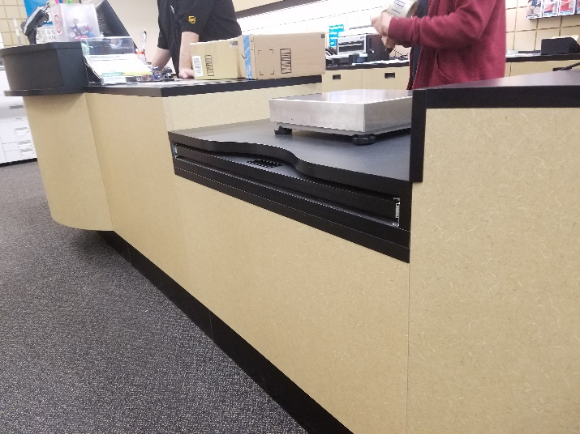
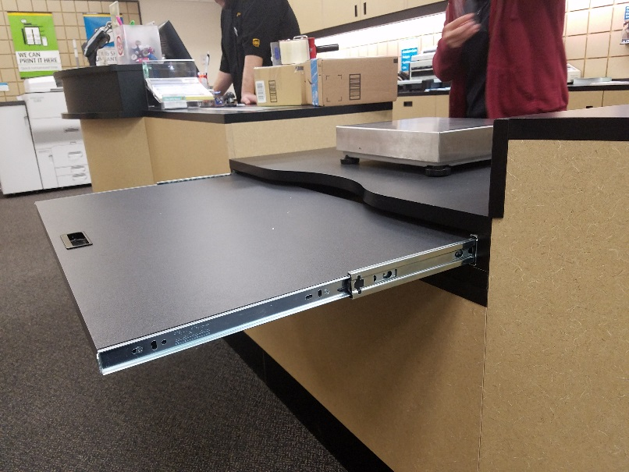
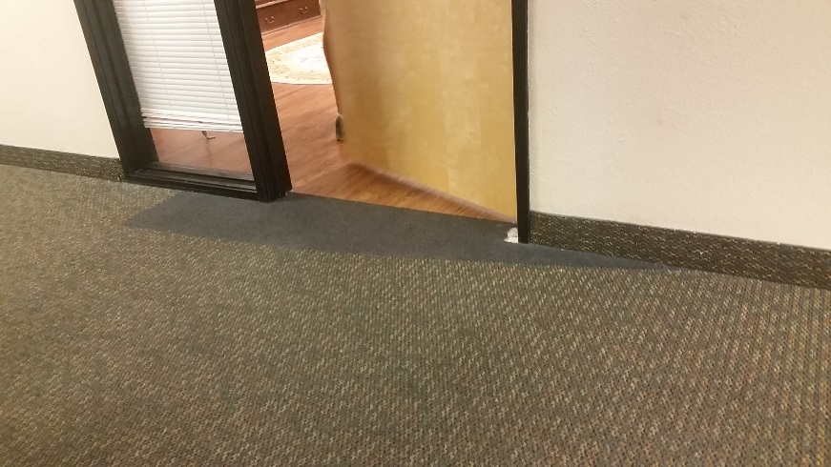
Key Elements to Inclusion
Thinking “universally” with Universal Design
  Strive to only develop those things that will meet the needs of the largest number of people
Burton Blatt Institute, Syracuse University (2010). What is an Inclusive Culture?
Notes:
Universal Design/Accessibility
Construction of structures, spaces, services, communications and resources that are organically accessible to a range of people with and without disabilities, without further need for modification or accommodation.
Recruitment, Training, and Advancement Opportunities
Recruitment of people with disabilities involves two components: a) accessible outreach and hiring practices, and b) targeted recruitment of workers with disabilities.
Policies and Practices
Consideration and consultation of people with disabilities are involved in the development and implementation of policies. Willingness to make accommodations when necessary.

Slide 24
Disability Facts
People with disabilities are America’s largest minority group, making up 20% of the population.
That’s about 56.7 million people
It is the only minority group that you can become part of at ANY time.
2010 U.S. Census data.
Notes:
Numbers based on U.S. Census data
In AZ that’s 806,294 adults with a disability and 95,958 kids

Slide 25
Disability Facts
Arthritis
46 million
67 million 2030
Bipolar
5.7 million U.S.
ADHD
4.5 million/U.S.
"Those"
People
Back Condition
75%
Brain Injury
Every 21
Seconds
1.7 million annually
Hearing Loss
28 million
Cerebral Palsy
800,000
Diabetes
23.6 million
5.7 million unaware
1.6 million new per yr.
Epilepsy
3 million
200,000 new per yr.
42 million worldwide
Wheelchair Users
1.7 million
Psychiatric
26.2% (1 in 4)
57.7 million
Vision Loss
10 million
40 million worldwide
Notes:
25
Disability Survey- Approximately 8 minutes total
CLICK one at a time and read these off as they appear on the screen.
-mental disorders are the leading cause of disability in the U.S. and Canada for ages 15-44
-diabetes contributed to a total of 233,619 deaths in 2005,
-low back pain, the most common cause of job-related disability and a leading contributor to missed work.
-Back pain is the second most common neurological ailment in the United States —
-More people have a hearing loss than any other disability. Hearing loss ranks with arthritis, high
blood pressure, and heart disease as one of the four most common health conditions in the United
States.
-52 million people in the US have a disability 28 million of those disability is hearing loss

Slide 26
Types of Disabilities
"It was ability that mattered, not disability, which is a word I'm not crazy about using.”
- Marlee Matlin

Slide 27


Variations in Disability Types
Adult Onset
Childhood Onset

Slide 28

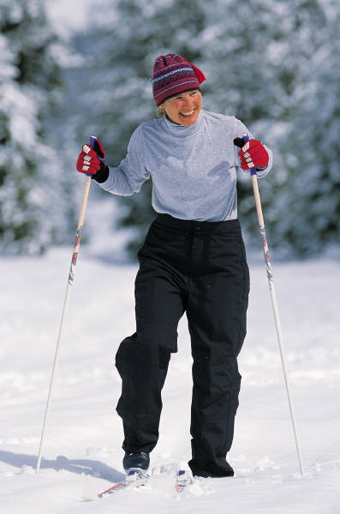
Variations in Disability Types
Visible
Invisible

Slide 29
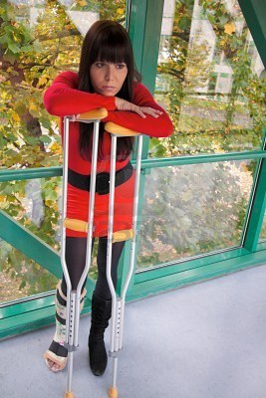
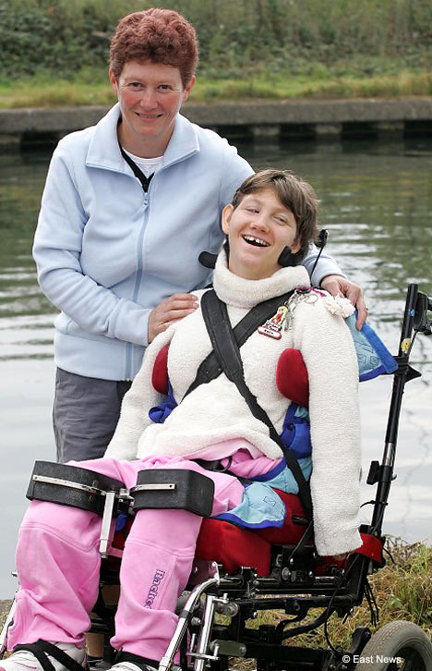
Variations in Disability Types
Temporary
Chronic

Slide 30
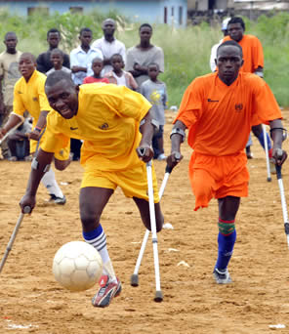
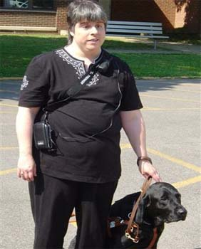
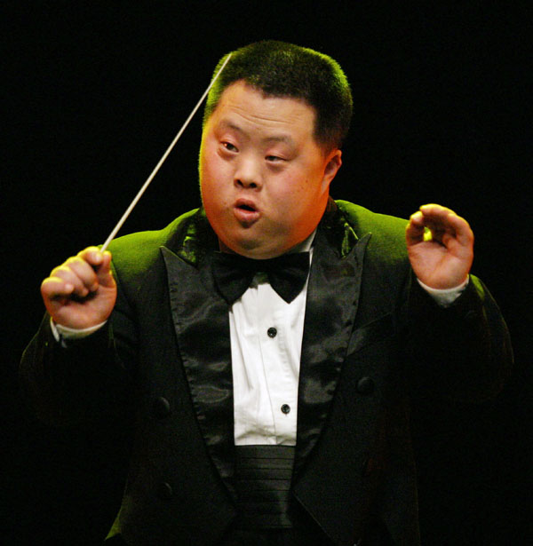

Variations in Disability Types
Nominally impairing
Significantly impairing

Slide 31
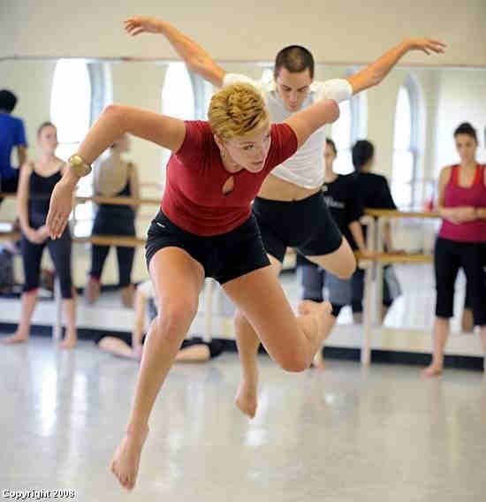
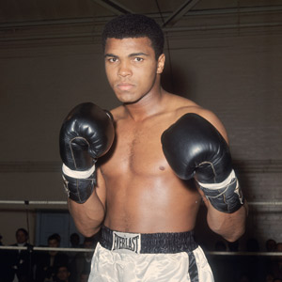
Variations in Disability Types
Stable
Progressive
Modern Disability. (2011). Disability etiquette… So everyone can relax and get the job done

Slide 32
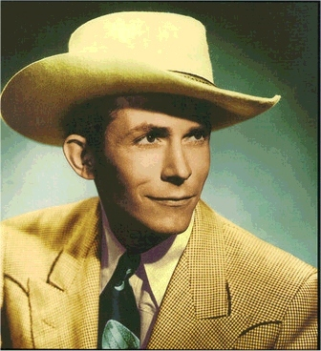
Hank Williams Sr.
Country music singer
Spina
Bifida

Slide 33

Josh Blue
2006 winner of Last Comic Standing
Cerebral
Palsy

Slide 34

Danny Glover
Actor - Lethal Weapon, Predator
Epilepsy
Notes:
School staff labeled him as “retarded”

Slide 35
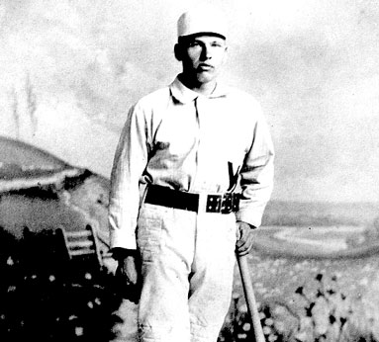
William Elsworth - “Dummy Hoy”
Center Fielder for Reds, Goodyear Executive
Deafness
Notes:
He is noted for being the most accomplished deaf player in major league history, and is credited by some sources with causing the establishment of signals for safe and out calls. Hoy became deaf after suffering from meningitis at age three, and went on to graduate from the Ohio State School for the Deaf in Columbus as class valedictorian. Hoy became the third deaf player in the major leagues, after pitcher Ed Dundon and catcher Tom Lynch. Hoy also worked as an executive with Goodyear after supervising hundreds of deaf workers during World War I. In 1951 he was the first deaf athlete elected to membership in the American Athletic Association of the Deaf Hall of Fame.

Slide 36

Sir, Richard Branson
Founder of Virgin Enterprises
Dyslexia

Slide 37
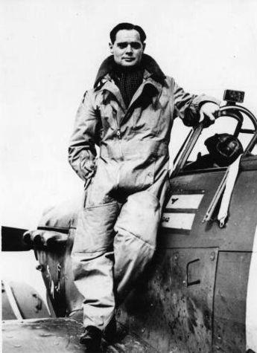
Douglas Bader
WWII war hero - Fighter pilot with the Royal Airforce
Legs
Amputated

Slide 38
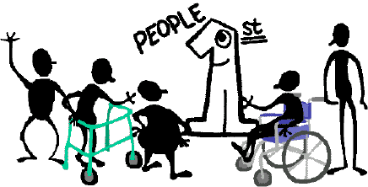
Language
Notes:
People who have disabilities are present in every aspect of society. They are:
moms and dads
sons and daughters
employees and employers
scientists (Stephen Hawking)
friends and neighbors
movie stars (Marlee Matlin)
students and teachers
Most importantly, they are people first.

Slide 39
Language
“Change your language and you change your thoughts.”
-Karl Albrecht

Slide 40

People First Language
Notes:
Language is power. Our words have the power to inspire, motivate, and uplift people. They also have the power to hurt, isolate and oppress individuals or entire segments of society. Often times, throughout our history, it has become necessary to change our language and the way in which we refer to individuals and groups to avoid further oppressing those members of society. The time has come to reshape our language once again so that we may refer to people with disabilities and the disability community in a respectful and inclusive manner.

Slide 41

Examples of Unacceptable Disability Language
crazy
crippled
retarded
deformed
afflicted
invalid
Wheelchair bound
defective
midget
abnormal
lunatic
victim
sufferer
afflicted
gimp
handicapped
Notes:
Many labels used for disabilities in our society have negative connotations or are misleading. Using labels contributes to negative stereotypes and devalues the person they attempt to describe. Avoid them when speaking to, or about, persons with disabilities.
The following terms should be avoided when speaking to or about people with disabilities:
invalid
wheelchair-bound
mongoloid
deaf and dumb
defective
mute
crippled
special person
suffers from
handicapped
stricken with
a patient
retarded
afflicted with

Slide 42
Words, Thoughts, Beliefs, Feelings, Behavior…Matter
Our words affect our thoughts
Our thoughts affect our beliefs
Our beliefs affect our feelings
Our feelings affect our behavior
and Our behavior affects our world.
- Shirley Devol VanLieu

Slide 43

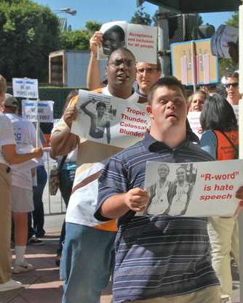
The Misconceptions
People with disabilities are often viewed as:
Victims or objects of pity
Horrible or grotesque
Burdens
Evil, some threat to comfort and safety of others
Unable to do things
Having multiple disabilities
Childlike
“Special”
Notes:
MOST misconceptions are based on insufficient or inaccurate information about people with disabilities and can perpetuate inappropriate interactions. That’s why we’re here today; to learn, to open our minds, to gain awareness.

Slide 44
Words matter…
Handicapped or Disabled?
Wheelchair Bound or Wheelchair User?
Midget or Dwarf or...?
Deaf or Hearing Impaired?
Blind or Visually Impaired?
Crazy, Nuts, or Mental Illness?
Notes:
Refer to Wikipedia article.
Note also: Handicap/disabled/accessible parking

Slide 45
Guarding Your Words
Put the person first
  Disability does not define the person.
  Use “person with a disability” instead of “disabled person.”
Avoid outdated terms
  Examples: “handicapped”, “crippled”, “invalid”, “afflicted with…”, and “suffers from…”
Notes:
The term “handicap” originated in Britain when people with disabilities were not allowed to work. They were forced to stand on the street with their “cap in hand” to beg for money.

Slide 46
Guarding Your Words
Avoid negative, disempowering terms.
  Examples: “victim”, “sufferer”
Avoid “Normal” or “Healthy”
  Denotes abnormality or illness
People with disabilities do not always agree on what is politically correct language.

Slide 47
Beyond Language in
Disability Etiquette
Refer to the individual first, then to his or her disability when it is relevant and appropriate.
Say "person with a disability" rather than "disabled person" or use the following formula:
Name or Title of Person + Verb + Assistive Device or Disability
Professor Jones + has + Rheumatoid Arthritis.
Mrs. Cassidy + utilizes + crutches.
Notes:
47

Slide 48
How to Replace the
UNacceptable Language
Do not refer to a person’s disability unless it is relevant to the conversation.
Use the word "disability" rather than "handicap" to refer to a person’s disability. Never use "cripple/crippled" in any reference to a disability.
Avoid referring to people with disabilities as "the disabled, the blind, the epileptics, the retarded." Descriptive terms should be used as adjectives, not as nouns.
Avoid negative or sensational descriptions of a person’s disability. Don’t say "suffers from, a victim of, or afflicted with." These portrayals elicit unwanted sympathy, or worse, pity toward individuals with disabilities. Respect and acceptance is what people with disabilities prefer.
Don’t use "normal" or "able-bodied" to describe people who do not have disabilities. It is better to say "people without disabilities," if necessary to make comparisons.

Slide 49
Beyond Language in
Disability Etiquette
Three Primary Principles:
Who People with Disabilities REALLY are…
They are NOT their disabilities.
They treasure their independence.
They are the experts.
Modern Disability. (2011). Disability etiquette… So everyone can relax and get the job done
Notes:
49

Slide 50
Basic Etiquette
Speak directly to the person.
It is appropriate to offer to shake hands.
OFFER assistance; don’t just give it. If accepted, listen or ask for instructions.
Treat adults as adults.
Relax, and stay calm.
Don’t apologize if you happen to use accepted, common expressions that seem to relate to a person’s disability.

Slide 51
Basic Etiquette
Don’t be afraid to ask questions when you are unsure what to do.
Service dogs are working tools. Do not pet, feed, or distract them while they are working. Ask their person before making any contact with the dog.
Don’t make assumptions.
Know where accessible restrooms, drinking fountains, and telephones are located within your work area.

Slide 52

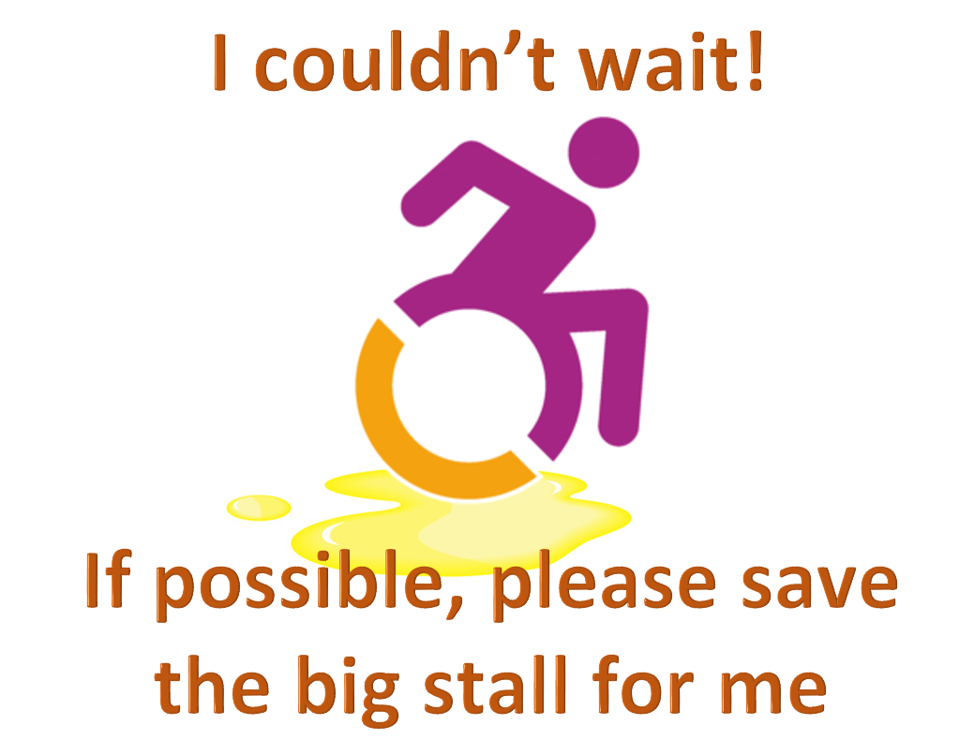
Etiquette 101:
Physical Disabilities
A wheelchair is part of a person’s body space - don’t lean on it.
Pushing the chair is a skill.
Sit at eye level for notable chats.
Offer help, but make sure it is provided in an unassuming manner.
Follow through on whatever needs to be done.
Keep paths clear in buildings and outside.
Don’t use the
accessible (wide)
bathroom stalls if
you don’t need to.
Notes:
A wheelchair is part of a person’s body space- don’t lean on it.
Pushing the chair is a skill- don’t assume you know what you are doing.
Sit at eye level of notable chats- don’t lean over them, sit down
Offer help, but make sure it is provided in an unassuming manner.
Follow through on whatever needs to be done. Do not make a premature exit when assisting someone.
Keep paths clear in buildings and outside
Don’t use wide bathroom stalls if you don’t need them
If you are driving, go easy on the brake.

Slide 53
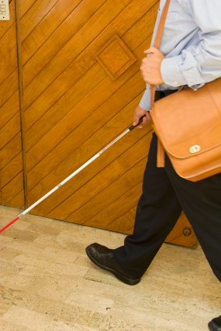
Etiquette 101:
Blindness or Low Vision
Always identify yourself and others with you.
Never touch or grab a cane - or the person. In order to gain their attention, you may touch the person lightly on the arm as you speak.
Don’t assume your help is wanted or needed, rather ask if they would like your help.
Offer your arm, elbow, or shoulder if assistance is needed. Give them information - “I’m offering you my arm.”
When moving, describe what is on their path ahead.
Let them know when you are leaving the room.
Face them when you speak.

Slide 54
Etiquette 101:
Blindness or Low Vision
Immediately greet them when they enter a room.
When greeting, feel free to shake his or her hand after saying, “How do you do? Let me shake your hand.”
Address them by name in a conversation so they know you are talking to them.
Speak in a normal tone and speed of voice.
Answer all questions verbally instead of with gestures or body language.
Direct your conversation to the person rather than someone who might be with them as a helper.

Slide 55
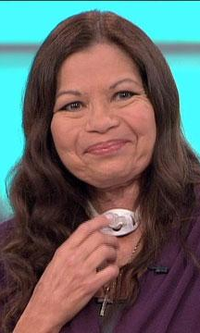
Etiquette 101:
Speech Impairment
Allow them to speak- feeling rushed impairs speech more.
Seek a quiet setting in which to talk.
Don’t complete their sentences.
Make eye contact.
Use the same tone of voice and volume that you would normally use unless the person asks differently.
Listen to the person’s words, not the manner in which they are said.
If you don’t understand, ask them to repeat.
Don’t pretend to understand if you are having difficulty doing so.
Notes:
People who have speech disabilities may use a variety of ways to communicate. The may use sign language, write, speak, use a communication device, or a combination of methods. Find out the person’s preferred method and use it.

Slide 56
Etiquette 101:
Speech Impairment
If you’re not sure you understood, repeat back what you heard.
If needed, ask them to write or use a computer.
Respect that a person with a speech impairment may prefer one-on-one conversation to group discussions.
If you are uncertain, ask the person how to best communicate instead of guessing.
If necessary, ask short questions that require short answers, a nod or shake of the head.

Slide 57

Etiquette 101:
Hearing Loss
Speak normally- hearing aids are tuned for it.
Keep your face and mouth visible for lip reading.
Don’t exaggerate speech or emotion.
Touch their arm or gesture to get attention.
When a translator is present, address the person with hearing loss.
Avoid sudden changes of topic in conversation.

Slide 58

Etiquette 101:
Cognitive Disability
Make no assumptions.
Might need extra time to process information.
Use clear language.
Don’t take lack of response personally - they might be overwhelmed.
Don’t take sudden emotions personally.
Direct eye contact can be intimidating.
Allow for different styles of processing information.

Slide 59
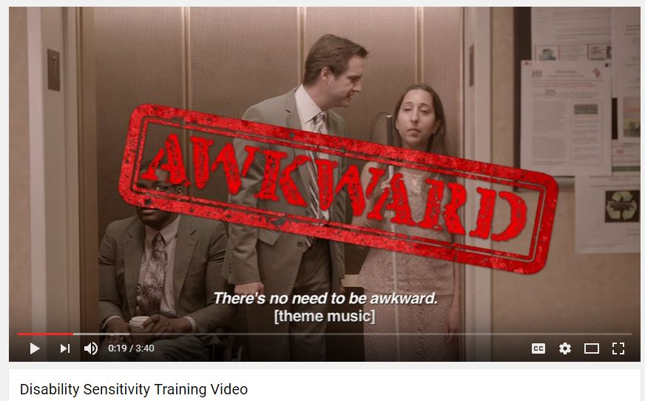
Disability Awareness
Watch the Video!

Slide 60
Reasonable Modification – What is it?
A reasonable modification is a change in Valley Metro’s service policies and practices in circumstances where established practices may prevent individuals with disabilities from accessing and participating fully in Valley Metro’s programs, services and facilities.

Slide 61
For Example…
  Other Mobility Devices
  Due to construction or obstacles, boarding customer in mobility aid in a different accessible location
  Eating and drinking for people with diabetes
  Handling fare for customer with disabilities that limit their ability to handle fare
  Taking injectable medicine on the bus/light rail

Slide 62
Reasonable Modification
We must consider all requests
If there are issues, we must interact with the person making the request
Violations of ADA
  Automatic refusal to accommodate
  Not dealing with requests in good faith
  Lack of interaction about request

Slide 63
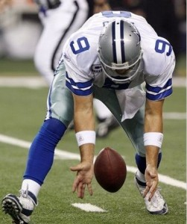
Reasonable Modification, Cont.
The ADA requires we engage with the person requesting an accommodation
  Reasonable modifications to be inclusive
  Case-by-case situations
  No “one-size-fits-all”
Put biases aside
If we drop the ball, we lose

Slide 64
What am I obligated to do or provide?
Individuals may request reasonable modifications online, by email, in
writing or by phone. To facilitate this
process, Valley Metro has made
this policy and the Reasonable
Modifications Request Form available
online and in hard-copy upon request at www.valleymetro.org/accessibility/reasonable_modifications. Customers may also call Valley Metro Customer Service to make this request.

Slide 65
What am I obligated to do or provide?
Valley Metro, (in consultation with those providers involved in a requested modification) will have five (5) business days to review and decide on each request. Valley Metro will have an additional (5) business days to provide a final response to the customer.

Slide 66
Undue Hardship
“If we say no…”
Reasonable
  Cost
  Resources
Safety
Fundamentally alter the program, service, or activity

Slide 67
Can we do more?
Yes, but…
Consider:
Are we setting a precedent?
Are we able to remain consistent in providing the same accommodation to everyone?

Slide 68
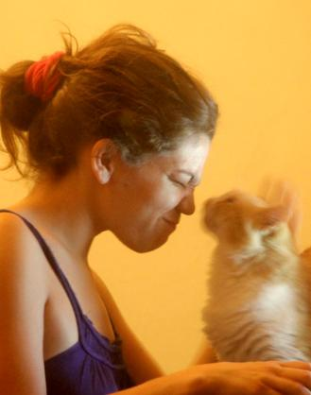
Service Animals
  According to FTA ADA guidance, a service animal is defined as:
    Any guide dog, signal dog, or other animal individually trained to work or perform tasks for an individual with a disability, including, but not limited to, guiding individuals with impaired vision, alerting individuals with impaired hearing to intruders or sounds, providing minimal protection or rescue work, pulling a wheelchair or fetching dropped items.
Notes:
Photo: young woman with cat
68

Slide 69
Service Animals, Continued
  The Department of Justice narrowed the definition of service animals to dogs and miniature horses, but this does not affect the Department of Transportation’s definition recognizing the possibility that other animals can be service animals.
Notes:
Photo: young woman with cat
69

Slide 70
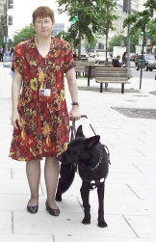
How do you determine if it’s a Service Animal?
Only two permissible inquiries:
  Is this a service animal required because of disability?
  What work or tasks is the animal trained to perform?
Notes:
70

Slide 71
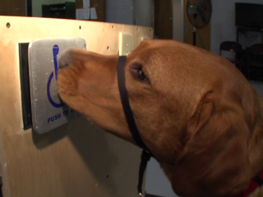
How do you determine if it’s a Service Animal?
What does “do work or perform tasks” mean?
The dog must be trained to take a specific action when needed to assist the person with a disability.
Notes:
71

Slide 72
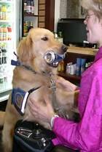
Examples of types of tasks…
  Tasks can be for people with physical, sensory, psychiatric, intellectual, or mental disabilities.
  Assist during seizure.
  Retrieve medicine or other items.
  Help individual with dissociative identity disorder to remain grounded.
  Prevent/interrupt impulsive or destructive behavior.
  Assist with balance, stability.
  Provide non-violent protection or rescue work.
Notes:
Photo: woman in wheelchair, dog with identifying vest and canned drink between teeth, bringing drink to woman. Drink cooler in background
72

Slide 73
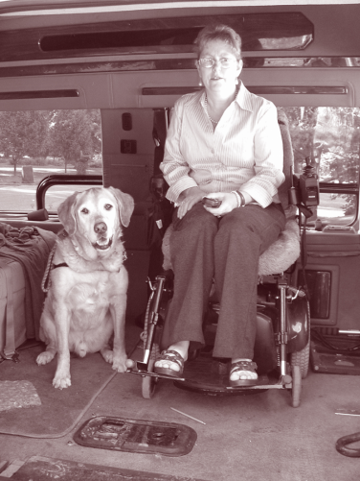
General rules regarding service animals
Can’t ask about disability.
Can’t request documentation (no formal training or certification required).
Can’t ask for additional payment (no surcharges).
Service Animals are not required to wear a vest, ID tag or harness.

Slide 74
What about emotional support or protection animals?
Dogs whose sole function is “the provision of emotional support, well-being, comfort, or companionship” are not considered service dogs under the ADA.
The use of service dogs for psychiatric and neurological disabilities IS protected under the ADA.
“The crime deterrent effects of an animal's presence” do not qualify that animal as a service animal and “an animal individually trained to provide aggressive protection, such as an attack dog, is not appropriately considered a service animal.”
Notes:
74

Slide 75
Emotional v. Service
Unless the animal is individually trained to do something that qualifies as work or a task, the animal is a pet or support animal and does not qualify for coverage as a service animal. A pet or support animal may discern that the handler is in distress, but it is what the animal is trained to do in response to this awareness that distinguishes a service animal from an observant pet or support animal.
DOJ states “that an animal that is trained to ‘ground’ a person with a psychiatric disorder does work or performs a task that would qualify it as a service animal as compared to an untrained emotional support animal whose presence affects a person’s disability. It is the fact that the animal is trained to respond to the individual’s needs that distinguishes an animal as a service animal.”

Slide 76
Emotional v. Service, Cont.
According to the DOJ, “the process must have two steps: Recognition and response. If a service animal senses that a person is about to have a psychiatric episode and it is trained to respond, for example, by nudging, barking, or removing the individual to a safe location until the episode subsides, then the animal has indeed performed a task or done work on behalf of the individual with the disability, as opposed to merely sensing an event.” Tasks performed by psychiatric service animals may include reminding the handler to take medicine, providing safety checks or room searches for persons with PTSD, interrupting self-mutilation, and removing disoriented individuals from dangerous situations.
Remember the difference between an emotional support animal and a psychiatric service animal is the work or tasks that the animal performs.

Slide 77
Service Animals –
Other Considerations
Transit agencies may refuse to transport service animals if the animal is out of control and the animal’s handler does not take effective action to control it. However, if a dog barks occasionally this does not necessarily mean it is out of its handler’s control.
The FTA does not prescribe limits to the number of service animals that can accompany a customer. Different service animals can provide different services.
Other riders’ or agency personnel’s allergies to dogs or other animals would not be grounds for denying service to a person accompanied by a service animal. The regulations explicitly state that service animals must be allowed to accompany individuals on vehicles and in facilities. Encountering a service animal in the transit or other environment is an expected part of being in public.
Notes:
77

Slide 78
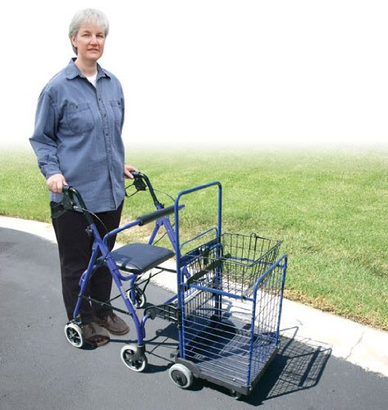
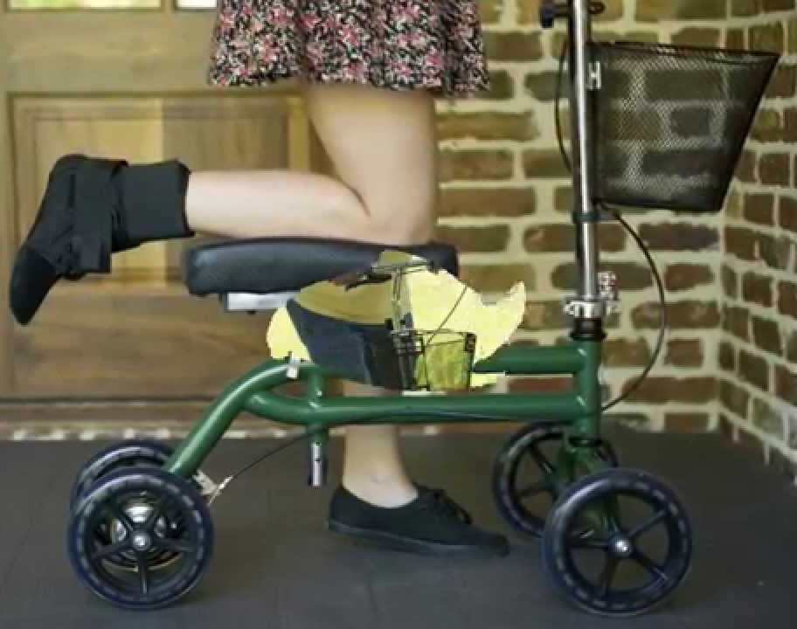
Other Mobility Devices
Persons with mobility disabilities may use devices other than wheelchairs to assist with locomotion. Canes, crutches, and walkers, for example, are often used by people whose mobility disabilities do not require use of a wheelchair. These devices must be accommodated on the same basis as wheelchairs.
Notes:
78

Slide 79
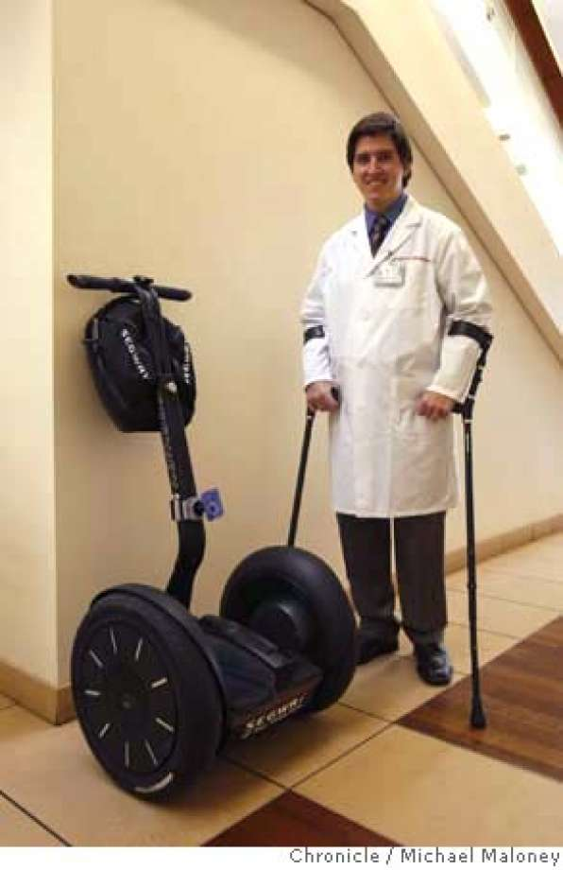
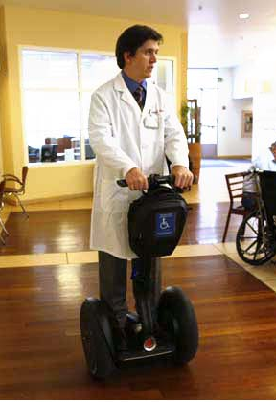
Other Mobility Devices
Other power-driven mobility devices like the Segway®, when used by a person with a disability as a mobility device, is part of the broad class of mobility. In this way, a Segway® occupies a legal position analogous to canes, walkers, etc.
Notes:
79

Slide 80

Other Mobility Devices -
What they are NOT
Valley Metro does not accommodate devices that are not primarily designed for use by individuals with mobility impairments on buses. This includes items such as shopping carts and bicycles. However, bicycles may be boarded on the light rail.
Notes:
80

Slide 81
Other Important Transit
ADA Policies
Announcing Bus and Light Rail Stops
Bus Stops
Maintenance of Lifts and Ramps
Mobility Aid Securement
Seatbelts
Operator Training
Priority Seating / Mobility Aid Securement Areas
Rescue Policy
Transferring to a Seat from a Mobility Device
Transporting Wheelchairs
Wheelchair Brakes

Slide 82

Applying the
ADA
Case
Studies
Notes:
Discussion on the various topics.

Slide 83
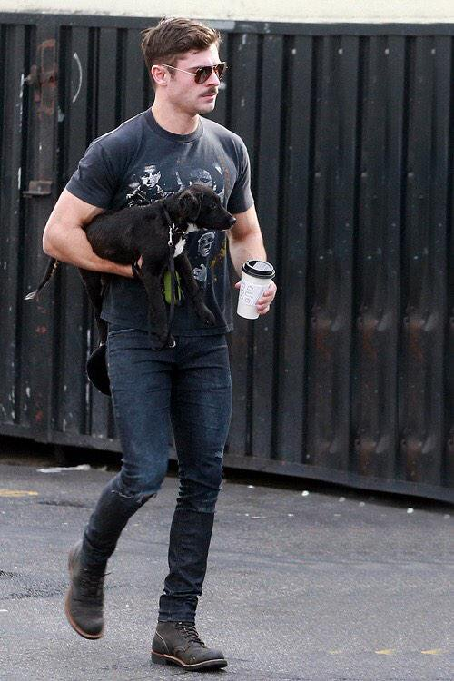
Case 1 –
Is it a Service Animal?

Slide 84
Applying the
ADA
Case
Studies
Notes:
Discussion on the various topics.

Slide 85
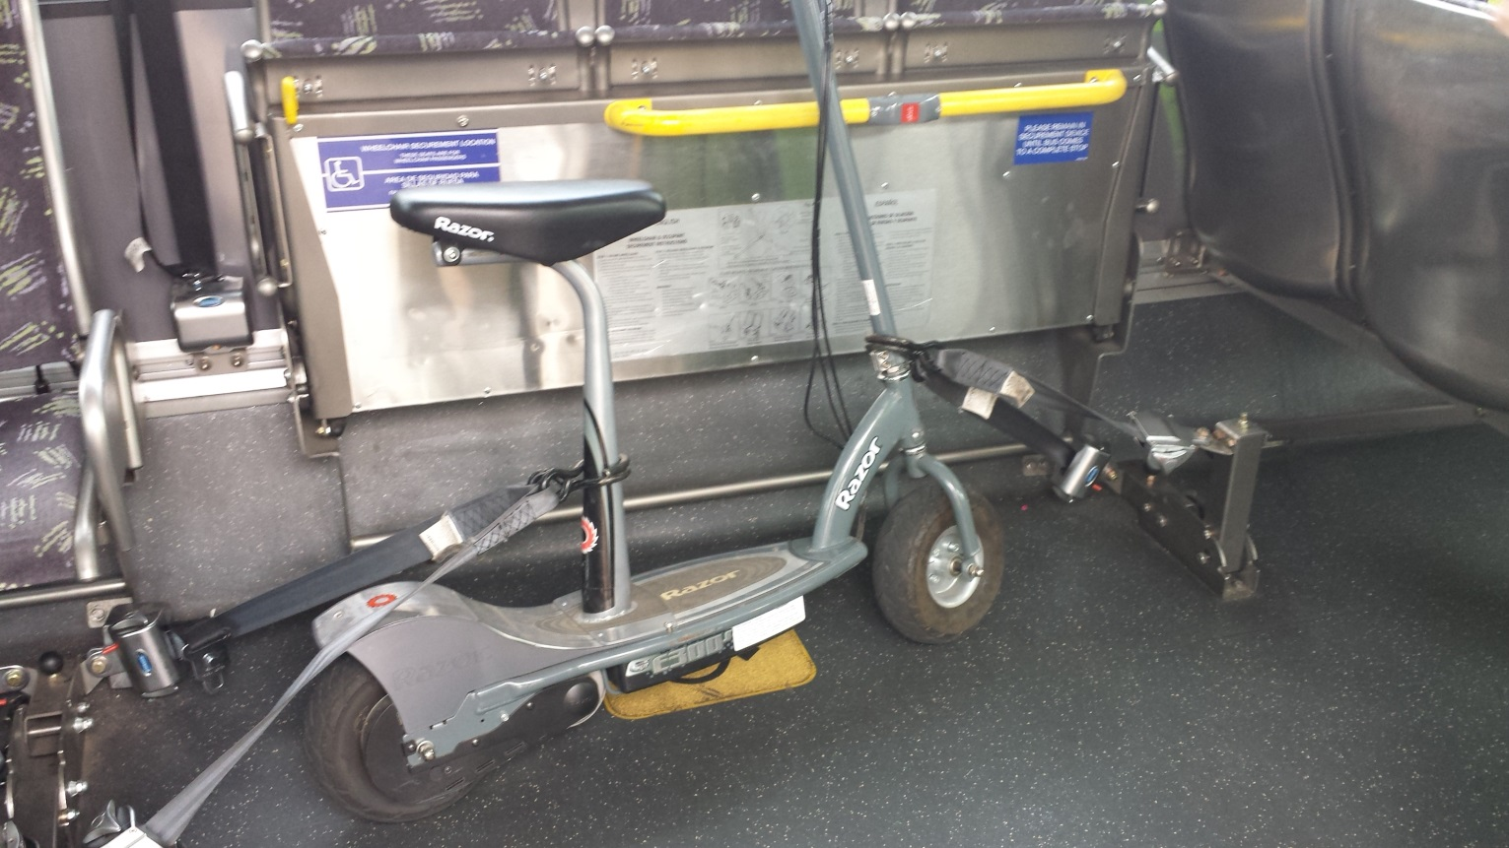
Case 2 – Is it a Mobility Device?
Notes:
Paraplegia is an impairment in motor or sensory function of the lower extremities

Slide 86
Applying the
ADA
Case
Studies
Notes:
Discussion on the various topics.

Slide 87
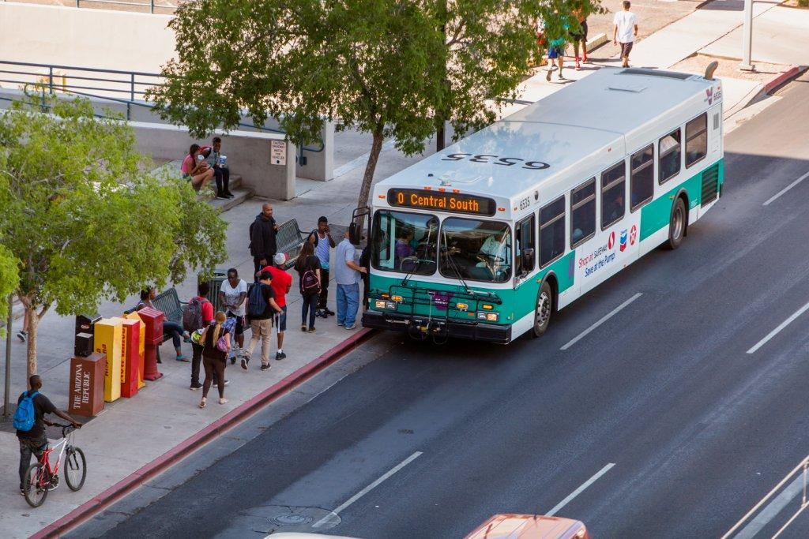
Calling All Streets!

Slide 88
Online Resources
Federal Transit Administration Guidance Circular 4710.1 American’s With Disabilities Act Guidance - OR City of Phoenix Public Transit Web page – Title VI and ADA Program
Bus and Light Rail Policies for Customers with Disabilities – Valley Metro Web site OR City of Phoenix Public Transit Web site – Title VI and ADA Program
This presentation – City of Phoenix Public Transit Web site – Title VI and ADA Program

Slide 89

Bottom Line
We are all obligated to respect and provide the best service to all customers, regardless of disability.

Slide 90
QUESTIONS?
Kristy Ruiz, ADA Coordinator
Kristy.Ruiz@phoenix.gov
602.495.0579
Peter Fischer, ADA Coordinator
Peter.Fischer@phoenix.gov
602.534.9276

