Slide 1
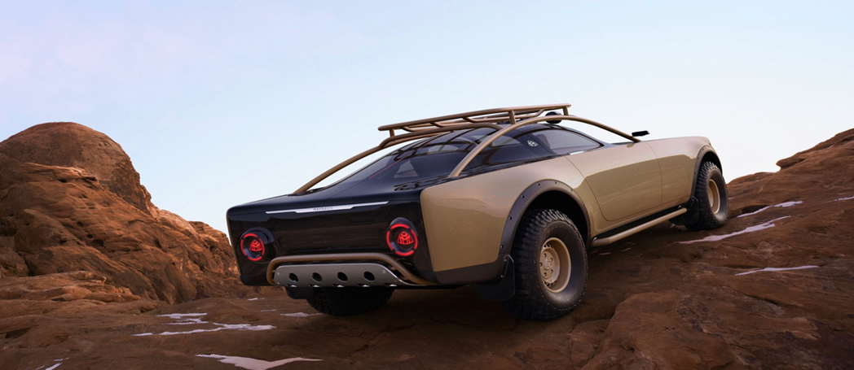
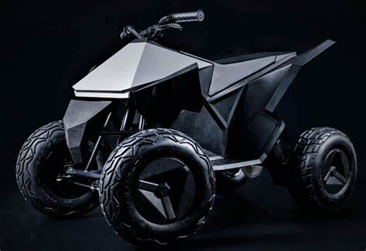
City of Phoenix Electric Vehicle Ad Hoc Committee
Public, Workplace & Home Charging Infrastructure Subcommittee Meeting
December 17, 2021
Mercedes goes MadMax lux with Project Maybach off-road EV coupe concept. Solar panels sit under long transparent hood.

Slide 2
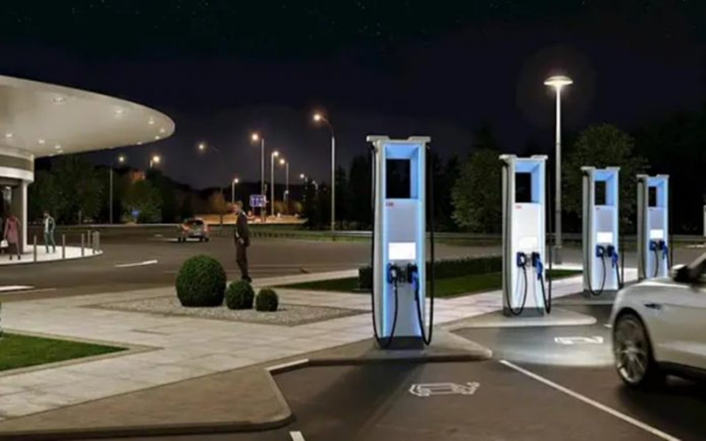
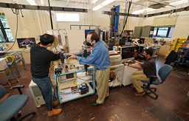
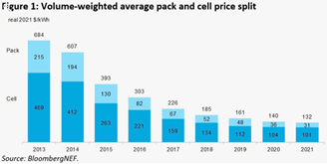
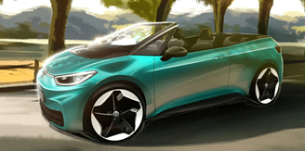
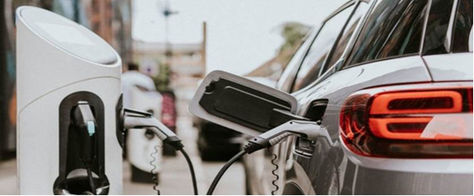
Tesla Cyberquad
(for kids)
$1,900 - Sells out within hours of release
Range: 15 miles
Top Speed: 10mph
Equipped: cushion seats, LED lights, fully adjustable suspension, and full steel frame

Slide 3
Gov’t of Spain
Issues a proposal EVSE installation order
1,000 EVSE’s installed at “gas” stations
Sales of 10M liters+ install DCFCs

Slide 4
Liquid Phase Change – Cooled Cable Development
Higher charging power levels mean higher current, which means greater amounts of heat
Cable able to remove up to 24.22 kW of heat – can deliver a current 4.6 times faster than current cable technology
Provides 2,400 amps compared to 520 amps of current chargers = faster charging speeds

Slide 5
Global average battery prices fell 6% between 2020 and 2021
Raw material prices are pushing battery prices back up – avg battery pack price in 2022 predicted to be $135/ kwh
Delay in $100/kwh milestone and push out targets
Predicted to dip below $100/kwh in 2024

Slide 6
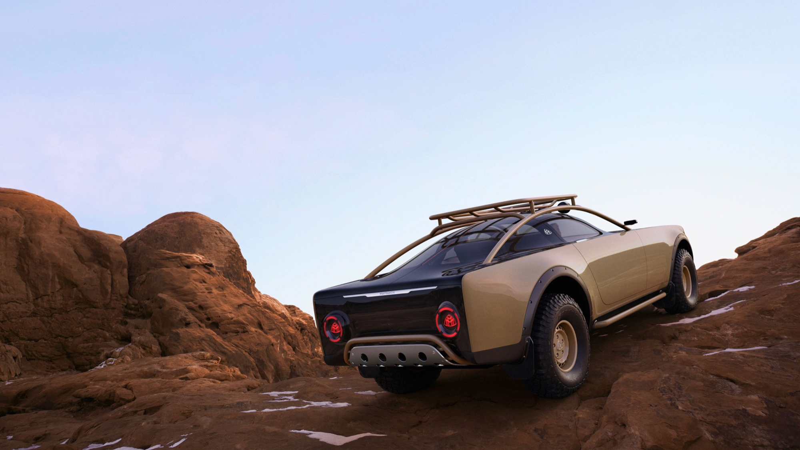
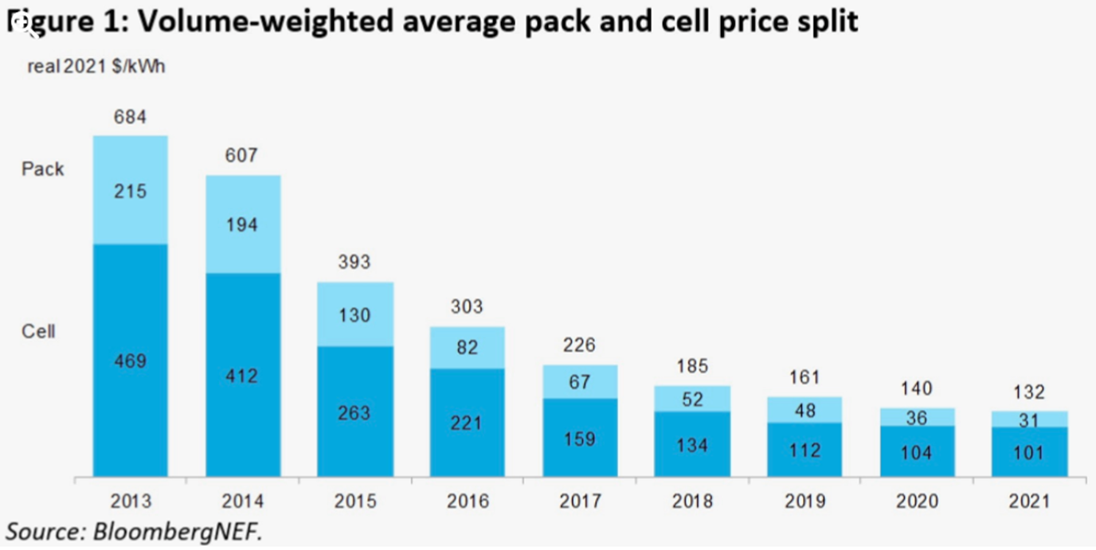
E-Convertible
VW rumored to be building
Based on the ID.3 Cabrio

Slide 7
Ad Hoc Committee Timeline
Ad Hoc Committee Calendar
 |  | Dec |  |  |  | Jan |  |  |  | Feb |  |  |  | Mar |  |  |  | Apr |  |  |  | May |  |  |  | Jun
Action | Responsible | 1 | 2 | 3 | 4 | 1 | 2 | 3 | 4 | 1 | 2 | 3 | 4 | 1 | 2 | 3 | 4 | 1 | 2 | 3 | 4 | 1 | 2 | 3 | 4 | 1 | 2 | 3 | 4
Ad Hoc Committee Meeting | Full Committee | 3 |  |  |  | 7 |  |  |  | 4 |  |  |  | 4 |  |  |  | 1 |  |  |  | 6 |  |  |  | 6
Education, Outreach & Equity | EOE Sub Ctte |  | 10 |  |  |  | 14 |  |  |  | 11 |  |  |  | 11 |  |  |  | 8 |  |  |  | 13 |  |  |  | 13
Public, Workplace & Home Charging | PWH Sub Ctte |  |  | 17 |  |  |  | 21 |  |  |  | 18 |  |  |  | 18 |  |  |  | 15 |  |  |  | 20 |  |  |  | 17
City Fleet & Charging Infrastructure | CFC Sub Ctte |  |  | 21 |  |  |  | 18 |  |  |  | 15 |  |  |  | 15 |  |  |  | 19 |  |  |  | 17 |  |  |  | 21
Drafting of report (Stages) |  | Outline |  | Draft Intro |  |  | Draft Deliverables |  |  |  | 1st Draft Roadmap |  |  |  | Translation |  |  |  |  |  |  |  | 2nd Draft |  |  | Final
Homebuilder Roundtable |  |  |  |  |  |  |  |  | 25
Valley Partnership Roundtable |  |  | 8
Employer Roundtable |  |  |  |  |  |  |  |  |  |  |  | 16
Public Workshops |  |  |  |  |  |  |  |  |  | 2 | 9
1st Draft Public Surveys + Workshops |  |  |  |  |  |  |  |  |  |  |  |  |  |  |  |  |  |  | 6 |  | 21

Slide 8
Electric
Vehicle
Happy Holidays
Mercedes goes MadMax lux with Project Maybach off-road EV coupe concept. Solar panels sit under long transparent hood.

