Slide 1
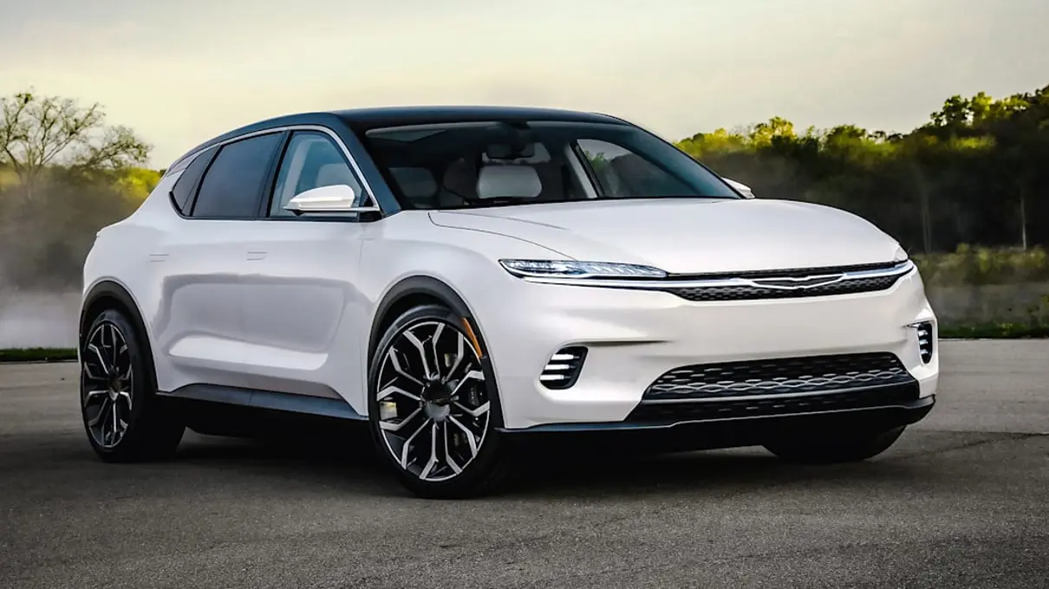
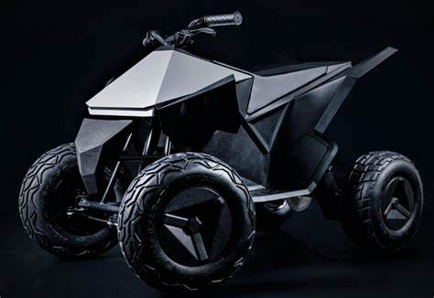
City of Phoenix Electric Vehicle Ad Hoc Committee
Education, Outreach & Equity Subcommittee Meeting
January 14, 2022
Chrysler concept crossover vehicle “Airflow” will have two 201 HP electric motors and a range of 350-400 miles and Level 3 autonomous driving – Stellantis – all electric by 2028

Slide 2
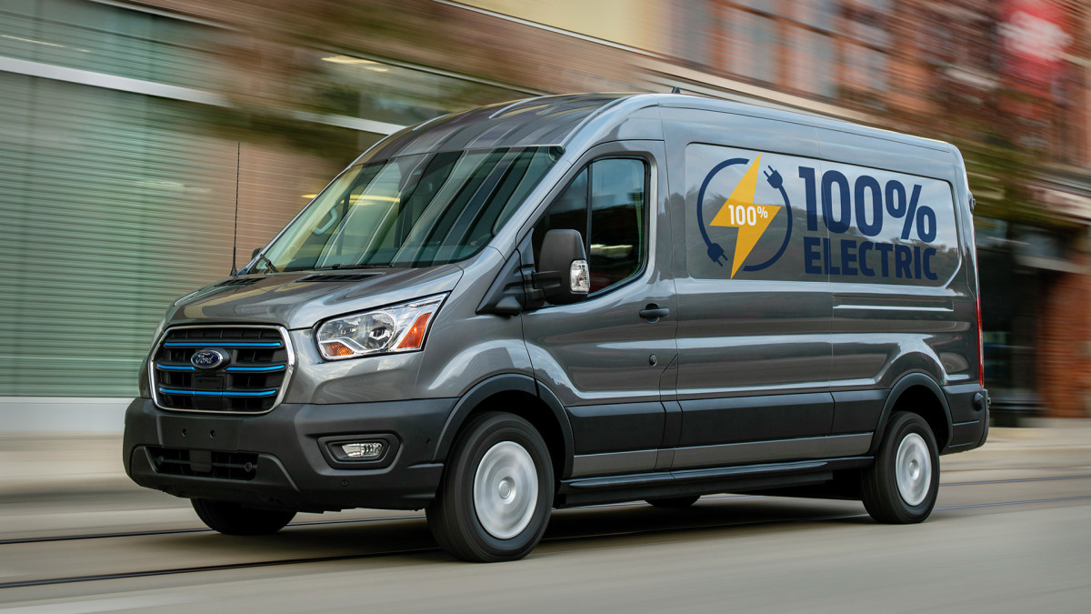
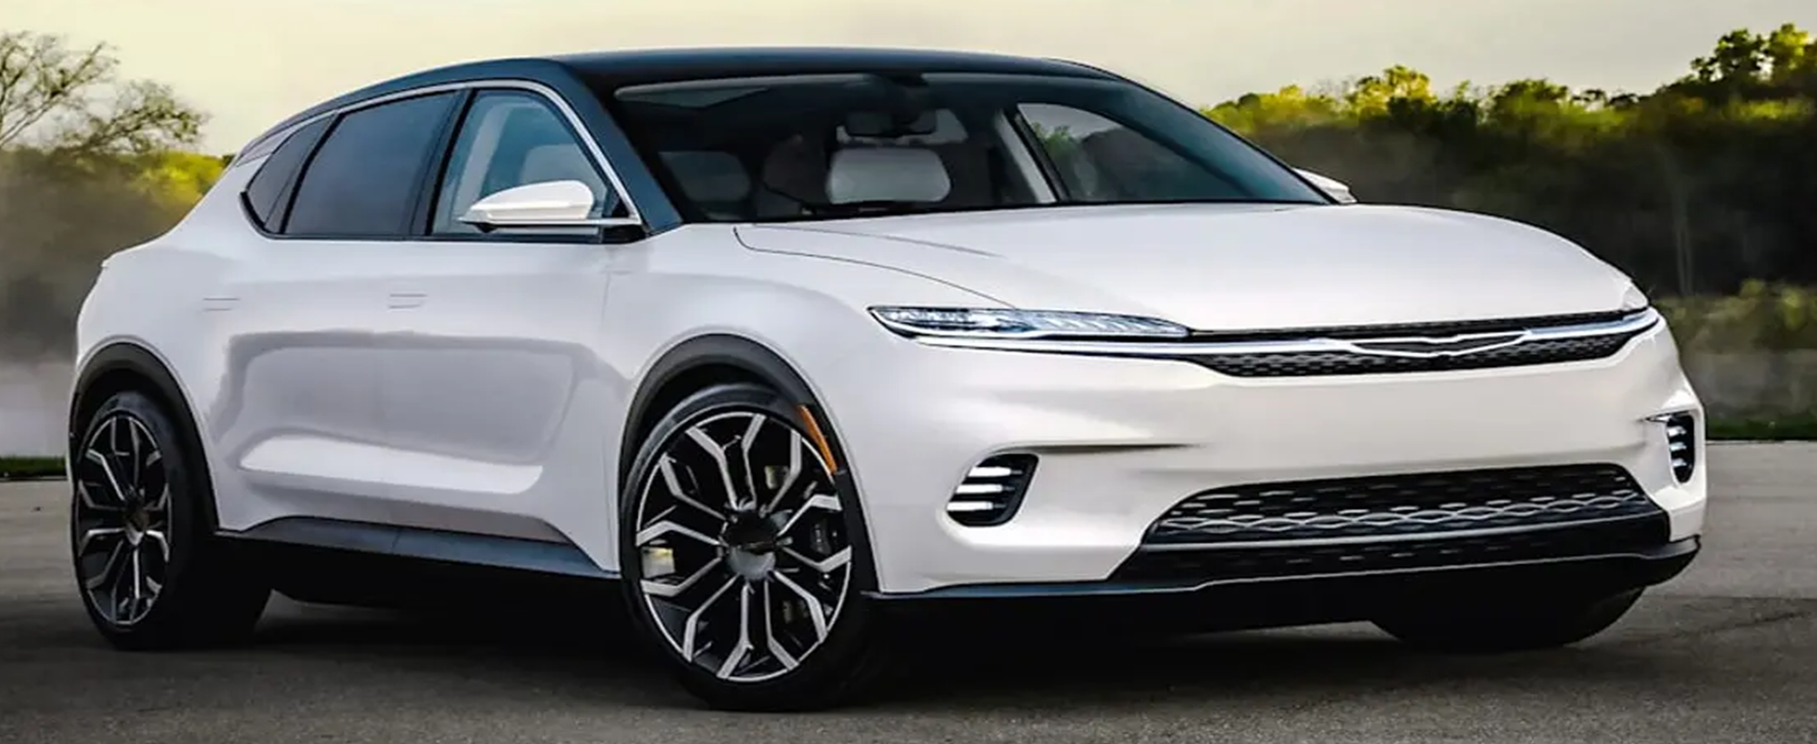
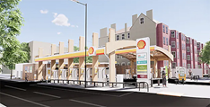
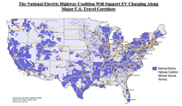
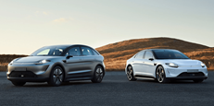
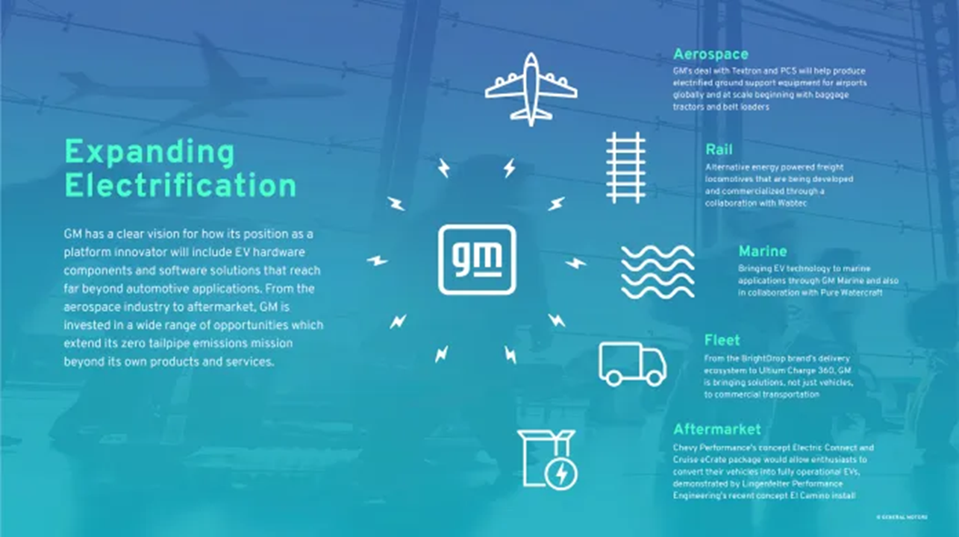
Federal Fleet Purchases to be ZEVs by 2035
December 2021 – EO directing the federal gov’t
Acquire 100% light-duty zero-emission vehicles by 2027
Acquire 100% zero-emission all classes of vehicles by 2035
Early 2022 – DHS field testing Ford Mustang Mach-E for use in law enforcement
In 2021 – DOI started transition to EV motorcycles for US Park Police

Slide 3
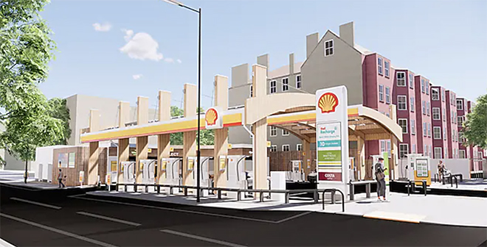
Shell Converts London Gas Station to EV Charging Hub
Opens in 2022
Features 10 175kW DCFC stations
Offers seating area for waiting EV drivers, along with coffee shop
Equipped with solar panels on the roof, chargers powered 100% certified renewable electricity

Slide 4
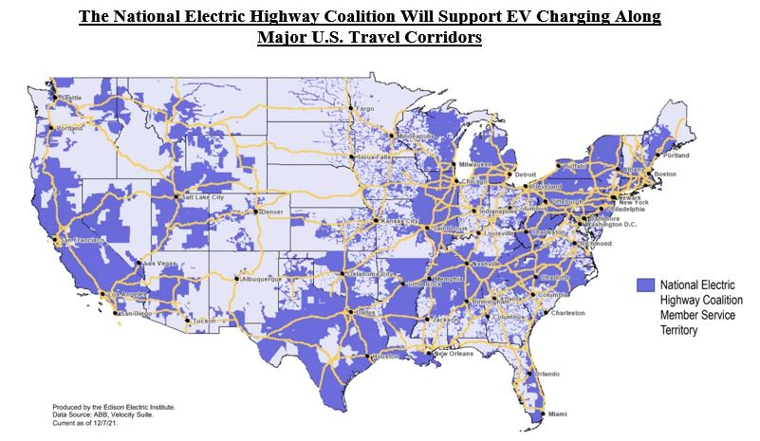
50 Utilities Form Group to Coordinate EV Infrastructure Efforts
Dec 2021 - Edison Electric Institute announced the formation of the National Electric Highway Coalition
Collaboration among electric companies committed to providing DCFC stations along major US travel corridors by the end of 2023

Slide 5
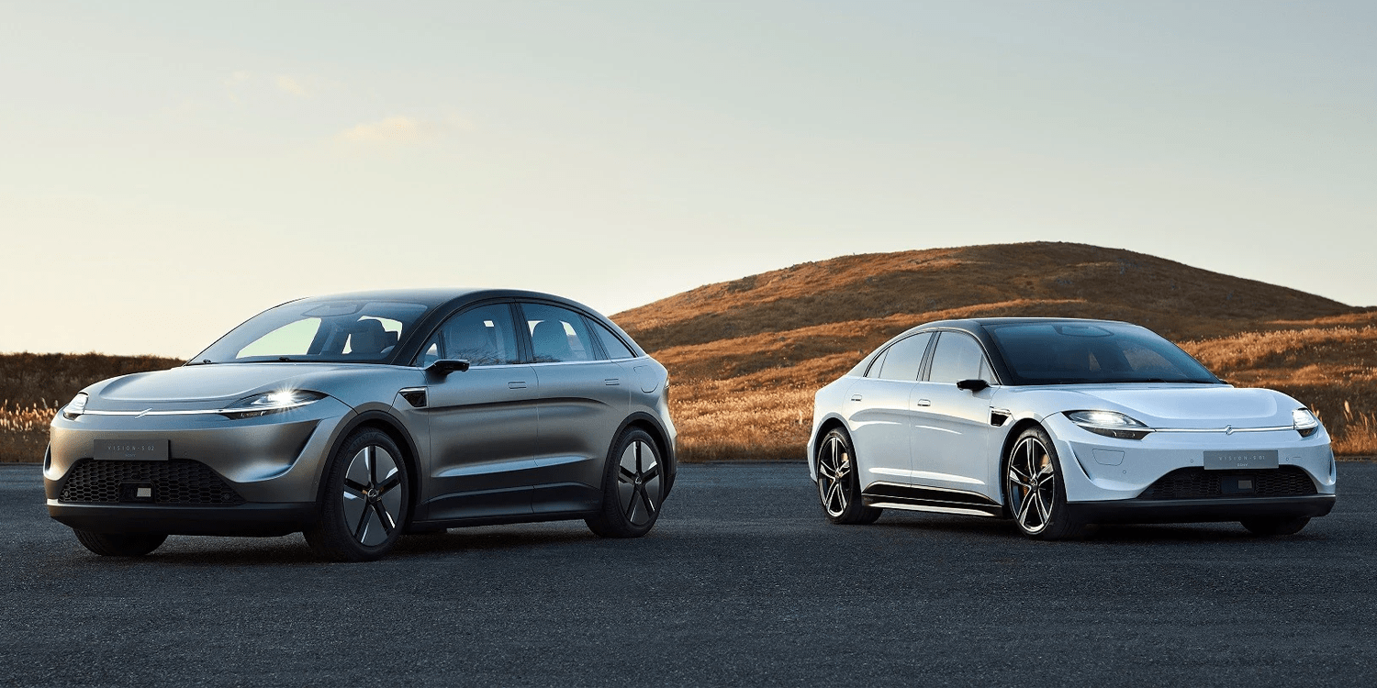
Sony Presents 2 Concept BEVs at CES
Vision-S 01 – Electric Sedan
Vision-S 02 – Electric SUV

Slide 6
