Slide 1
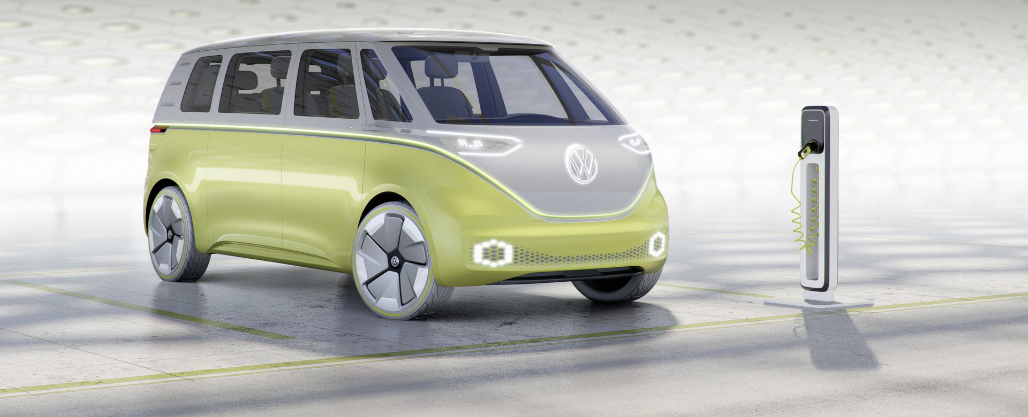
City of Phoenix Electric Vehicle Ad Hoc Committee
City Fleet & Charging Infrastructure Subcommittee
February 15, 2022
In 2023, VW ID. Buzz debuts in the US and will come in passenger, cargo and California camper versions.

Slide 2
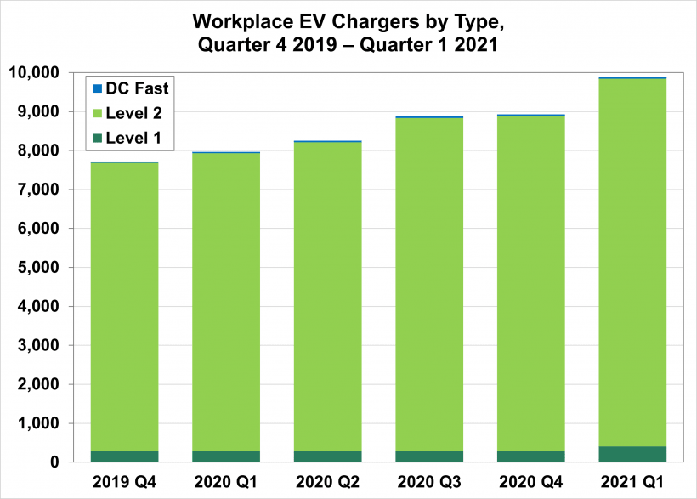
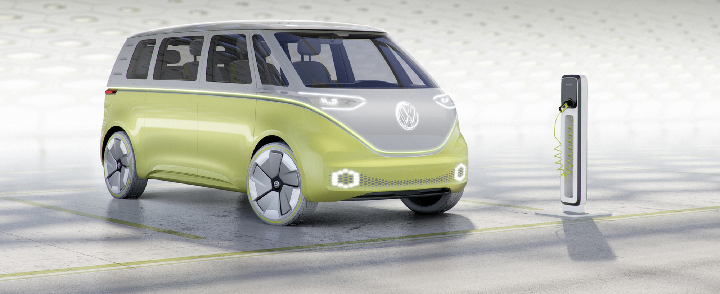
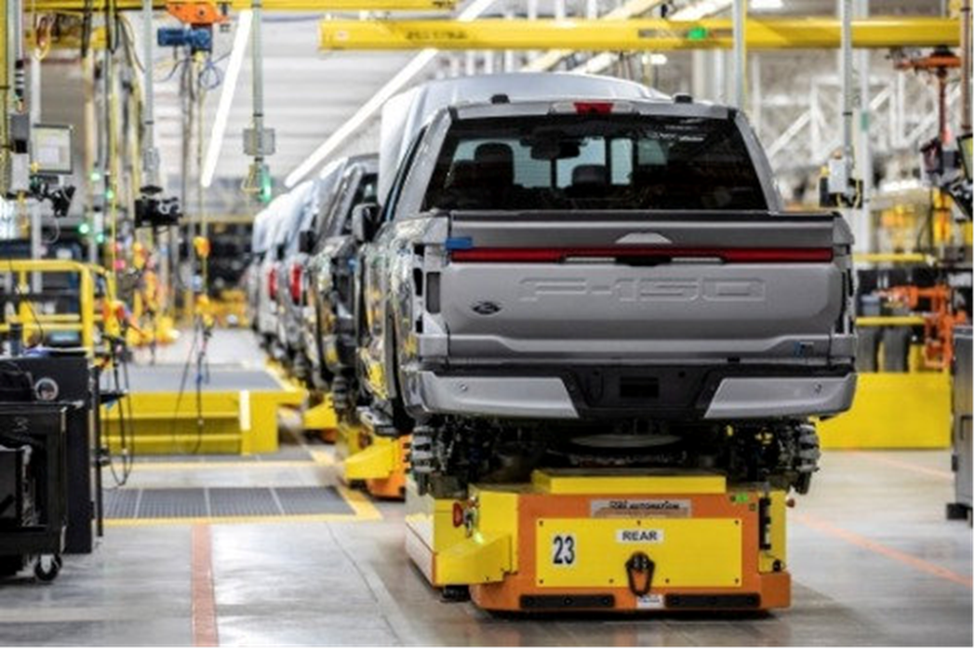
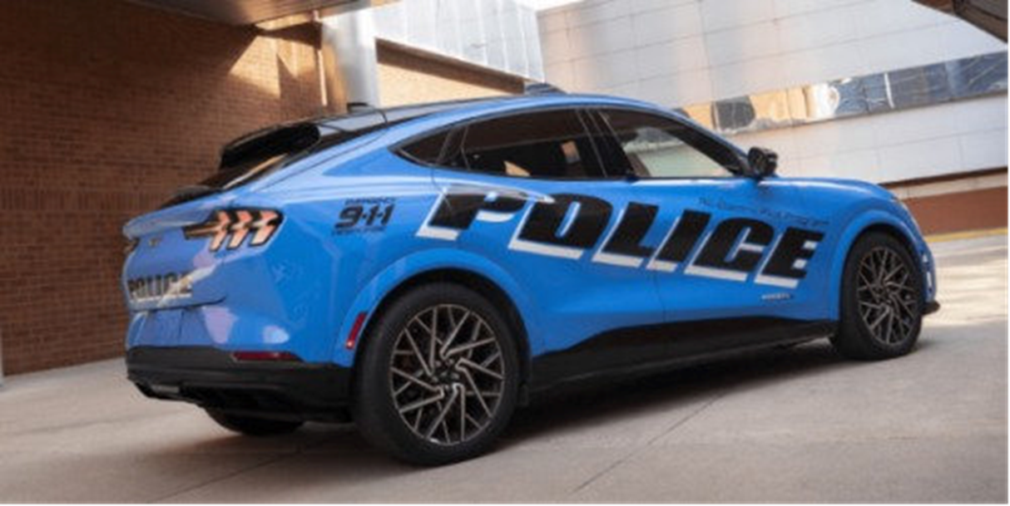
Increase in Workplace Charger Installations
NREL and DOE reports that between 4Q 2019 and 1Q 2021, 9,894 workplace chargers were installed in the US
End of March 2021
95% L2
4% L1
<1% DCFC

Slide 3
Goodyear Develops New EV Tire
ElectricDrive GT is an ultra-high performance, all season tire
Acts as a built-in sound barrier that helps reduce road noise
Initial release is one size which fits most popular EV high-performance models
Plans to extend the ElectricDrive product portfolio in 2022

Slide 4
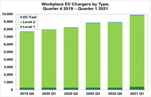
French Car Ads Legislation
Starting in March 2022, auto ads on the radio, tv, and before movies, in print, and elsewhere have to feature a message to consider cycling, carpooling, walking, or taking transit.
Feature hashtag “moving without polluting”
Penalties up to $56,622 for those who fail to post these messages

Slide 5
Ford Increases F-150 Lightening Production
Doubles production capacity to 150,000 vehicles a year by mid-2023 after receiving nearly 200,000 reservations.

Slide 6
NYC Invests in EVs
$420M to transition muni fleet to all electric by 2035
184 Ford Mustang Mach-Es for use in multiple city depts.
250 Tesla Model 3s

Slide 7
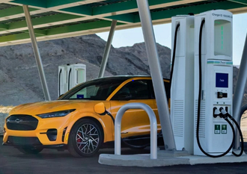
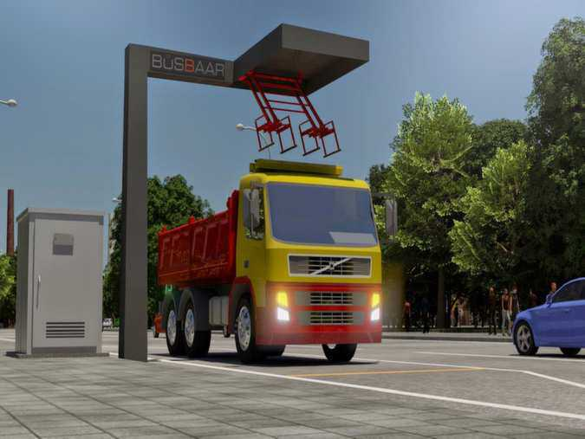
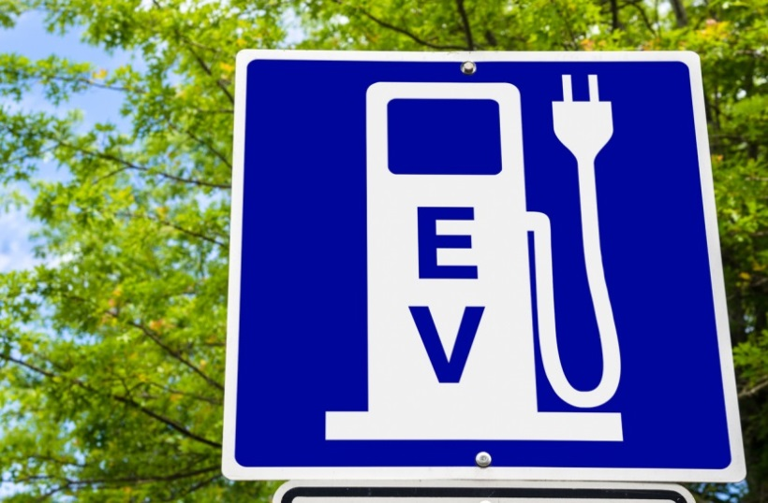
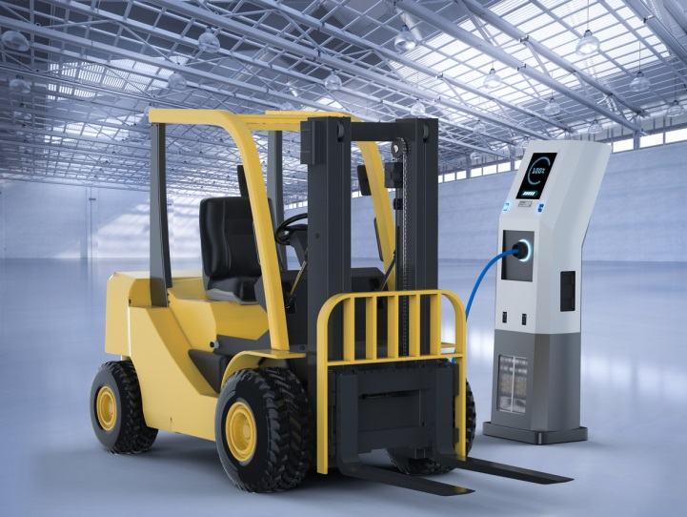
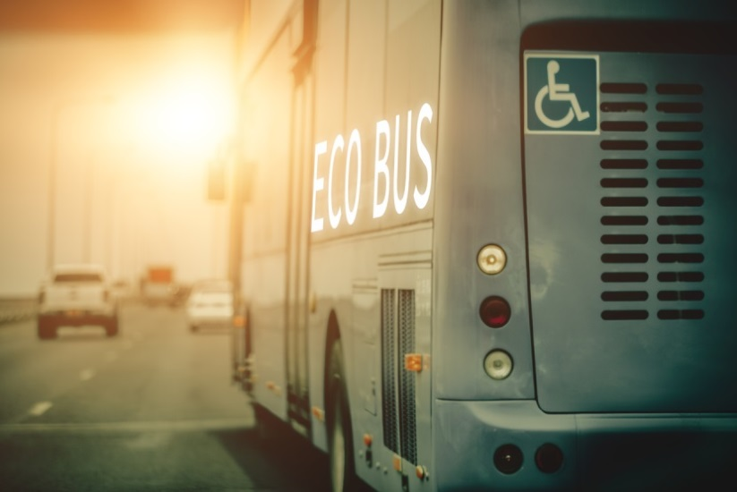
EVITP 4.0

Slide 8
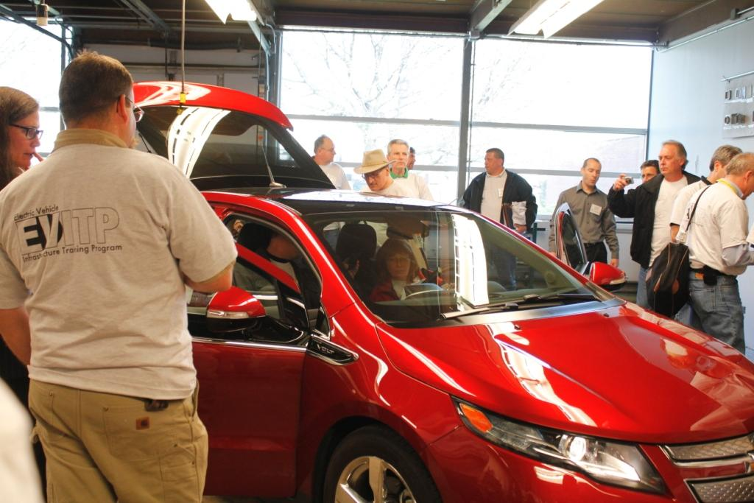
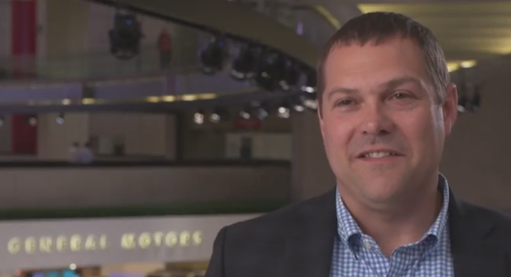
Automakers Key to Establishing EVITP
Special Thanks to GM’s
Britta Gross & Alex Keros

Slide 9
Eligibility: Qualified Electricians
Minimum Requirement for EVITP Certification:
In states or local jurisdictions where required, electricians must be licensed or certified.
In other states or local jurisdictions, electricians must have completed at least 8,000 hours of documented on-the-job training.
A key to EVITP success is that the training builds on the platform of qualified electricians’ extensive knowledge, skills, and experience.

Slide 10
Why EVITP?
EV Charging Infrastructure
Training
Education
Safety, Safety, Safety
Performance and Reliability
Risk and Liability Reduction & Safety. Reduces Risk First and Foremost for People and Property, also Governments, Financial Institutions, Insurers, and the EV Industry

Slide 11
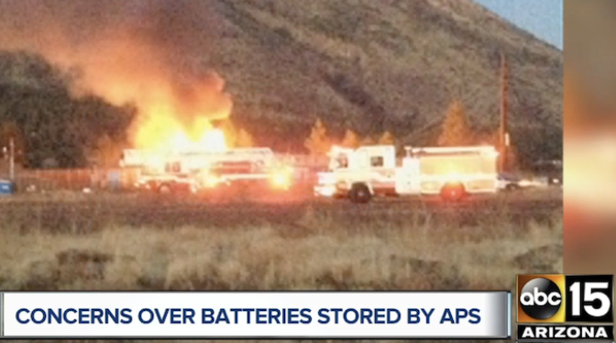
Battery Fires Are Bad News

Slide 12
Salt River Project’s Response:
Comprehensive SAFETY Measures
One Example, Battery Conference, 2022

Slide 13
Some EVITP Requirements/Precedents
CA Public Utilities Commission Safety Language Dec. 2016: SDG&E, So. Cal. Edison, PG&E
Ports of Long Beach and Los Angeles
Nevada Utility: NV Energy, Electric Highway
National Smart Cities Award: Columbus, OH
Cities of Carson, Pico Rivera, Long Beach, Montebello, Maywood & Petaluma, CA
AB 841: CARB & CPUC - 1/1/22, CEC – 9/1/21
South Coast Air Quality Mgmt. District, and …

Slide 14
EVITP in U.S. DoT Guidance 2/10/22
“Installing, operating, and maintaining the NEVI Formula Program’s EV charging infrastructure will create new opportunities for workers in the electrical and other construction trades, … To ensure safety and high- quality delivery, each State Plan should consider the training and experience level of the workforce that is installing and maintaining EV charging infrastructure. This includes ensuring the workforce is trained in high quality training programs like the Electric Vehicle Infrastructure Training Program (EVITP).”
https://twitter.com/USDOT/status/1491826977036189697?s=20&t=89VL8Ct4xp-ZaisIHDBakg

Slide 15
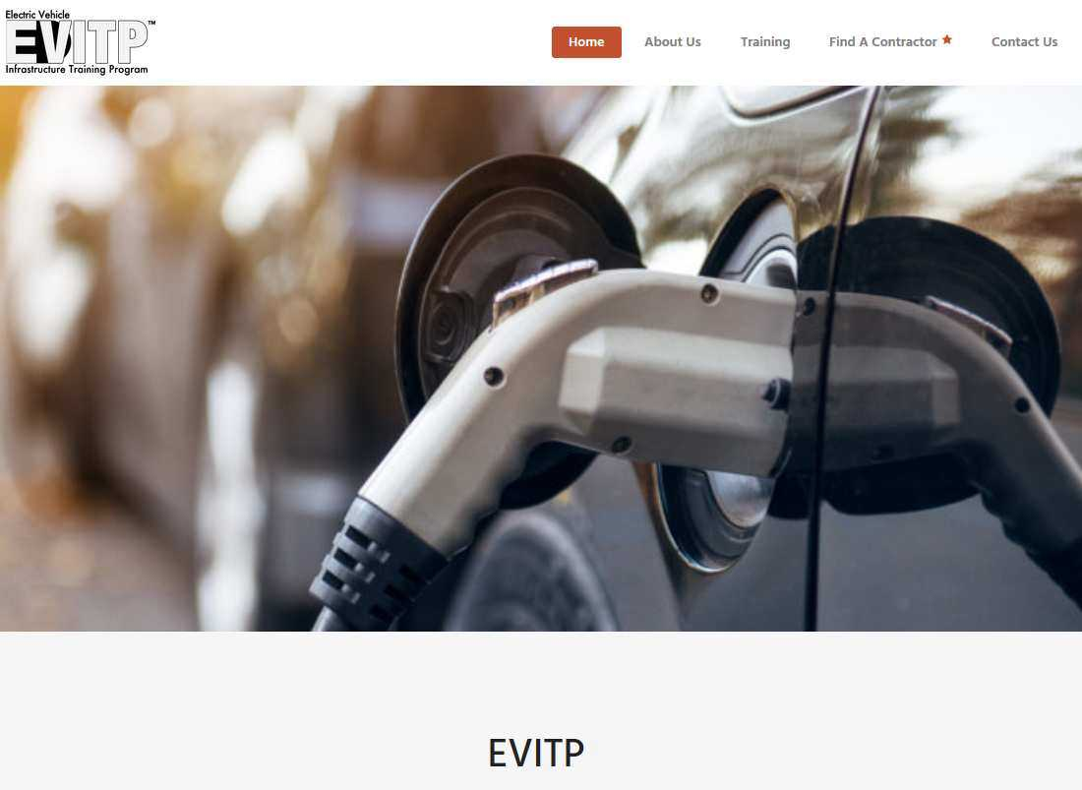
https://evitp.org/

Slide 16
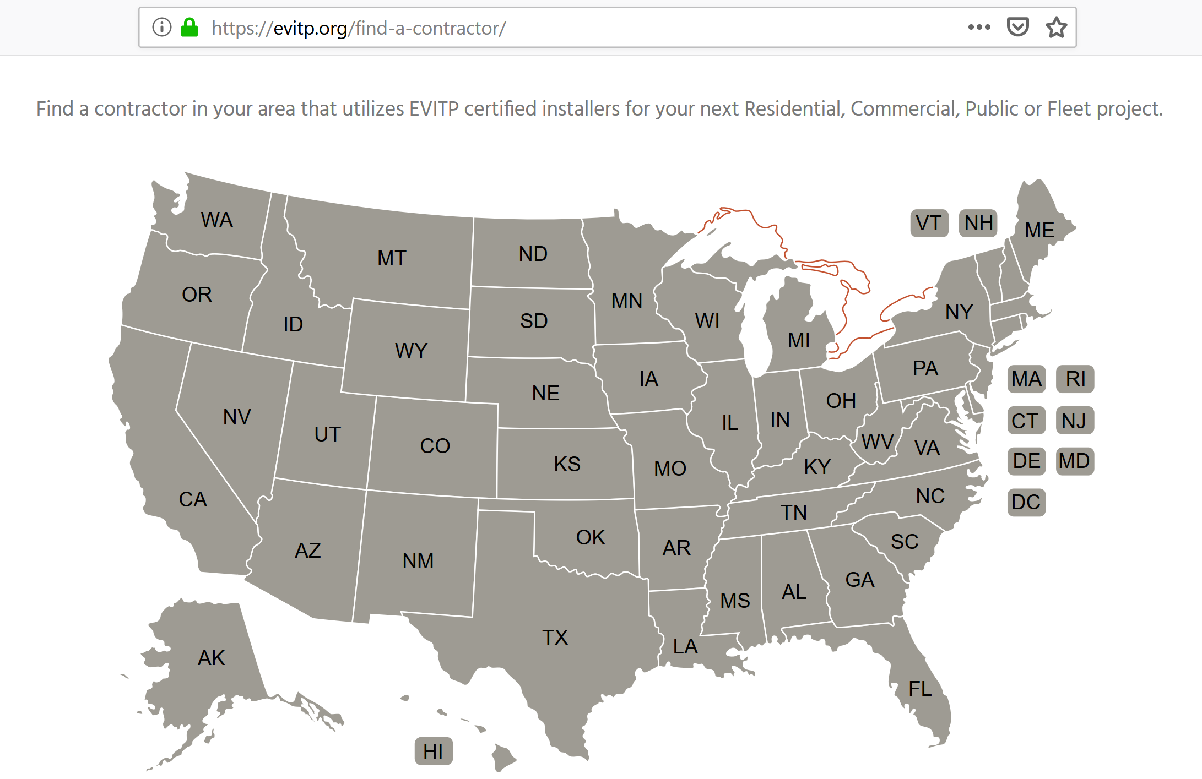
EVITP in All
50 States

Slide 17
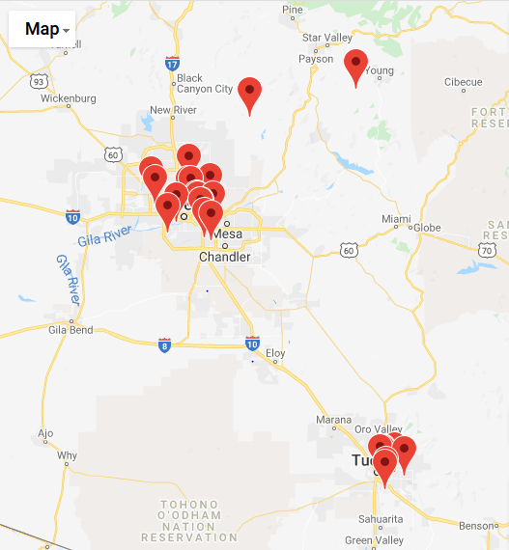
Arizona: 26 Electrical Contractor/Employers
Map Pins Indicate Offices, Not Service Areas

Slide 18
Thank You
Questions?
Electric Vehicle Infrastructure
Training Program (EVITP) 4.0

Slide 19
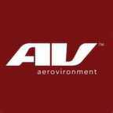
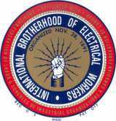
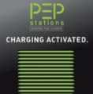
EVITP Partner Advisors

Slide 20
What is the Electric Vehicle Infrastructure Training Program (EVITP)?
A non-profit, volunteer, brand neutral, national EV industry collaborative training program launched at the University of Michigan in 2012. EVITP addresses the technical requirements, safety imperatives, and performance integrity of industry partners and stakeholders including:
Automobile Manufacturers, and Battery Makers
Investor-Owned and Municipal Utilities
Electric Vehicle Supply Equipment/EVSE (“Charging Station”) Manufacturers
State and Local Electrical Inspectors
Electrical Contractors and Electrical Workers
First Responders

Slide 21
EVITP 4.0 Curriculum (Updated 2020)
Comprehensive Residential, Commercial, Industrial Charging Infrastructure Training
Level 2 (220V) Residential Charging
Commercial / Institutional Level 2 Charging
DC Fast Charging
Medium Duty (MD) Commercial / Institutional
Heavy Duty (MD) Commercial & Industrial
Site assessment and load calculations (Core)
Maintenance, Troubleshooting and Repair
Wireless Inductive Energy Transfer

Slide 22
How EVITP is Different
Objectives, approach, and content
Non-proprietary and brand neutral vs. brand focused
Comprehensive vs. specific
Electricians often take some training from the brand of equipment they will install. That’s helpful.
EVITP is much more in depth at 20 hours
Heavy emphasis on code, standards, site assessment and load calculations + demanding 2 hour exam
The only training …

Slide 23
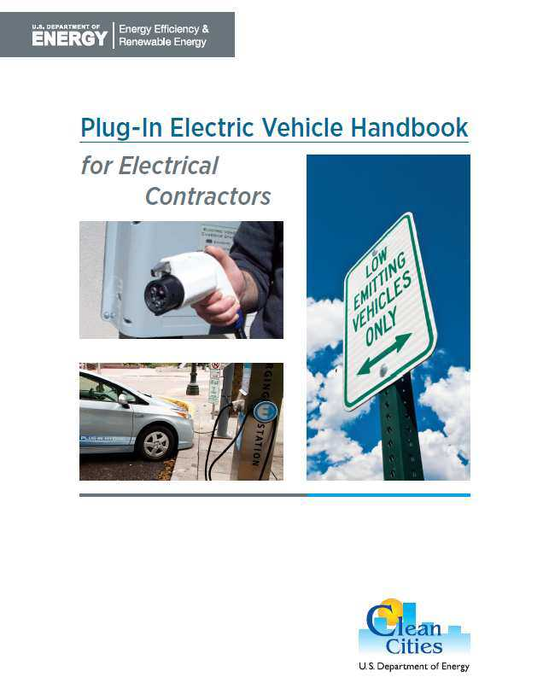
U.S. DoE Clean Cities for Contractors

Slide 24
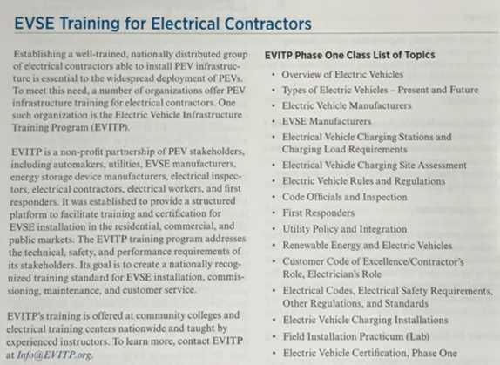
EVITP is the Only Training Featured

Slide 25
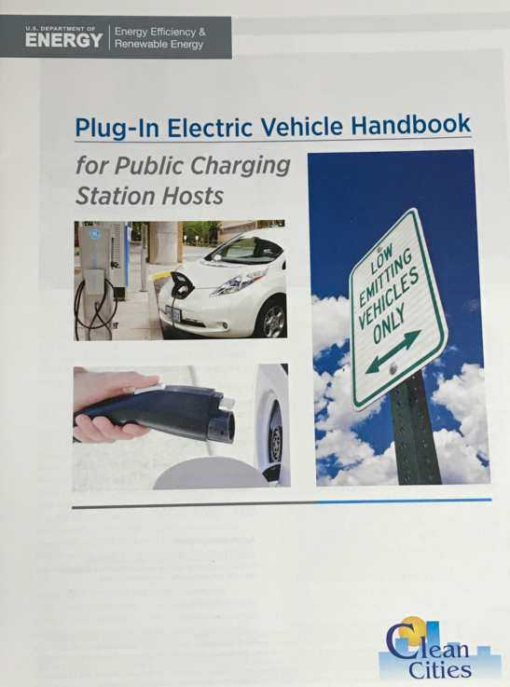
U.S. DoE Clean Cities for Public Hosts

Slide 26
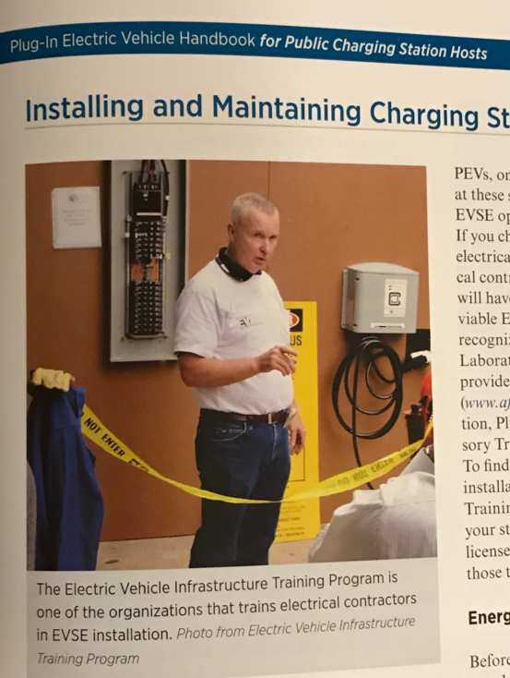
EVITP is the Only Training Featured

Slide 27
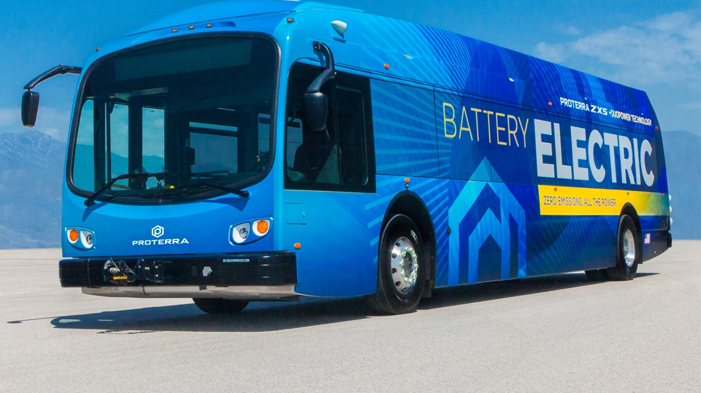
Electric/Hybrid Bus Transition and Green Transit Technology Overview
Electric Vehicle Ad Hoc Committee
City Fleet and Charging Infrastructure Subcommittee
February 15, 2022

Slide 28
Climate Action Plan – Transportation Sector (TS) Goals
Goal TS2 – Increase the use of low-carbon fuels (fuels other than gasoline and diesel)
Target: 100% of city fleets to be fueled by alternative fuels or electric
Hydrogen-powered vehicles can play a role
Pursue investments in electric buses, gain operational and maintenance experience, and deploy them into the system as performance improves
Goal TS4 – Reduce the percentage of single-occupant vehicle trips taken to 60% of all trips
Continue transportation investments that encourage transit-oriented communities
Expand the bus and light rail service network and hours as part of the city’s T2050 program

Slide 29
Public Transit Commitments
Contribute to cleaner air across the region through multiple efforts
Incorporate viable low- and zero-emissions technologies (electric and/or other) in support of the Climate Action Plan
Operate 55% of regional bus service miles
Phoenix realizes 65% of regional ridership
Provide a safe, reliable, positive transit experience for our passengers
Partner with our service providers and transit personnel to provide a well-maintained fleet, including the planned replacement of at least 40 buses per year

Slide 30
Progress on Vehicle Purchases
Cooperative agreements for newer-technology buses
Can expedite purchases, as the competitive process has been completed
Green Transit Technology RFP – Expansion approved by City Council
Support for low- and no-emissions buses in recently passed Federal Bipartisan Infrastructure Law
Funding set aside nationwide over five years for competitive grants for low- to no-emissions buses and associated charging infrastructure
Submitted $8.2M FTA joint grant application (COP/Valley Metro) for electric buses and infrastructure
Continued research and testing with transit vehicle manufacturers
Improvements to Electric-Hybrid and Hydrogen propulsion
Continue visiting and learning from other agencies’ EV bus testing (Tucson, Flagstaff, Nevada, and others)

Slide 31
Vehicle Funding Considerations
85% federally funded
15% Proposition 400 (Regional Transit Funding)
Federal formula and discretionary grants
Vehicle cost assumptions built into long-term funding plans
18 cities + county fund regional system (Valley Metro)
T2050 funds used for transit service operations
Transit contract assumptions – vehicle types and replacements; maintenance and parts needs

Slide 32
Transit System Considerations
Battery-Electric Bus (BEB) ranges
Local testing shows 150-180-mile range
Anticipated range improvements in the next 2-3 years
Pilot BEBs on shorter trips
On-board equipment energy consumption
Fast- and slow-charging options for Battery Electric Buses (BEBs)
Further study needed for site-specific infrastructure changes based on charging/fueling needs

Slide 33
Next Steps
Enter into cooperative transit vehicle purchasing contracts for newer technologies
Expanded Green Transit Technology RFP from $25M to $150M
Purchase newer-technology buses (electric, electric/hybrid, or other) as contracts and funding strategies are in place
Implement pilot program and prioritize purchases thereafter
Explore and test available propulsion systems; evaluate charging needs, costs and funding

Slide 34
Next Steps
Pursue new federal grant opportunities for electric and alternative propulsion system buses – Bipartisan Infrastructure Law and other potential funding opportunities
Continue partnership with other city departments and utilities – identify city facilities for charging infrastructure upgrades necessary to support this transition
Review annually with City Council to seek input on future years’ heavy duty bus orders
Engage an expert consultant on alternative transit propulsion to review and update Phoenix Transit’s vehicle propulsion strategy, with a focus on implementing BEB, electric hybrid, and other lower-emissions technologies

Slide 35
Discussion / Questions

