Slide 1
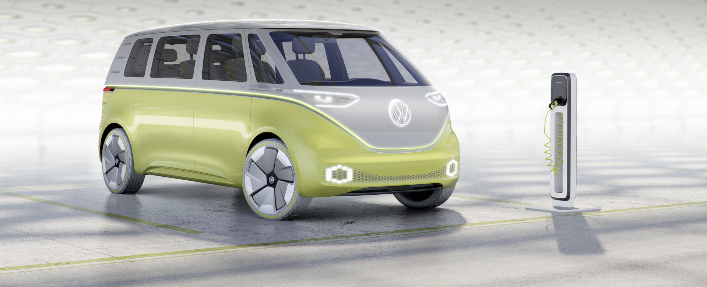
City of Phoenix Electric Vehicle Ad Hoc Committee
Public, Workplace, and Home Charging Infrastructure Subcommittee Meeting
February 18, 2022
In 2023, VW ID. Buzz debuts in the US and will come in passenger, cargo and California camper versions.

Slide 2
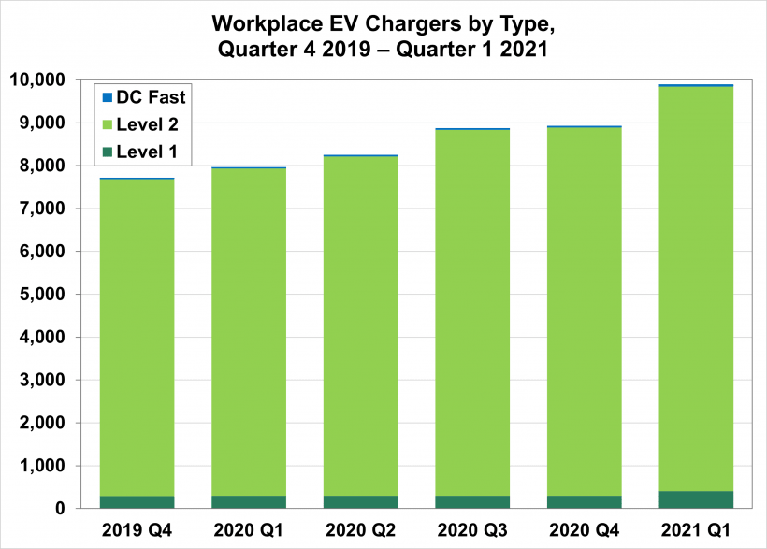
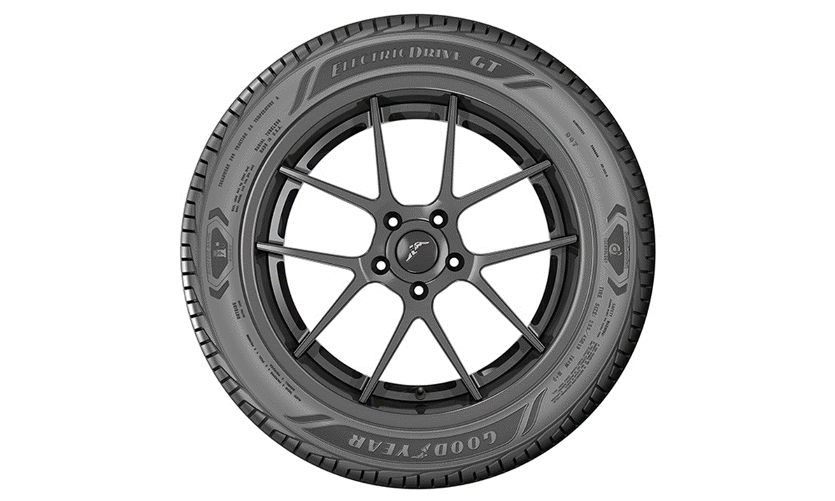
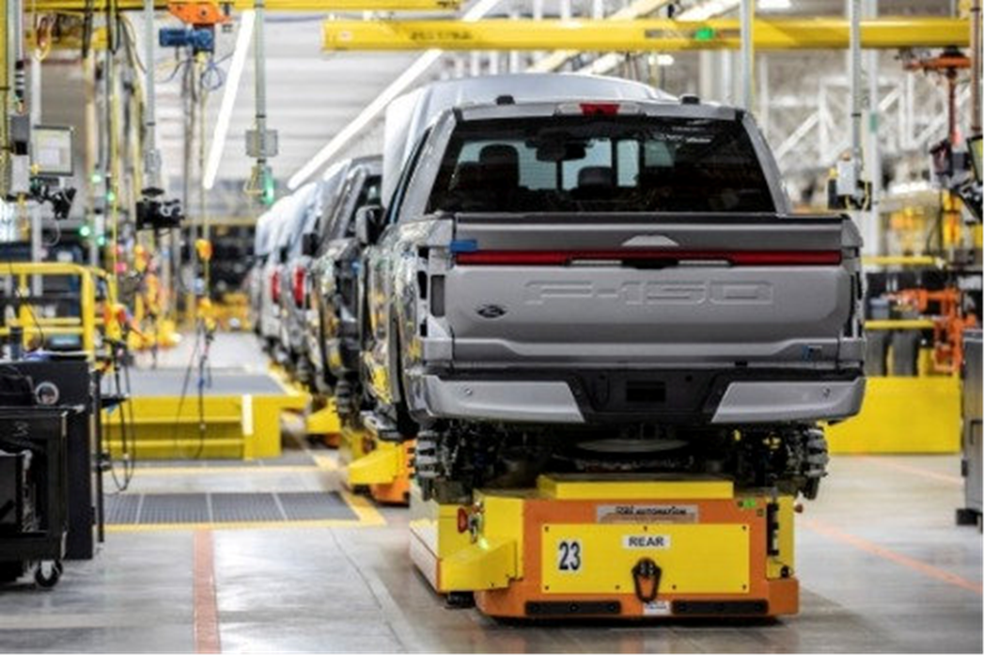
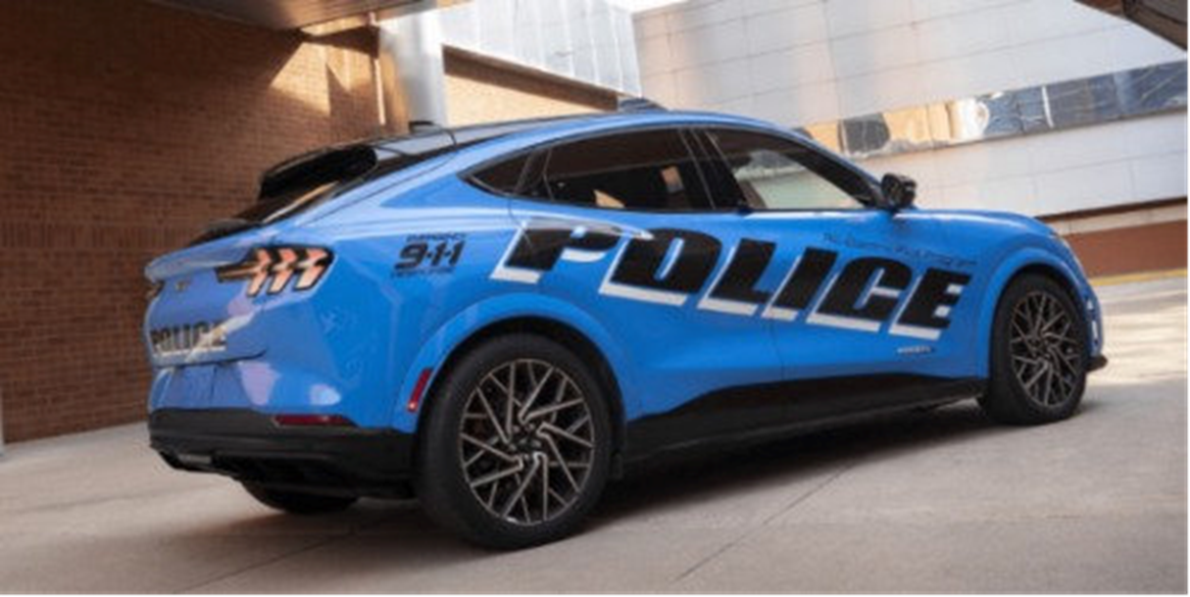
Increase in Workplace Charger Installations
NREL and DOE reports that between 4Q 2019 and 1Q 2021, 9,894 workplace chargers were installed in the US
End of March 2021
95% L2
4% L1
<1% DCFC

Slide 3
Goodyear Develops New EV Tire
ElectricDrive GT is an ultra-high performance, all season tire
Acts as a built-in sound barrier that helps reduce road noise
Initial release is one size which fits most popular EV high-performance models
Plans to extend the ElectricDrive product portfolio in 2022

Slide 4
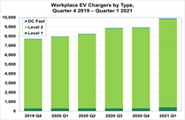
French Car Ads Legislation
Starting in March 2022, auto ads on the radio, tv, and before movies, in print, and elsewhere have to feature a message to consider cycling, carpooling, walking, or taking transit.
Feature hashtag “moving without polluting”
Penalties up to $56,622 for those who fail to post these messages

Slide 5
Ford Increases F-150 Lightening Production
Doubles production capacity to 150,000 vehicles a year by mid-2023 after receiving nearly 200,000 reservations.

Slide 6
NYC Invests in EVs
$420M to transition muni fleet to all electric by 2035
184 Ford Mustang Mach-Es for use in multiple city depts.
250 Tesla Model 3s

Slide 7
Phoenix EV Ad Hoc Public, Workplace and Home Charging
Melissa Martinez & Christine Fini | February 18, 2022

Slide 8
Distribution Planning: Electric Vehicles
SRP 2035 Goal:
Support Enablement of 500k EVs
Manage 90% of EV Charging Load

Slide 9
Distribution Planning: Electric Vehicles
Projecting residential customer EV adoption by feeder and customer segment over time
Developed model for identifying preferred sites for public DC Fast Charging in service territory

Slide 10
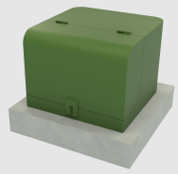
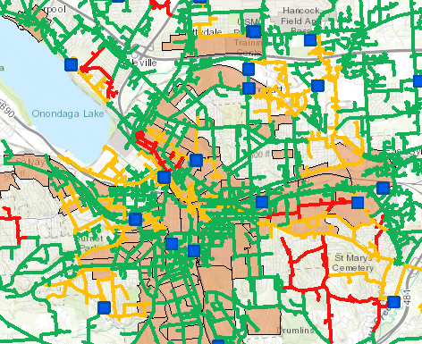
Distribution Planning: Electric Vehicles
Using analytics to find and proactively replace overloaded service transformers before they fail
Creating an EV locational value map to help direct customers to locations that have existing distribution infrastructure capacity.

Slide 11
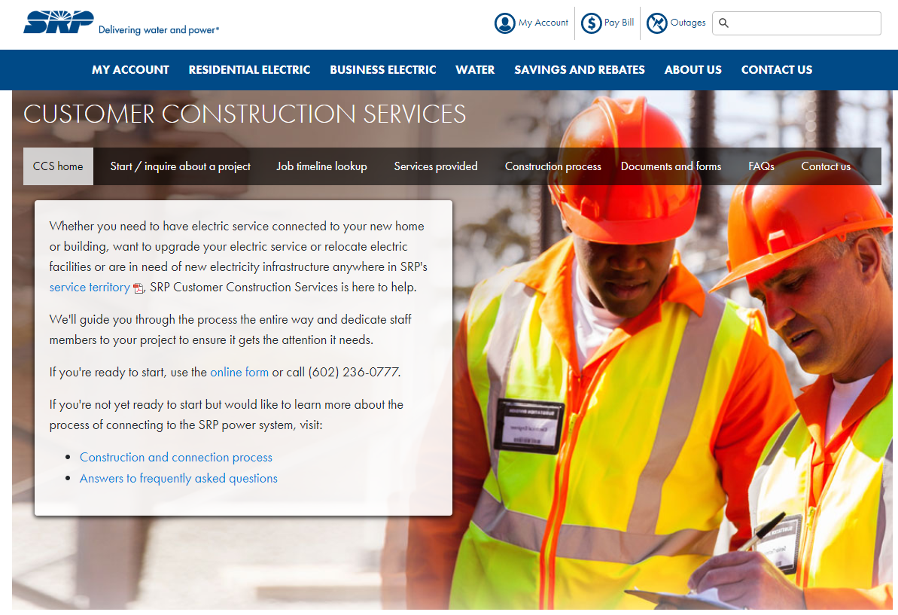
Customer Construction Services
Customers can contact SRP via:
Phone 602-236-0777
Website: www.srpnet.com/electric/business/ccs
SRP Business Rebates
Website: www.savewithsrpbiz.com

