Slide 1
City of Phoenix
Electric Vehicle Ad Hoc Committee Meeting
November 5, 2021
Aspark is a car company based in Osaka, Japan, developing the fastest accelerating supercar. The all-electric Aspark Owl goes from 0 to 60 mph in 1.69 seconds and hits a top speed of 248 mph. The manufacturer will produce only 50 of these sporty cars worldwide. Each costs more than $3 million.

Slide 2
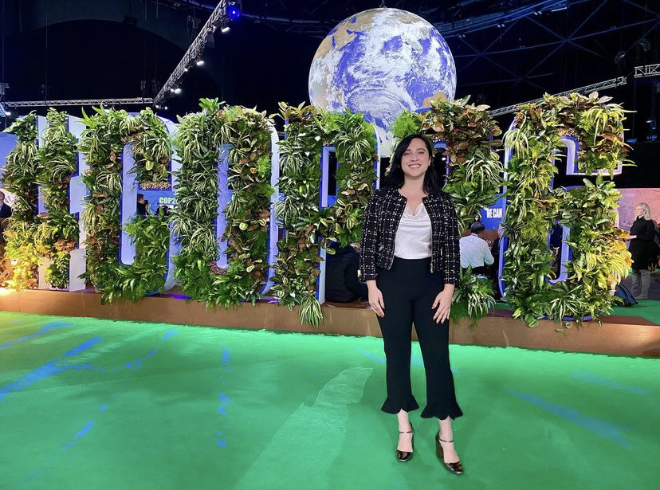
Announcements: COP26
The COP26 summit brought parties together to accelerate action towards the goals of the Paris Agreement and the UN Framework Convention on Climate Change.

Slide 3
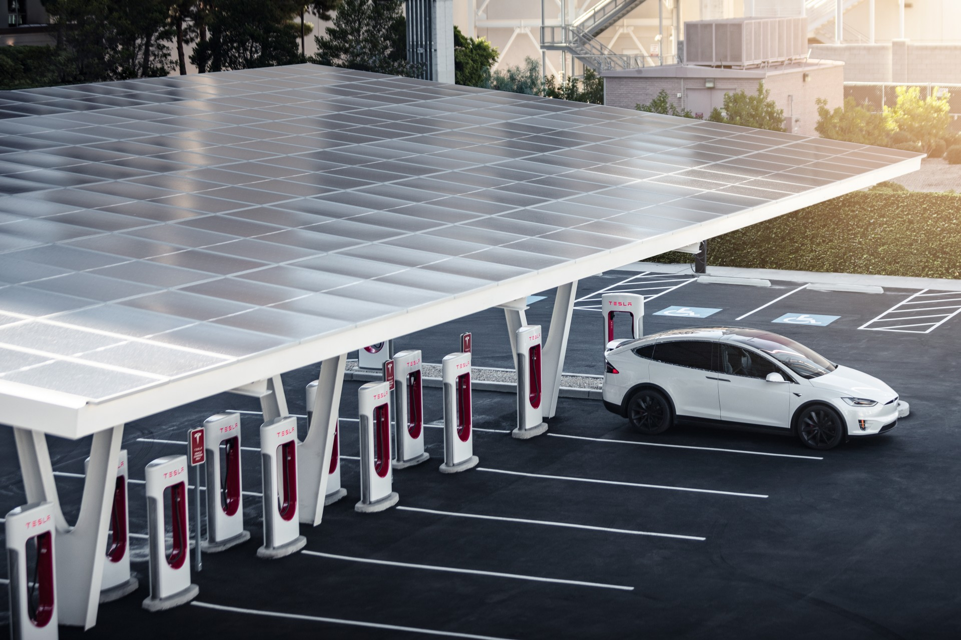
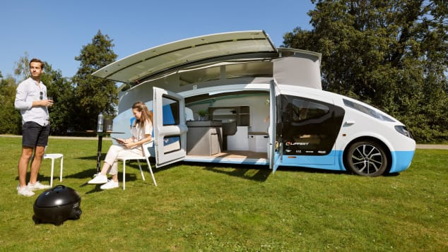
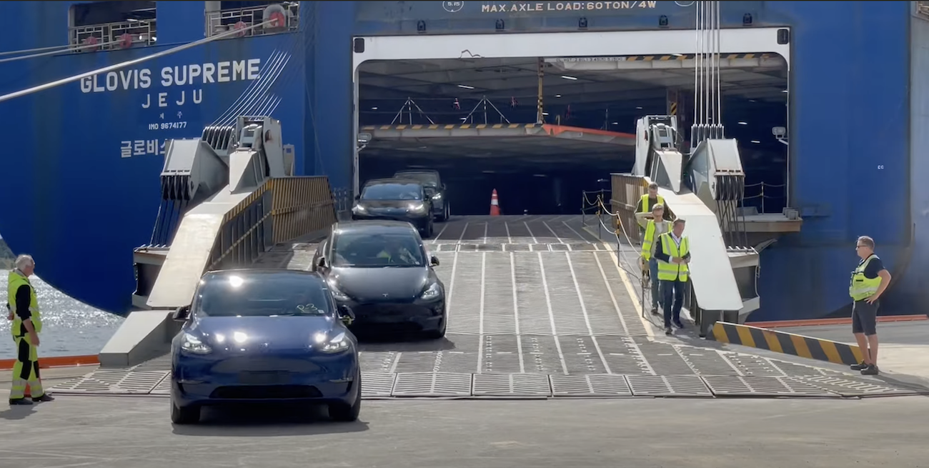
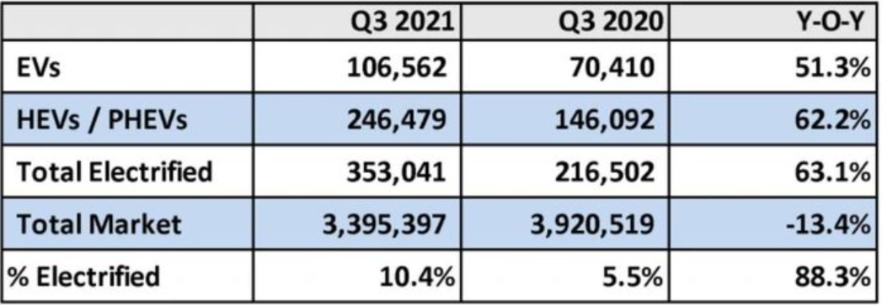
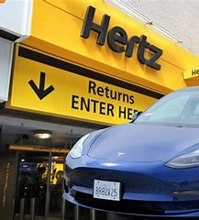
In the News
Tesla aims to triple the Supercharger network in two years
Tesla CEO Elon Musk confirmed in July that Tesla will be making its Supercharger network available to other EVs in the US later in the year
10 test sites in Holland to gauge demand

Slide 4
In the News
"Stella Vita" is a campervan for two people that is entirely powered by the solar panels on its roof.
"Stella Vita" described as a self-sustaining house on wheels," has driven almost 1,242 miles)without stopping for fuel or plugging in to charge.

Slide 5
In the News
Stellantis announced partnership with LG Energy and Samsung SDI to build two new US battery plants.
Toyota will invest $1.3 billion in its new battery plant.

Slide 6
In the News
As of October 2021, there are more electric vehicles than gas vehicles on the road in Oslo, Norway

Slide 7
In the News
Sales of EVs jumped by nearly 60%, according to recent analysis by Kelley Blue Book.
In fact, more than a million electrified vehicles have been sold so far in 2021

Slide 8
In the News
Hertz has submitted an initial order to purchase 100,000 Tesla’s by the end of 2022
50,000 available to Uber drivers to rent

Slide 9
Announcements
Ad Hoc Electric Vehicle Subcommittee
New SharePoint Page:
www.phoenix.gov/sustainability/electric-vehicles/ad-hoc-committee

Slide 10
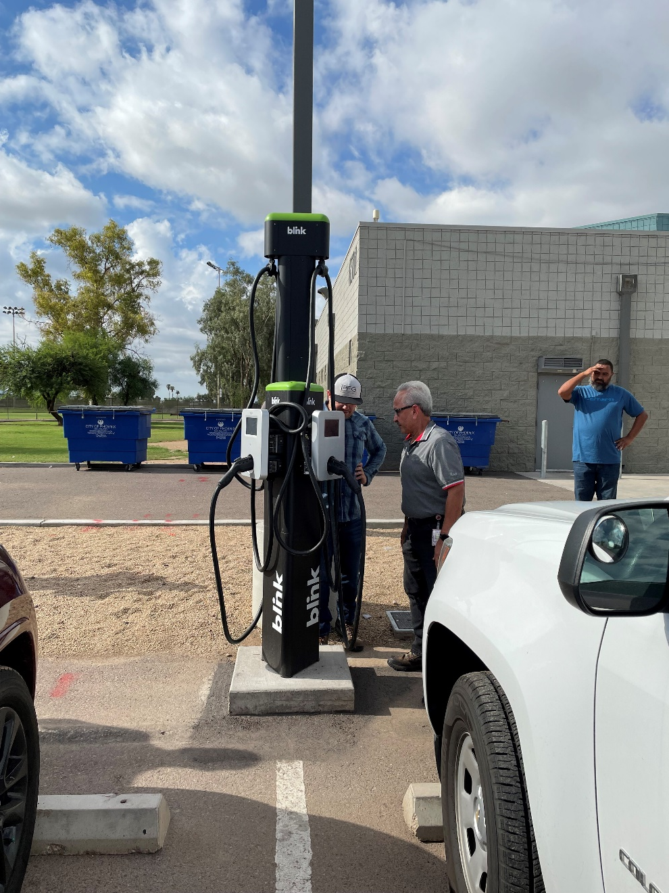
Announcements
SRP Rebate – City of Phoenix
EV Charger
Ribbon Cutting
Desert West Park
6501 W Virginia Ave, Phoenix, AZ
November 15, 2021
9:00am – 10:00am
Event Invites to Follow

Slide 11
Status Update: Statewide Transportation Electrification Plan
Caryn Potter, Utility Program Manger Southwest Energy Efficiency Project (SWEEP) cpotter@swenergy.org
City of Phoenix EV Ad Hoc Committee, Friday, November 5th, 2021

Slide 12
Development of Arizona Statewide Transportation Electrification Plan
In July 2019, the ACC approved a second policy directing APS and TEP to educate customers on the benefits of managed EV charging, expand their EV rate options, and explore the best locations for installing EV charging stations.(1)
This policy also directed APS and TEP to work with stakeholders to develop a long-term statewide transportation electrification plan. APS and TEP hired a third-party facilitator to engaged hundreds of diverse stakeholders five different work groups (and related sub-groups) to develop recommendations on: (1) EV Infrastructure; (2) Equity, (3) Programs and Partnerships, (4) Goods Movement and Transit, and (5) Vehicle Grid.
Phase 2 process ended with the Arizona Transportation Electrification Statewide Plan (AZ TE Statewide Plan) as the final product.
The ACC’s professional staff recently filed a proposed order, recommending adoption of the plan as filed and requiring TEP and APS to file semi-annual progress reports each year with the Commission.
https://docket.images.azcc.gov/0000199128.pdf and https://docket.images.azcc.gov/E000011644.pdf?i=1631729584618
Notes:
The impetus for the AZ TE Statewide Plan was two ACC policy statements.

Slide 13
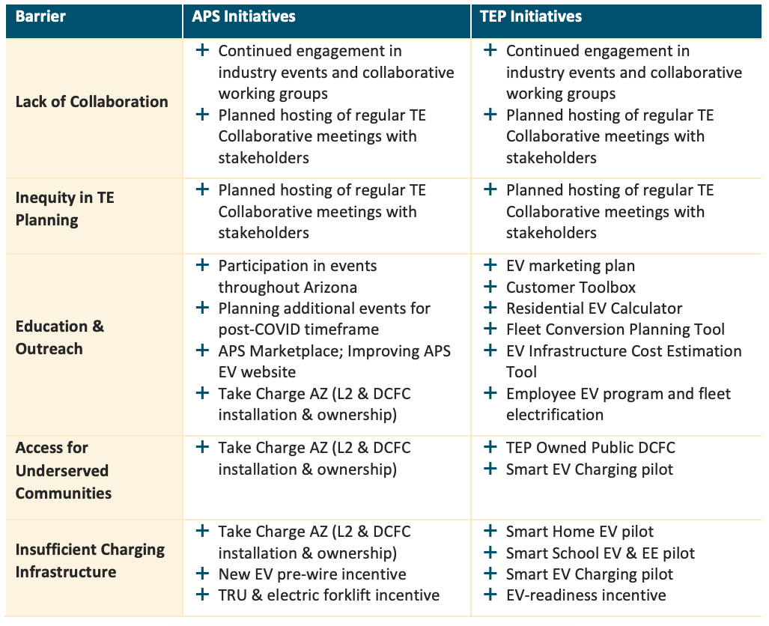
APS and TEP Ongoing and Planned Initiatives
Page 80 of Phase II Plan

Slide 14
Other Stakeholder Recommendations
APS and TEP should file an updated plan at least once every three years that is reviewed and approved by the Commission.
The plan should explain how APS and TEP are working in partnership with third-party providers, local governments, and other market actors.
APS and TEP should maintain stakeholder collaboratives to develop and inform TE program design and implementation.
APS and TEP should report annually on the progress of their EV initiatives conduct a reasonable efforts to collect the following data related to participation, environmental, and economic metrics.

Slide 15
Featured Metrics
Metric Type | Target
Participation | Public EV charging stations and plug counts, both statewide and within APS and TEP service territories. Customers enrolled in EV or TOU rates. Customers enrolled in residential and commercial EV programs. Ratio of DCFC stations to battery electric vehicle adoption. EV models available to Arizona residents compared to total EVs available in the United States. Individuals and organizations attending and engaging in ongoing TE Collaborative meetings. Number of municipalities that have incorporated TE into their fleet(s). Summary of ongoing EV pilots and programs in each service territory. Electric Vehicle program spending, broken out by program category.
Environmental | Reduced carbon emissions resulting from EVs and TE programs. Reduced Ozone Concentrations (ppm or ppb) resulting from EVs and TE programs.
Economic | Geographical distribution of program participants and infrastructure investments. Fuel cost savings realized relative to conventional transportation fuels. Aggregated customer load profile data for comparisons of the impact of different pricing arrangements on charging behavior.
Page 8 of Phase II Plan

Slide 16
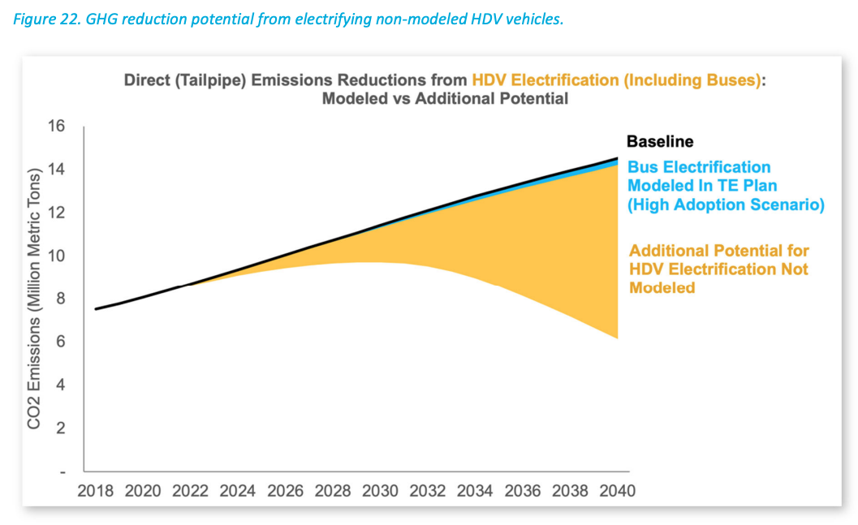
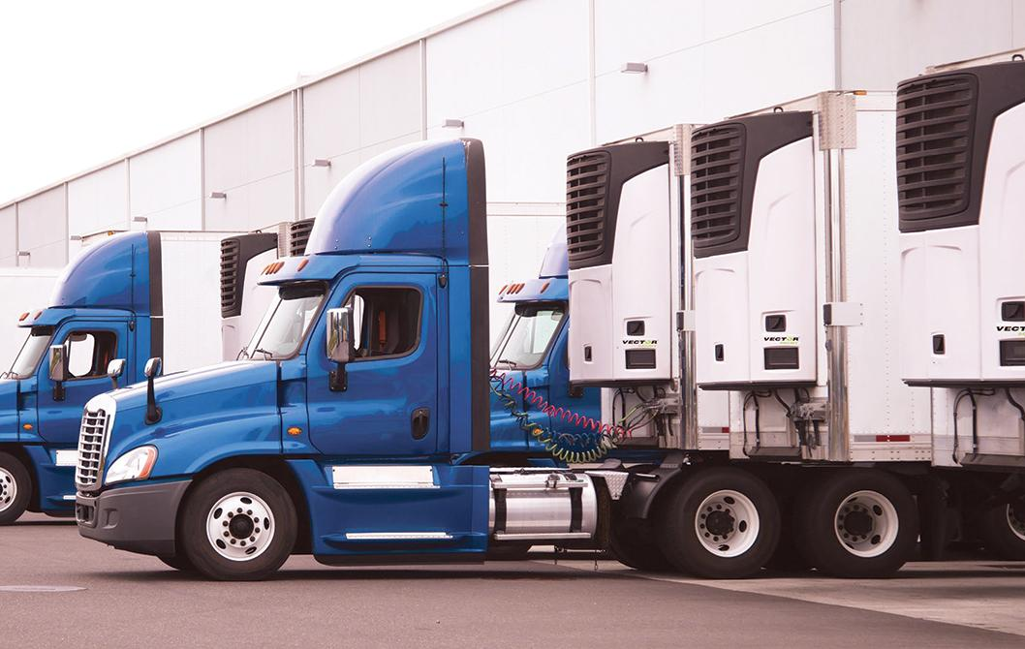
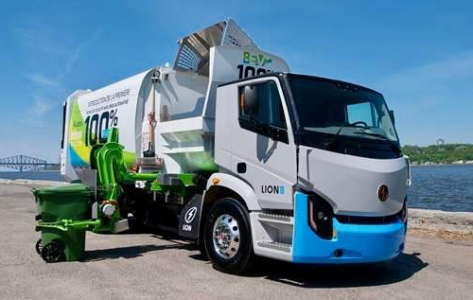
Future Modeling and Research: MD/HD Electric Vehicles
Evaluation of various vehicle adoption scenarios and related impacts for medium and heavy-duty vehicle segments must be considered in future modeling. (e.g., electric medium-duty parcel delivery trucks, school buses, dump trucks, etc.)
(Left) Transport Topics, https://www.ttnews.com/articles/refrigerated-carriers-finding-value-electric-powered-reefer-units and Wall Street Journal, Electric Trash Trucks Are Coming Quietly to Your Town
(Right) Figure 22, Arizona Statewide Transportation Electrification Plan: Phase II

Slide 17
5 Takeaways for City of Phoenix EV Committee
The City of Phoenix operations has a significant role to play in enabling the growth of electric vehicles community-wide. The private market alone will not meet the charging infrastructure need.
Building upon the AZ TE Statewide Plan’s adoption goals and programs could be significant role of the City of Phoenix’s EV/TE program development.
City of Phoenix should participate in future utility EV collaborative meetings.
AZ TE statewide plan can help address potential gaps in City of Phoenix EV readiness planning while evolving decision-making processes.
Since the market is advancing quickly, it is vital to create short-term and long-term planning cycles that avoid reinventing the wheel while expediting program approval to push faster adoption.

Slide 18
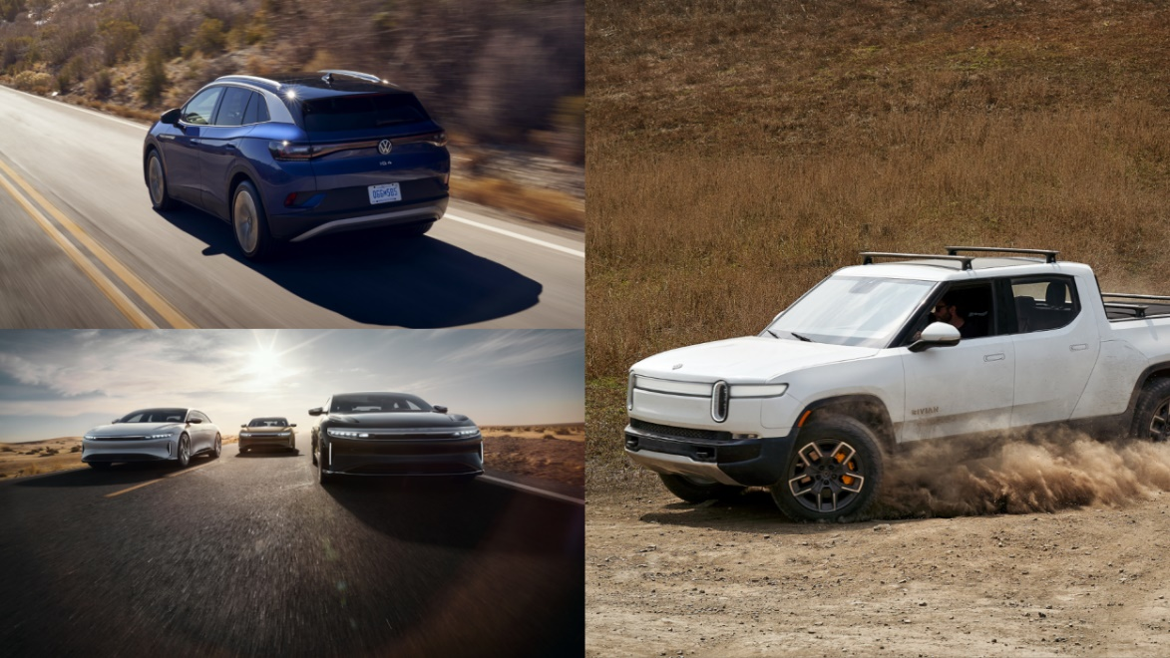
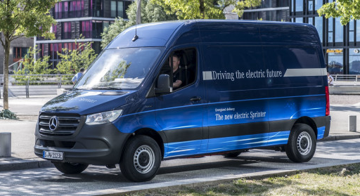
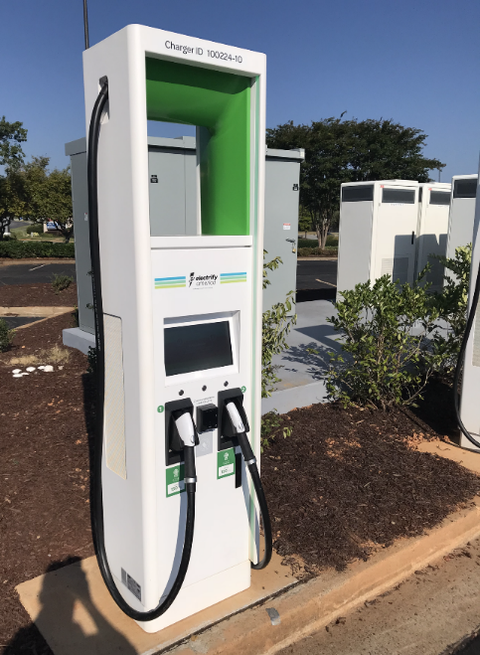
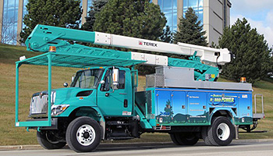
City of Phoenix EV Ad Hoc Committee
SRP’s EV Strategy & Initiatives
Catherine O’Brien, SRP
Electric Vehicle Lead, Sustainability Policy & Programs
catherine.obrien@srpnet.com

Slide 19
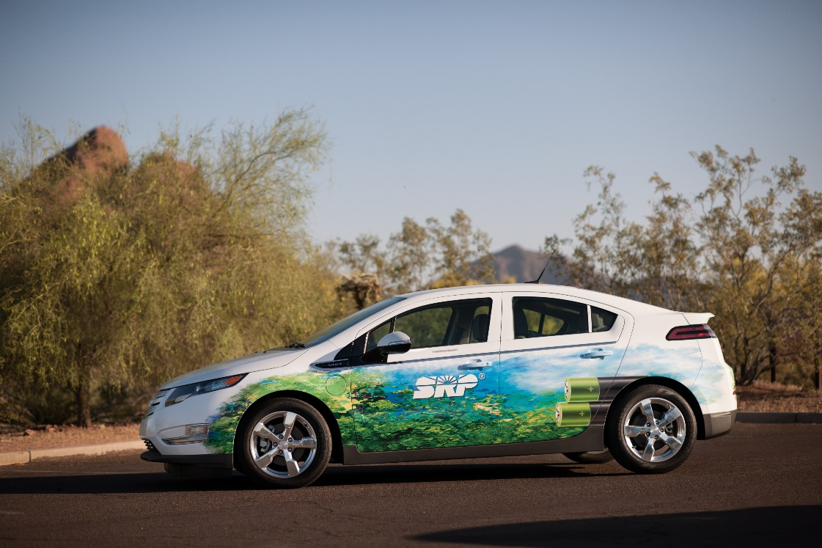
Topics to be Covered:
SRP’s 2035 Sustainability & EV Goals
SRP’s EV Strategy & Initiatives
Planning for the Future
How We can Work Together

Slide 20
2035 Sustainability Goals

Slide 21
Our 2035 EV Goal
Support the enablement of 500,000 EVs in SRP’s service territory and manage 90% of EV charging.

Slide 22
SRP EV Strategy
Single-Family Homes​
Reduce barriers of creating an EV-ready home and simplify the process of retrofitting existing homes​
Proactively drive implementation and expansion of commercial, workplace and multi-unit dwelling (MUD) charging​
Fleets
Collaborate with customers to optimize energy supply for electric fleets and accelerate electrification through targeting outreach​
Public Charging
Commercial & Multifamily
Facilitate third-party buildout of public charging infrastructure and fill the gaps​
Policy
Innovation
Education & Awareness

Slide 23
Supporting the Enablement of 500,000 EVs Commercial Programs
Business Charging Station Rebate
$1,500 per L2 port
Charging Make-Ready Incentive
$2,500 per L2 port to cover cost of infrastructure for munis, non-profits, schools & multifamily
New Home Charging
Pre-Wire
$300 per home to homebuilders
NEW! – Fleet Electrification Service
Up to $20,000 to evaluate converting to electric

Slide 24
Supporting the Enablement of 500,000 EVs Residential Programs
EV Community
Tell us about your EV, get a $50 bill credit
EV Charging Station Rebate
$250 towards a smart home charging station
EV Price Plan
Save money by charging off-peak at home
EV Calculator
Compare models to find the right EV for you

Slide 25
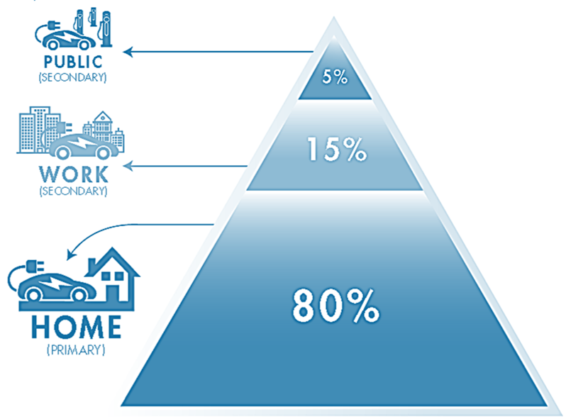
Managing 90% of EV Charging
Managed Charging Examples
Passive | Active
Time-varying rates, including TOU & hourly dynamic rates | Direct load control via charging device
Communication to customer to reduce charging load | Direct load control via automaker telematics
Incentive or rewards programs for off-peak charging | Direct load control via a smart circuit breaker or panel

Slide 26
Current and Future Research Efforts
Planning for the future: Grid enablement, public charging
Grid scenario planning and transformer load management
Spatial correlation between public charging, site design, and EV adoption
Calculating annual net regional emissions reductions from EV adoption

Slide 27
Meeting our EV Goals
SRP is committed to working together to optimize transportation electrification and seize the benefits it can bring our customers and community.

