Slide 1
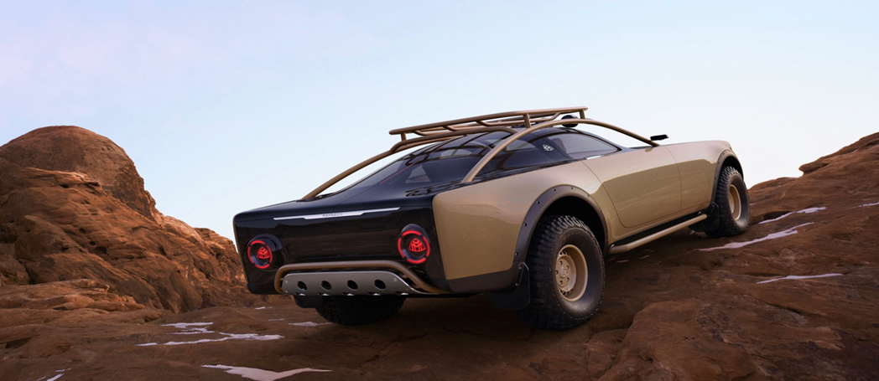
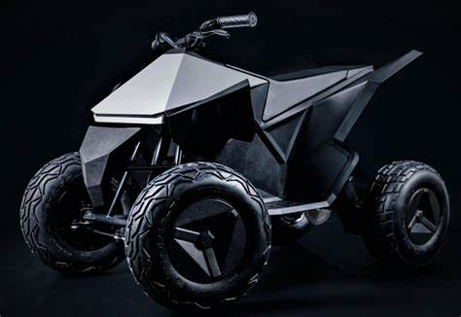
City of Phoenix Electric Vehicle Ad Hoc Committee
Education, Outreach & Equity Subcommittee Meeting
December 10, 2021
Mercedes goes MadMax lux with Project Maybach off-road EV coupe concept. Solar panels sit under long transparent hood.

Slide 2
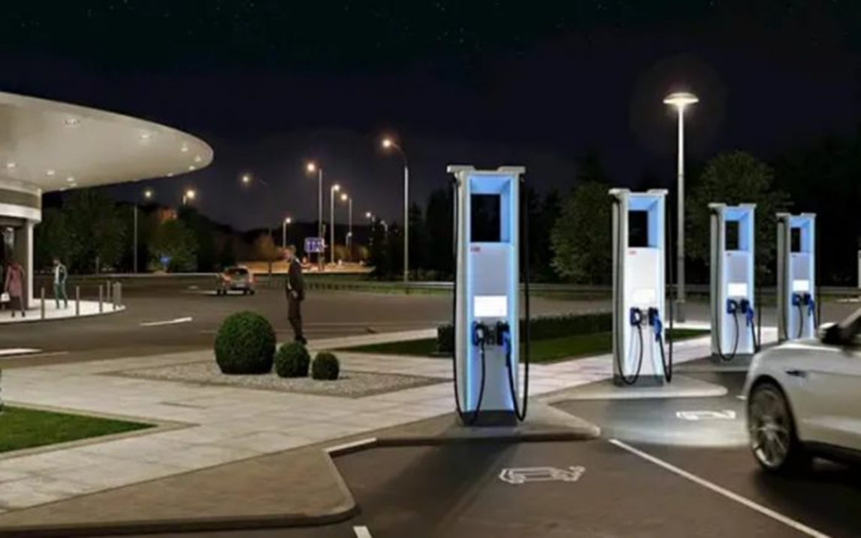
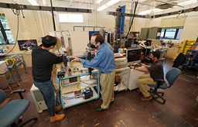
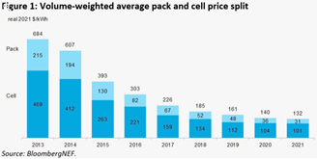
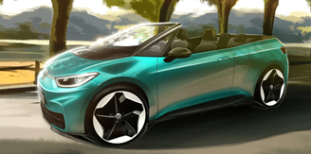
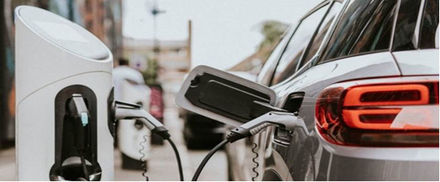
Tesla Cyberquad
(for kids)
$1,900 - Sells out within hours of release
Range: 15 miles
Top Speed: 10mph
Equipped: cushion seats, LED lights, fully adjustable suspension, and full steel frame

Slide 3
Gov’t of Spain
Issues a proposal EVSE installation order
1,000 EVSE’s installed at “gas” stations
Sales of 10M liters+ install DCFCs

Slide 4
Liquid Phase Change – Cooled Cable Development
Higher charging power levels mean higher current, which means greater amounts of heat
Cable able to remove up to 24.22 kW of heat – can deliver a current 4.6 times faster than current cable technology
Provides 2,400 amps compared to 520 amps of current chargers = faster charging speeds

Slide 5
Global average battery prices fell 6% between 2020 and 2021
Raw material prices are pushing battery prices back up – avg battery pack price in 2022 predicted to be $135/ kwh
Delay in $100/kwh milestone and push out targets
Predicted to dip below $100/kwh in 2024

Slide 6
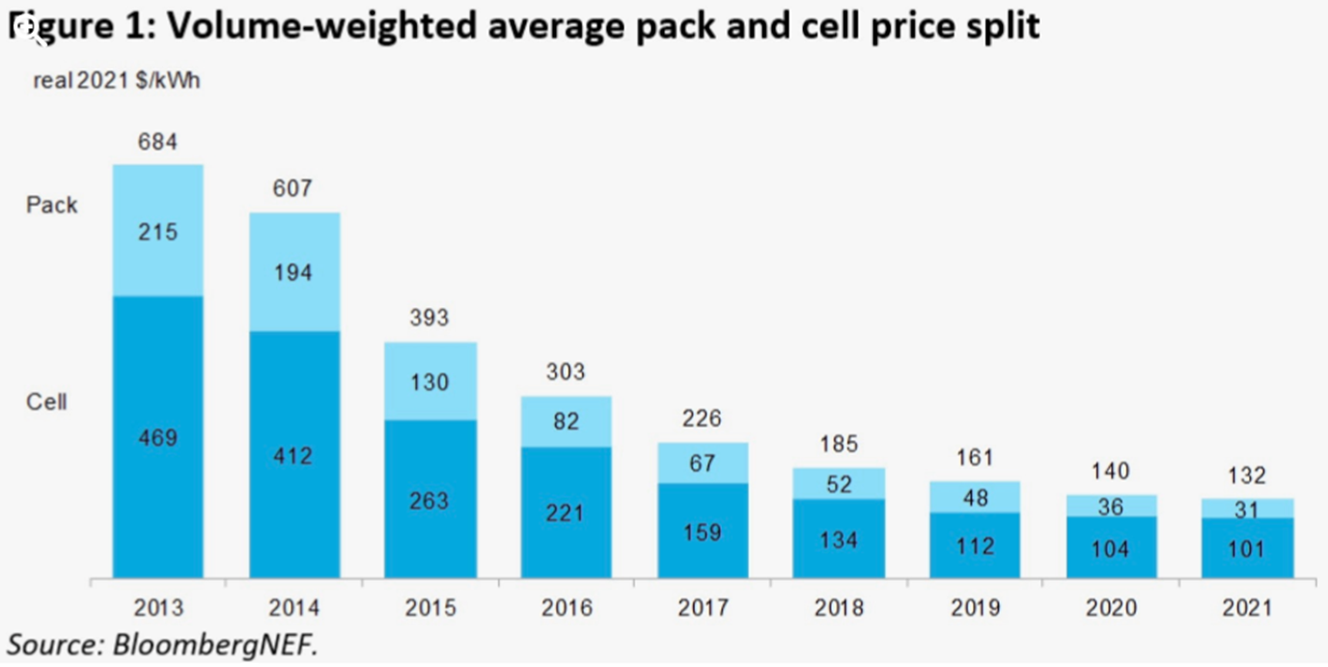
E-Convertible
VW rumored to be building
Based on the ID.3 Cabrio

Slide 7
Announcements
SRP Transportation Electrification Activator Webinar
Topic: Guide to Electric Vehicles
Date: December 14, 2021
Time: 11am – 12:30pm MST
Presenters: SRP, City of Phoenix, and SWEEP
In this webinar, we will look at:
How EVs work, charging and technology
Vehicle performance and ranges
Environmental and economic benefits
Model availability and anticipated growth by vehicle segment
Current and future growth of EVs nationally and locally
Free informational resources available to consumers

Slide 8
Ad Hoc Committee Timeline
Ad Hoc Committee Calendar
 |  | Dec |  |  |  | Jan |  |  |  | Feb |  |  |  | Mar |  |  |  | Apr |  |  |  | May |  |  |  | Jun
Action | Responsible | 1 | 2 | 3 | 4 | 1 | 2 | 3 | 4 | 1 | 2 | 3 | 4 | 1 | 2 | 3 | 4 | 1 | 2 | 3 | 4 | 1 | 2 | 3 | 4 | 1 | 2 | 3 | 4
Ad Hoc Committee Meeting | Full Committee | 3 |  |  |  | 7 |  |  |  | 4 |  |  |  | 4 |  |  |  | 1 |  |  |  | 6 |  |  |  | 6
Education, Outreach & Equity | EOE Sub Ctte |  | 10 |  |  |  | 14 |  |  |  | 11 |  |  |  | 11 |  |  |  | 8 |  |  |  | 13 |  |  |  | 13
Public, Workplace & Home Charging | PWH Sub Ctte |  |  | 17 |  |  |  | 21 |  |  |  | 18 |  |  |  | 18 |  |  |  | 15 |  |  |  | 20 |  |  |  | 17
City Fleet & Charging Infrastructure | CFC Sub Ctte |  |  | 21 |  |  |  | 18 |  |  |  | 15 |  |  |  | 15 |  |  |  | 19 |  |  |  | 17 |  |  |  | 21
Drafting of report (Stages) |  | Outline |  | Draft Intro |  |  | Draft Deliverables |  |  |  | 1st Draft Roadmap |  |  |  | Translation |  |  |  |  |  |  |  | 2nd Draft |  |  | Final
Homebuilder Roundtable |  |  |  |  |  |  |  |  | 25
Valley Partnership Roundtable |  |  | 8
Employer Roundtable |  |  |  |  |  |  |  |  |  |  |  | 16
Public Workshops |  |  |  |  |  |  |  |  |  | 2 | 9
1st Draft Public Surveys + Workshops |  |  |  |  |  |  |  |  |  |  |  |  |  |  |  |  |  |  | 6 |  | 21

Slide 9
Equity Questions
Are low-income electric scooter subsidies an equity solution?
What are the demographics of riders?
Is $1 for a short distance a good use of funds or a luxury?
Are they primarily for fun or are they practical for commutes / groceries?
What would make a low-income Electric Car Share program equitable?
Could carshare subsidy increase a family’s transportation costs?
Should we ensure we are not moving people away from lower-cost options?
Would it move people away from mass transit? (Is that an issue?)
If you had $5M, what would an EV Equity Program look like?
E-Bikes, Carshare, Transit Pass, Autonomous E-Shuttle, E-Bus?

Slide 10
Electric
Vehicle
Happy Holidays
Mercedes goes MadMax lux with Project Maybach off-road EV coupe concept. Solar panels sit under long transparent hood.

