Slide 1
City of Phoenix
Electric Vehicle Ad Hoc Committee Meeting
March 4, 2022
2022 - Superbowl LVI - EV Ad Blitz

Slide 2
2022 Superbowl EV Commercials
Overview
7 auto brands aired 8 commercials
6 auto brands focused on EVs – record $6.5M/30 secs
Kia – EV6
Hyundai – Ioniq 5
BMW – iX
GMC (2) – Silverado, Ultium Platform
Polestar – Polestar 2
Nissan – Ariya
** Toyota – No EV focused ads
1 – EV charger – Wallbox
Data and Stats (Canalys)
In 2021
6.5M EV (BEV and PHEV) sold worldwide
109% EV sales growth over 2020
Only 4% growth in total global passenger car market
EV market growing at 25 times the pace of the car market overall
Of the 6.5M sold, only 535,000 EVs sold in US – representing about 4% of new car sales (3.2M China, 2.3M Europe)

Slide 3
In the News
Robo Dog
Kia – EV6
Most images and specs accessed on Cars.com

Slide 4
In the News
History of Evolution
Hyundai Ioniq 5

Slide 5
In the News
Zeus & Hera
BMW - iX

Slide 6
In the News
Dr. Evil
GMC Ultium Platform

Slide 7
In the News
No Compromises
Polestar – Polestar 2

Slide 8
In the News
Struck by Lightening
Wallbox

Slide 9
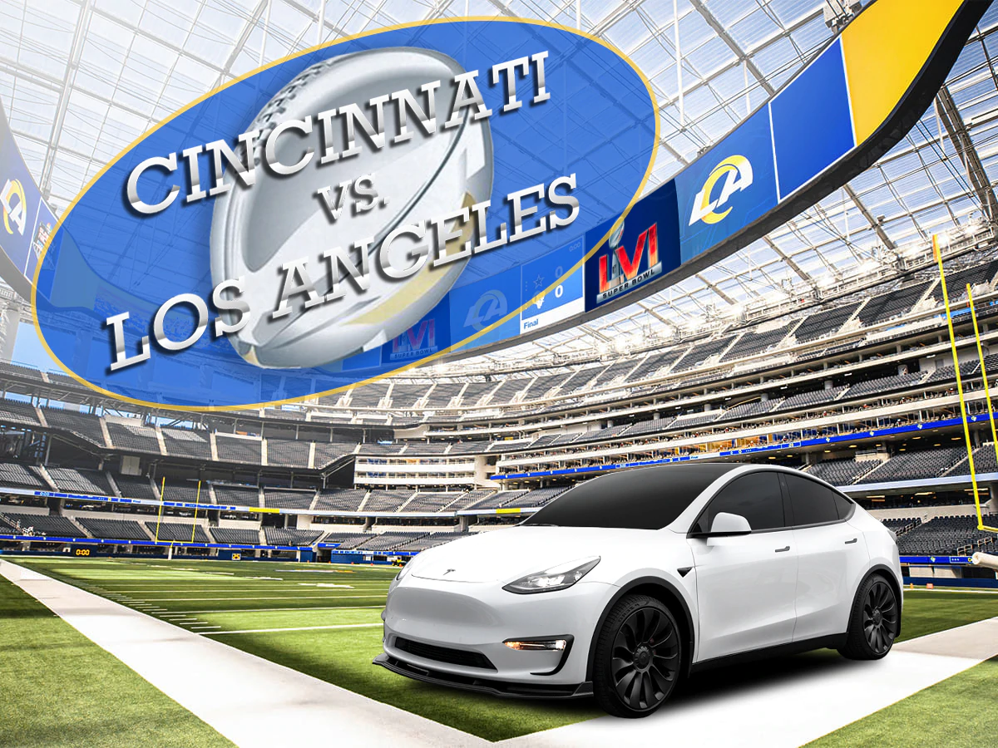
2022 Superbowl LVI - EV Commercials
Key Points
Availability at the dealers –
GM - two models that advertised are available to purchase now
Hummer EV – shipped last year (limited availability at dealers)
EV600 – electric delivery van
Lyriq – spring 2023/Silverado EV – spring 2023
BMW iX – ships in summer 2022
Hyundai Ioniq 5/Kia EV6 – limited dealer availability
Polestar 2 – available now
EVs continue to gain market share and commercial increased brand awareness and the transition to EVs
Quote – Arnold Schwarzenegger
“We have to talk about how to get rid of pollution. One of the things you can do is drive electric cars”

Slide 10
City of Phoenix Electric Vehicle Ad Hoc Committee
March 4, 2022
Jason Smith, Energy Innovation Program Consultant, Customer to Grid Solutions
Randon Allen, Engineer III, Distribution Planning Engineering

Slide 11
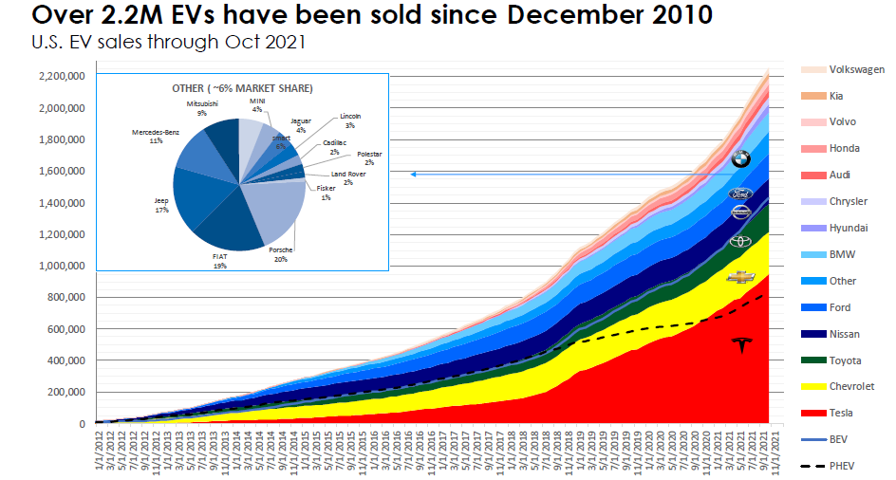
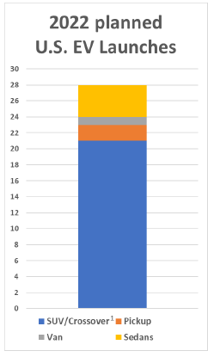
EV Growth
Source: EPRI

Slide 12
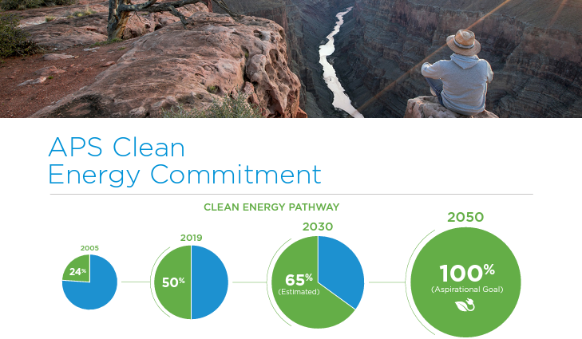
APS’ Commitment to EVs
EVs contribute to cleaner air, reduced GHG emissions, improved public health, and contribute to the local economic development
Increased revenue from new EV load can reduce pressure on rates for all customers and create opportunities for infrastructure to support transportation electrification
EVs complement APS’s Clean Energy Commitment
APS’s EV goal:
450,000 light-duty EVs in our service territory by 2030

Slide 13
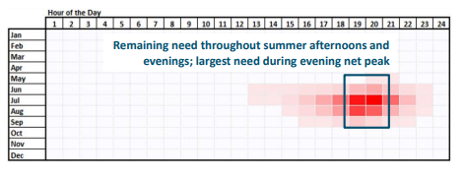
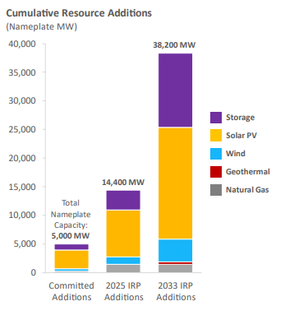
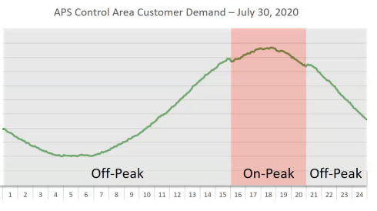
Resource Planning/Analysis

Slide 14
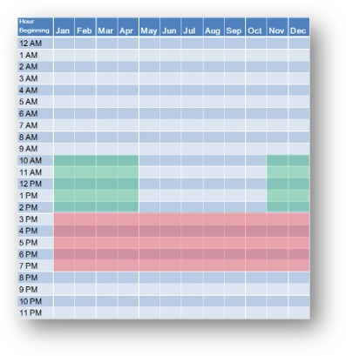
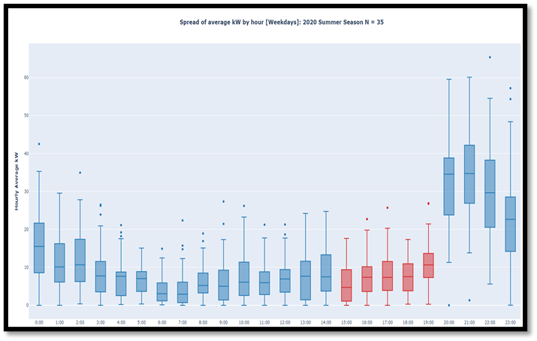
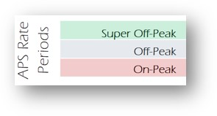
Off-Peak Charging/Managed Charging
Load shape analysis of 35 APS customers with EnelX JuiceBox smart home charging stations
On Peak charging

Slide 15
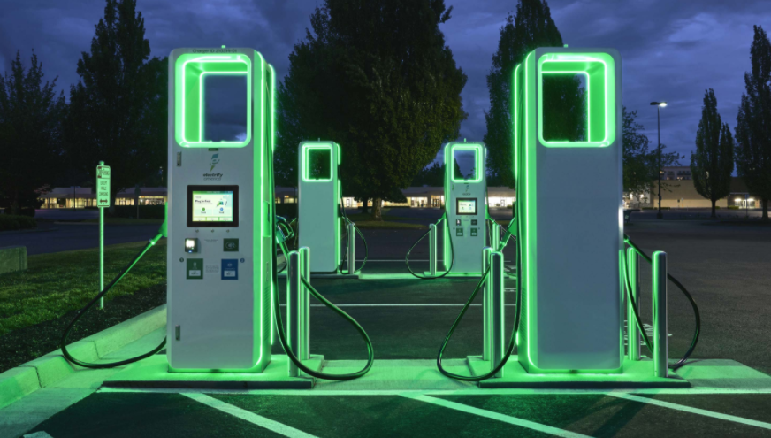
Supporting EV Growth
Each project is unique
Project location (site layout, existing capacity, required infrastructure, etc.)
Load variability (L2 vs. DCFC, charger kW demand, number of chargers, time of charging, etc.)
Project phasing
Commercial/fleet EV form
Customer construction support
Interacting early
Collaboration
Notes:
https://www.aps.com/en/About/Construction-and-Power-Line-Siting/Construction-Services/Getting-Your-Project-Started

Slide 16
Preparing for the Future
Data Analytics
Service transformers & cable
Standards for construction
Distribution forecasting Improvements
EV charging growth factors
Maintaining industry awareness
Notes:
https://www.aps.com/en/About/Construction-and-Power-Line-Siting/Reliability

