Slide 1
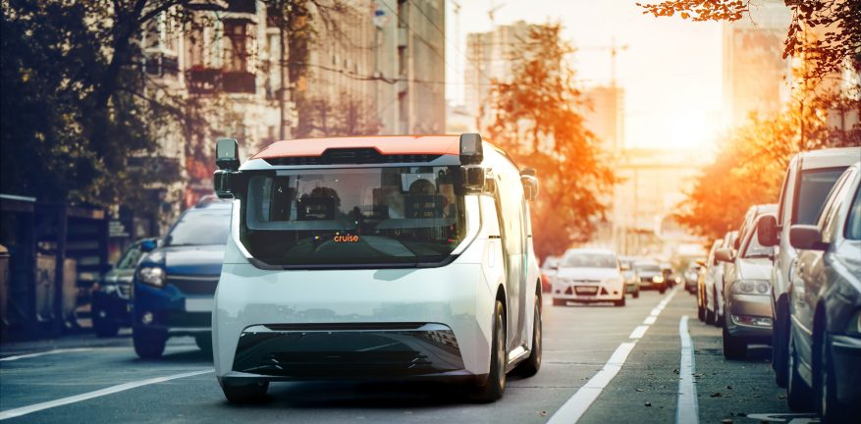
City of Phoenix
Electric Vehicle Ad Hoc EOE Subcommittee Meeting
March 11, 2022
GM Cruise seeks Commercial Deployment of its Origin shuttle, an AV/EV. Would expand mobility options for seniors or disadvantaged communities. Currently operates an AV taxi service in San Fran. Arizona-based AV developer.

Slide 2
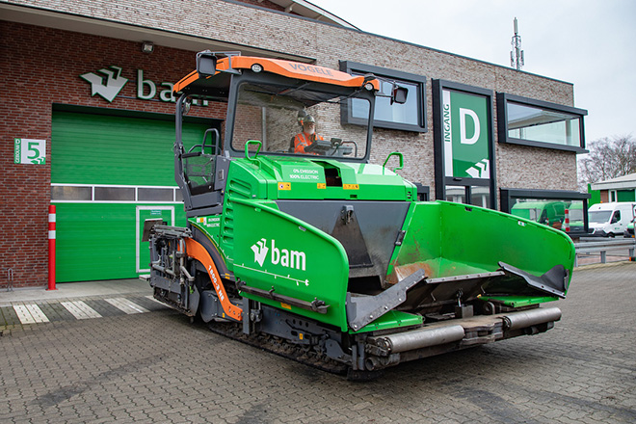
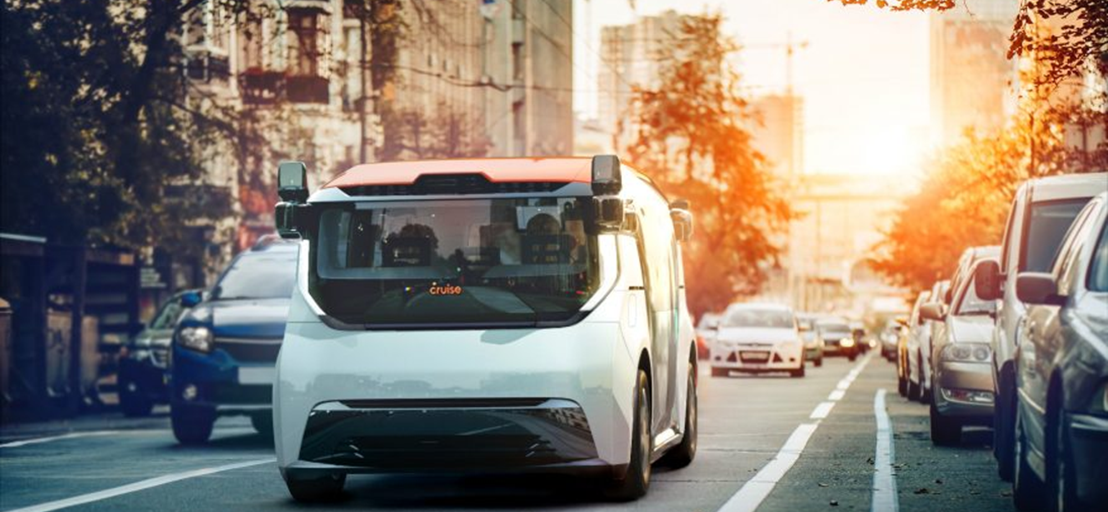
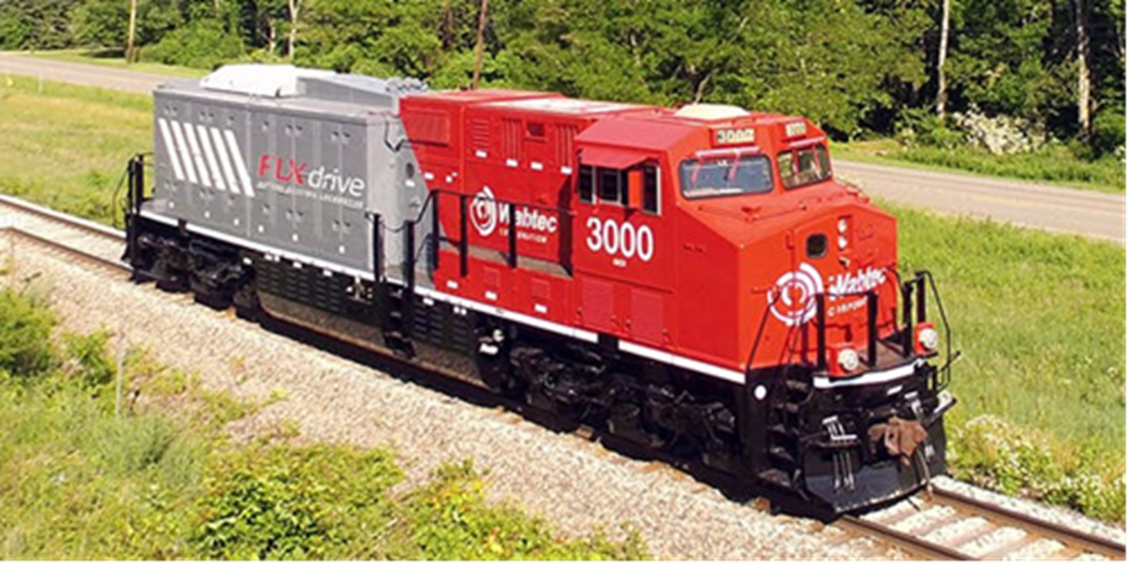
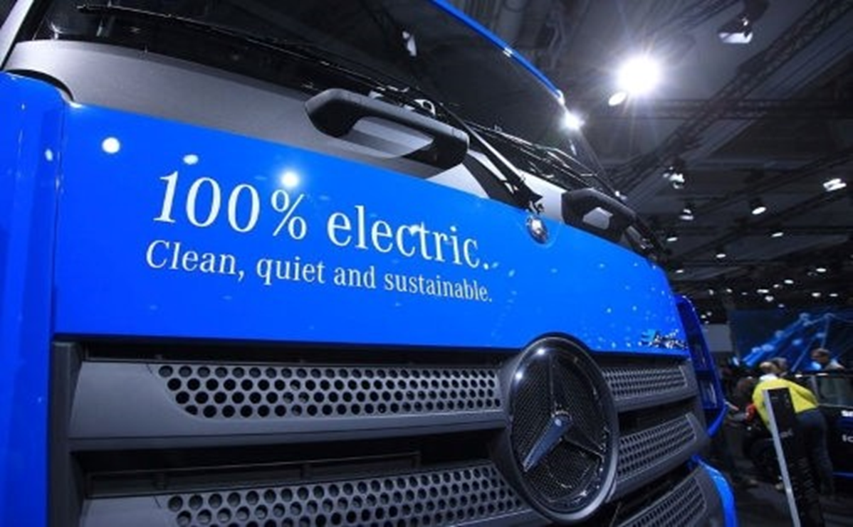
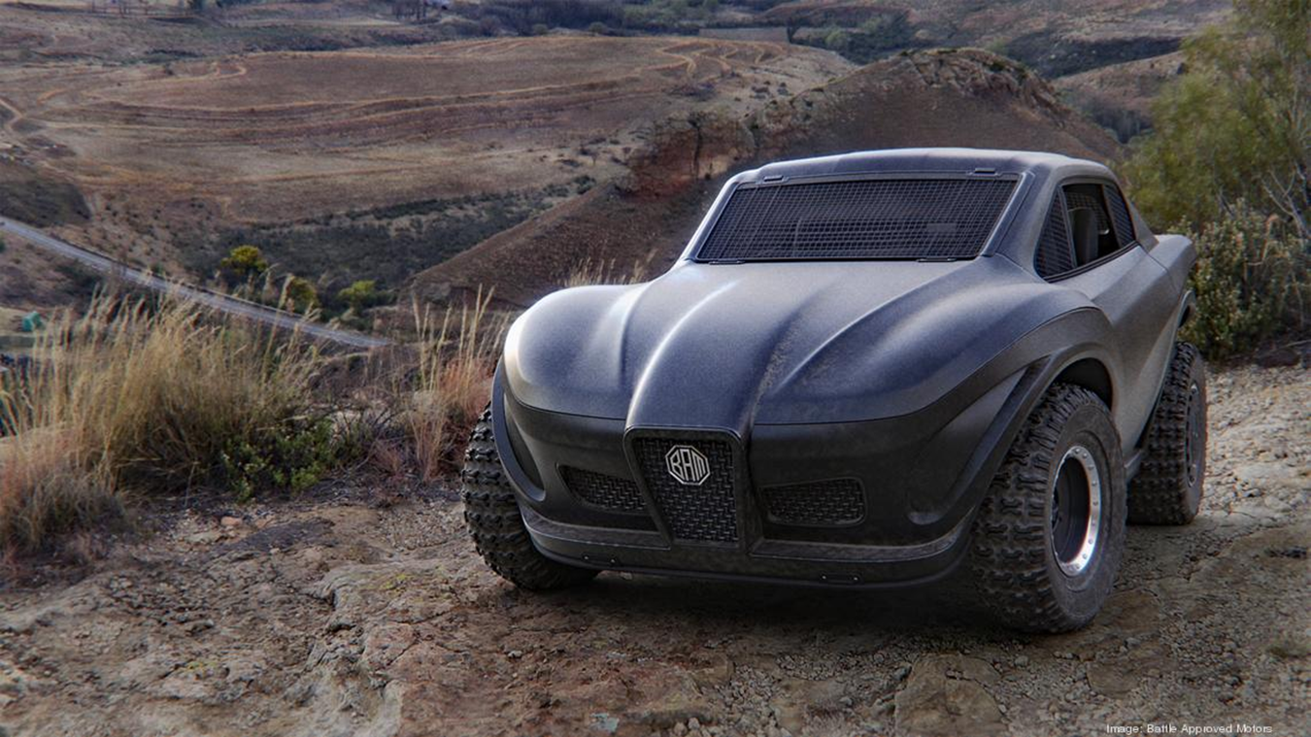
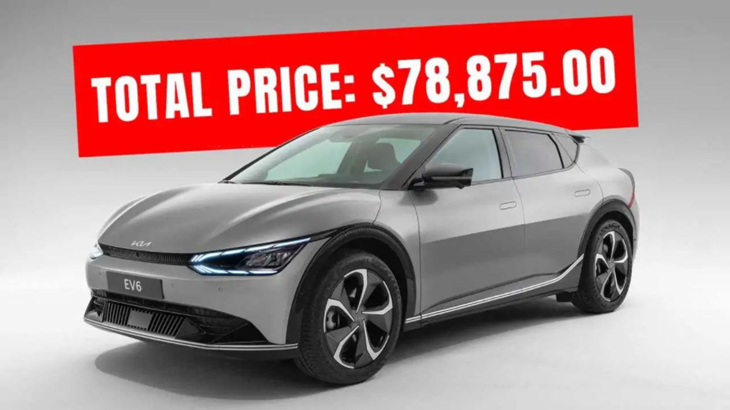
Electric Asphalt Spreader
Bam builds world’s first fully converted electric paver in Netherlands
270kWh battery pack, 10 hours on a charge, less noise
Reduces fuel costs and CO2 and NOX emissions
Bam also built an electric asphalt roller in 2020

Slide 3
Electric Locomotives
Rio Tinto in Australia purchased four 7MWh battery electric locomotives
Charged at the port or mines
Capable of generating additional energy while in transit through regenerative braking

Slide 4
Charging for Electric HD Trucks
BlackRock, Daimler and NextEra Energy announce joint venture to spend $650M to deploy EV charging and hydrogen refueling stations for electric and hydrogen fuel cell trucks in the US
Build network of charging sites on freight routes on east and west coasts by 2026

Slide 5
Battle Approved Motors
Phoenix – early stage start up
Building an electric UTV – utility task vehicle
“Ferrari meets Tesla in the dirt.”

Slide 6
EV Dealer Price Hikes
On-going chip shortage putting a strain on the new EV market.
Dealers are reporting limited inventories
Number of dealerships marking up high demand cars.
Mustang Mach-E
Mercedes Benz EQS
Kia EV6 – dealer in IL asking $19,000 over MSRP

