Slide 1
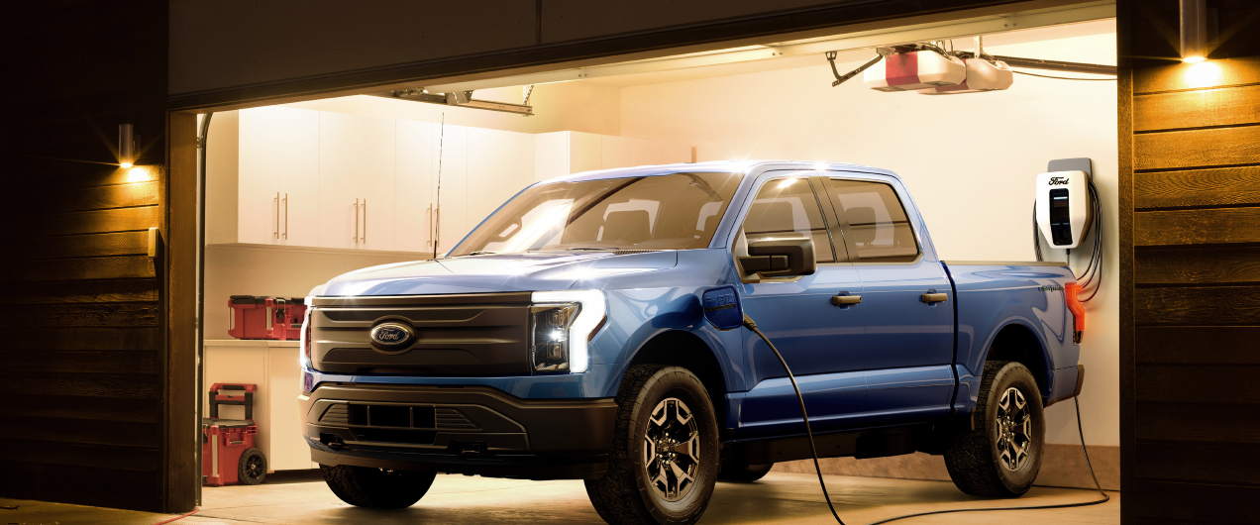
City of Phoenix
Electric Vehicle Ad Hoc Committee Meeting
May 6, 2022
April 26, 2022: F-150 Lightning rolled off the production line. 600,000 by end of 2023, 2M by 2026

Slide 2
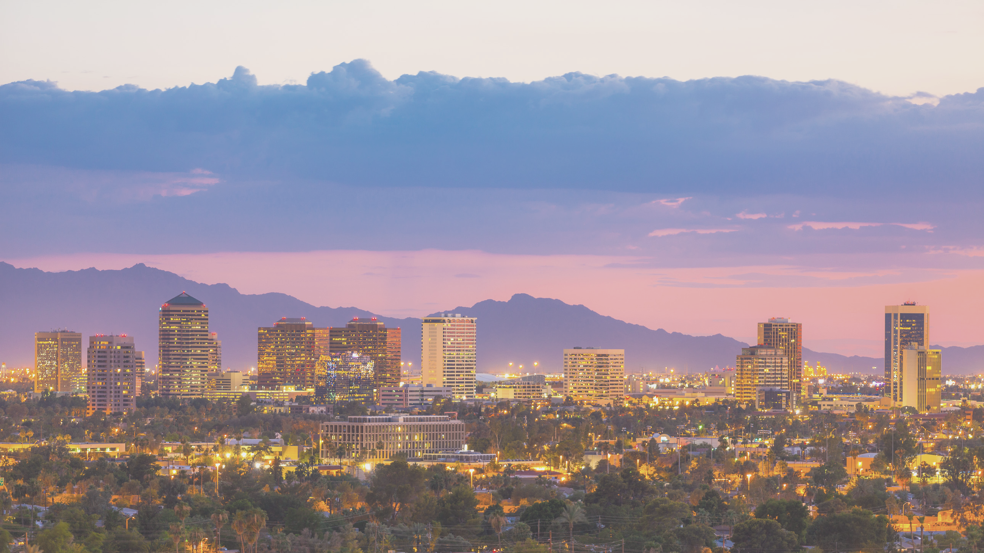
Transportation Electrification Options for Underserved Communities in Phoenix
EV CHANGERS: Stephanie Davis, Stephanie Georgiou, Izzy Tsark, Adrian Keller, and Sam Dent
Notes:
Stephanie Georgiou:
Hello Everyone! We are the EV Changers team and we are here to present on "Transportation Electrification Options for Underserved Communities in Phoenix".

Slide 3
Our Team
Stephanie
Georgiou
Stephanie
Davis
Izzy
Tsark
Adrian
Keller
Sam
Dent
Notes:
Stephanie Georgiou:
Our team consists of myself, Stephanie, another Stephanie, Izzy, Adrian, and Sam.

Slide 4
Project Partners
Karen Apple
City of Phoenix
EV Program Manager
Mindy Davis
City of Surprise
Code Enforcement Supervisor
Courtney Anderson
City of Phoenix
Community Engagement Manager
Notes:
Stephanie Georgiou:
We were fortunate enough to work with 3 amazing project partners. Our primary partner was Karen Apple, who is the EV Program Manager for the City of Phoenix and was the one who spearheaded the ideas for this project. Next we worked with Mindy Davis and Courtney Anderson from the City of Phoenix Housing Department to get us connected with a local community in Phoenix. These two were the ones who had existing relationships with residents of the Edison-Eastlake Community and welcomed us to attend community events and engage with residents directly.

Slide 5
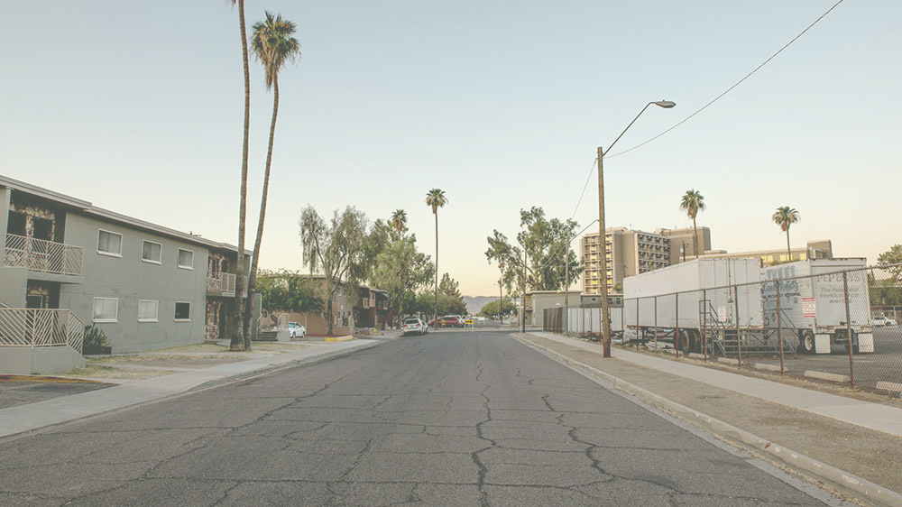
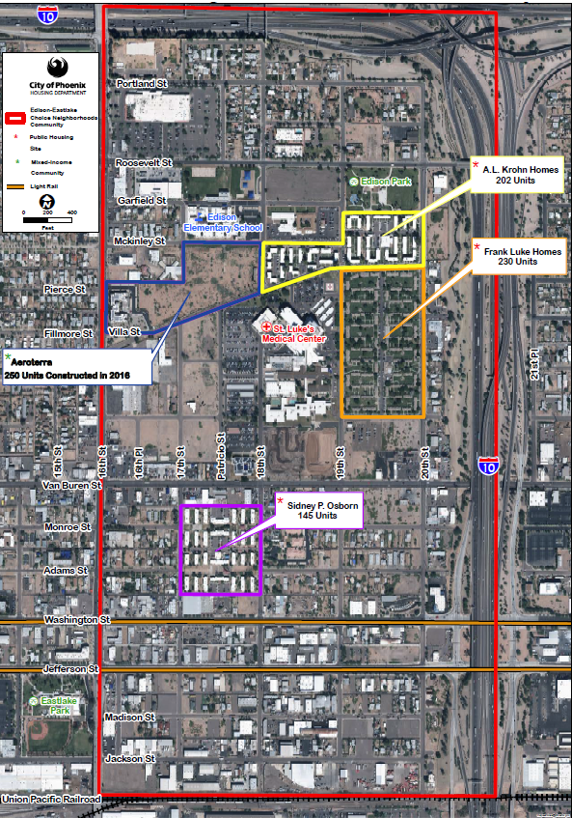
Project Context
Edison-Eastlake Community (EEC):
Noise pollution, urban heat island, limited shading, no light rail stops, etc.
1 in 5 children have asthma
50% car ownership
Transportation accounts for 47% of Phoenix emissions
Electric Vehicles (EV's): Any fully electric mode of transportation - electric bikes, cars, scooters, etc.
EV Equity: Distribution of EV products and services in a way that meets the diverse needs of our communities.
Notes:
Stephanie Georgiou:
Before getting into the depth of our project, we would like to mention our community of focus and define 2 important terms. The Edison-Eastlake Community is a robust and diverse community that falls within the pocket of the 1-10 and is located about 2 miles from Downtown Phoenix. This community faces a lot of noise pollution from overhead planes and freeway noise along with significantly higher temperatures. Even with only 50% of residents in the community owning vehicles, 1 in 5 children experience asthma here due to pollution. Overall, 47% of total emissions in Phoenix are caused by transportation.
There are 2 terms we would like to define. First we will be referencing Electric Vehicles quite a bit, which we define as any fully electric mode of transportation. Next, we define EV Equity as "the distribution of EV products and services in a way that meets the diverse needs of our communities".
We do acknowledge that EV's alone are not a perfect climate solution and contribute to levels of environmental degradation in their lifecycle. But we do see them as a significant piece of the solution to reduce transportation related emissions. And now here is Sam to go over the details of our project!

Slide 6
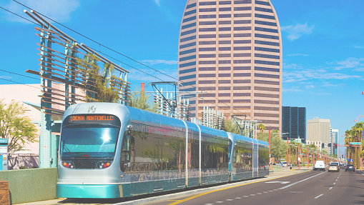
Our Mission:
To understand and communicate transportation needs of the Edison-Eastlake Community in order to provide equitable electric mobility options.
Our Vision:
Fostering equitable access to electric transportation throughout the City of Phoenix in order to improve air quality, community health, and achieve carbon neutrality.

Slide 7
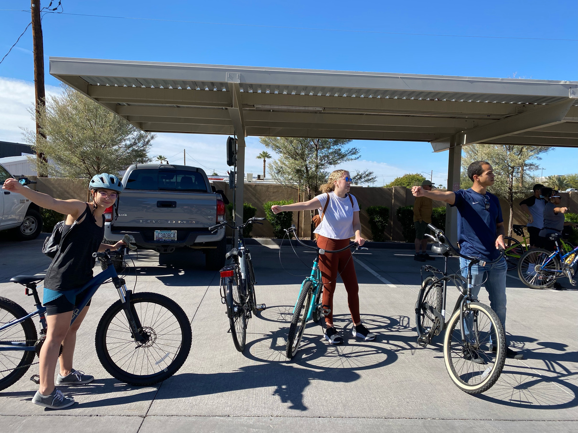
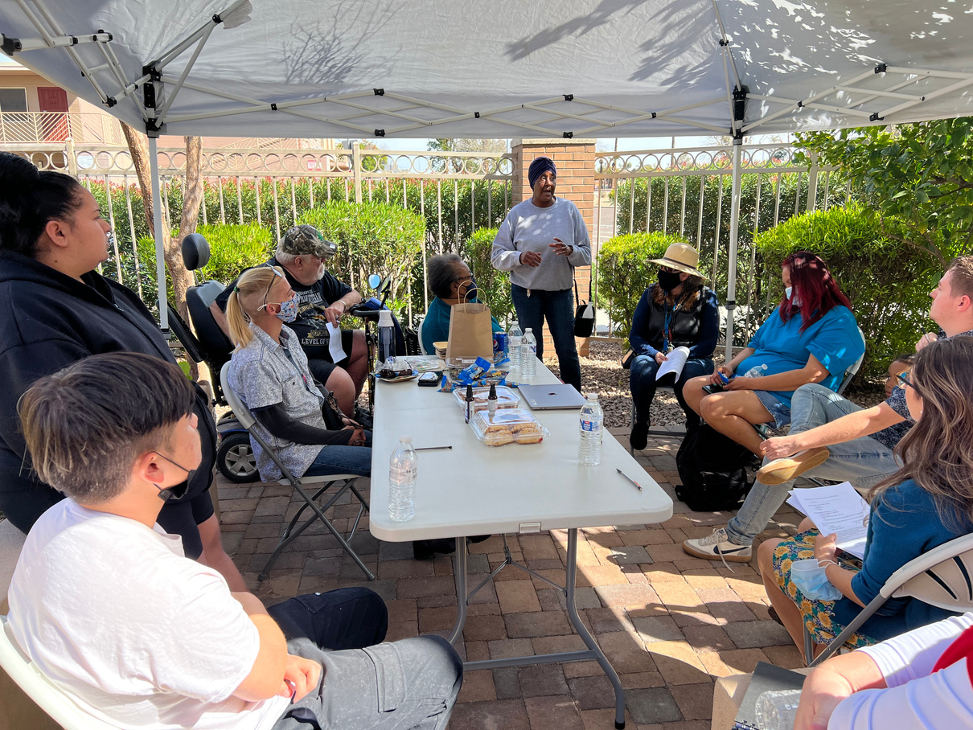
Project Overview
Distributed EV & Transportation survey and held a listening session
Analyzed survey data to make recommendations for City of Phoenix
Conducted cost analysis and comparative city analysis
Presenting recommendations to EV Ad Hoc Committee
Notes:
Sam Dent:
Our team has taken a series of steps to approach this project. To better understand the transportation wants and needs of the EEC and their perception of EVs, we distributed a survey. We also conducted a listening session with community members and attended two community bike rides to gain context and additional insights to the survey responses.
Then, we took the responses and what we heard from residents, identified trends and information of critical importance, and included them into our recommendations.
We also looked at what other cities have done with EVs and the associated costs of micro-mobility options to identify some best practices and determine which options might be the most feasible.
Following our presentation here, in early May we plan to present our recommendations to the EV Ad Hoc Committee, where our project may help inform some of their efforts to equitably electrify the Phoenix Metro.

Slide 8
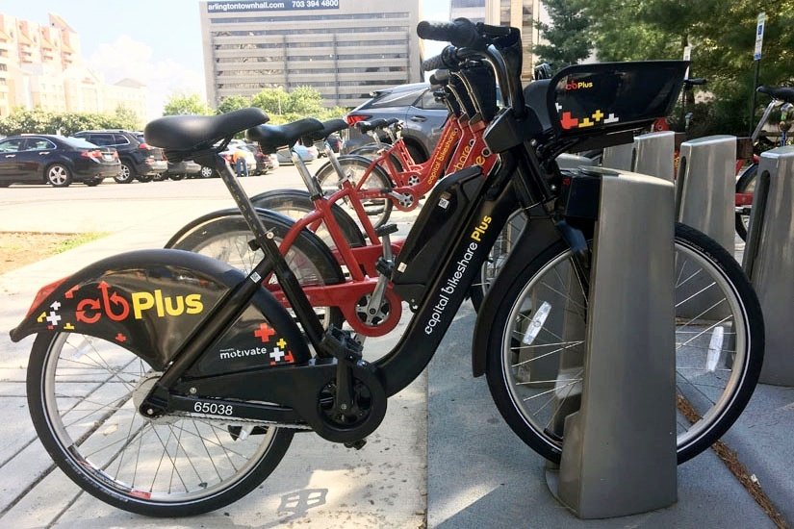
Cost Analysis
Program Feature | Approximate Cost
Cost per e-bike | $1,500 - $2,400
Cost per e-bike docking station (15-19 bikes) | $40,000 - $50,000
Operating cost per e-bike (Admin, Labor, Technology) | $900-$3,500 annually
Operating cost per docking station | $1,730 annually
Kiosk and solar array | $12,000 per station
Cost per e-scooter | $1,000
Operating cost per e-scooter | $2,000 annually
Notes:
Sam Dent:
Our group used a basic cost analysis to determine which micro-mobility options might be the most feasible to close the last mile between EEC residents and other transit options. The costs of both e-bike and e-scooter programs tends to be fairly staggering. Capital Bikeshare, serving the DC Metro has reported running their program at a high operating deficit, upwards of a million dollars per year. You may have also noticed the high operating cost per bike in the table as well. This is largely due to expenses including redistributing bikes to meet community needs, maintenance and labor costs, and administration. The high costs may potentially prompt the need to work with existing private partners like Bird and Lime.
Some local governments have also adopted equitable practices to reduce costs for residents and ensure equitable distribution of transportation options. Capital Bikeshare offers $5 annual memberships for residents who qualify for federal assistance programs like SNAP. In Baltimore City's Dockless Vehicle Pilot Program, they have required vendors to place 25% of e-scooters in 15 equity zones based on income level.

Slide 9
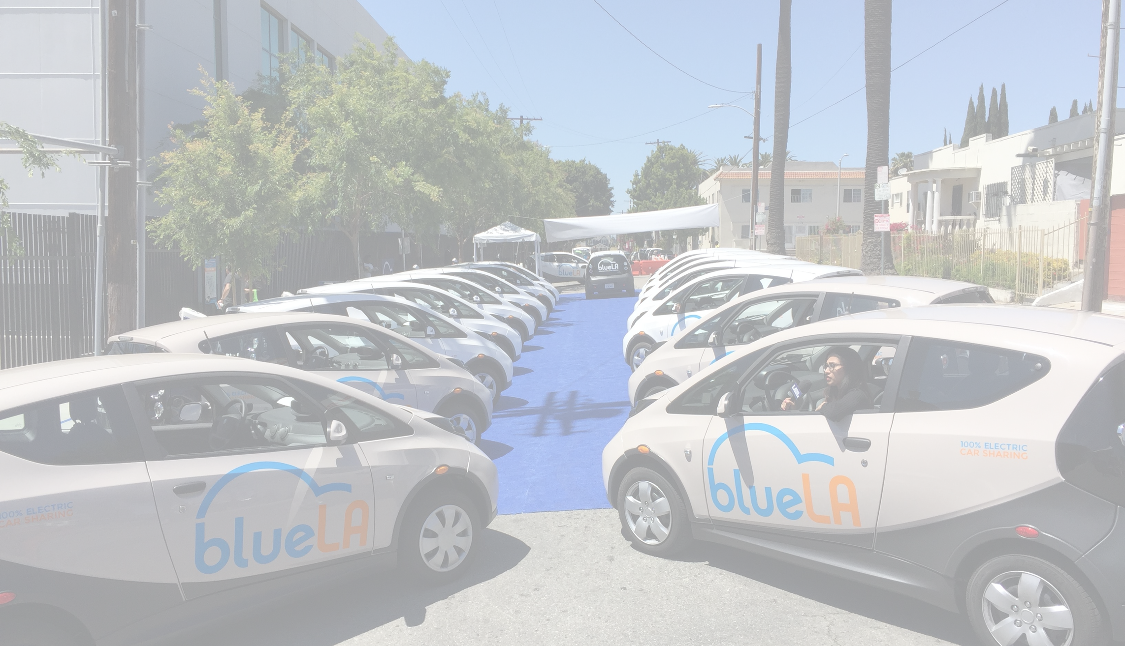
Los Angeles, CA
BlueLA EV car share
- 40 Locations
Comparative City Analysis
Seattle, WA
Prioritize dense, urban development and walkable communities.
Austin, TX
Plug-In Austin: unlimited charging to city residents for $4.17/month
Notes:
Adrian Keller:
We did a comparative city analysis that consisted of 12 cities, 10 located in the US and 2 internationally. We pulled out 3 of these cities whose programs stood out to us:
In LA, the BlueLA car sharing program allows residents in 40 locations to rent electric vehicles for short-term use at a low price, just like bike share, but with electric vehicles.
Seattle has a goal that half of all shared mobility (taxis, rideshare, bikes) be electric by 2030, in addition to updating their comp plan to prioritize dense, walkable neighborhoods as well as at least one city block entirely car-free. This is crucial as the best way to reduce transportation related emissions is to design cities that don't require cars.
Last, the Plug-In Austin initiative allows city residents unlimited access to public charging stations for only $4.17/month. There are already 1000s of chargers available which improves charging access particularly for folks who live in apartments and can't charge at home - a key reason holding many would-be EV owners back.

Slide 10
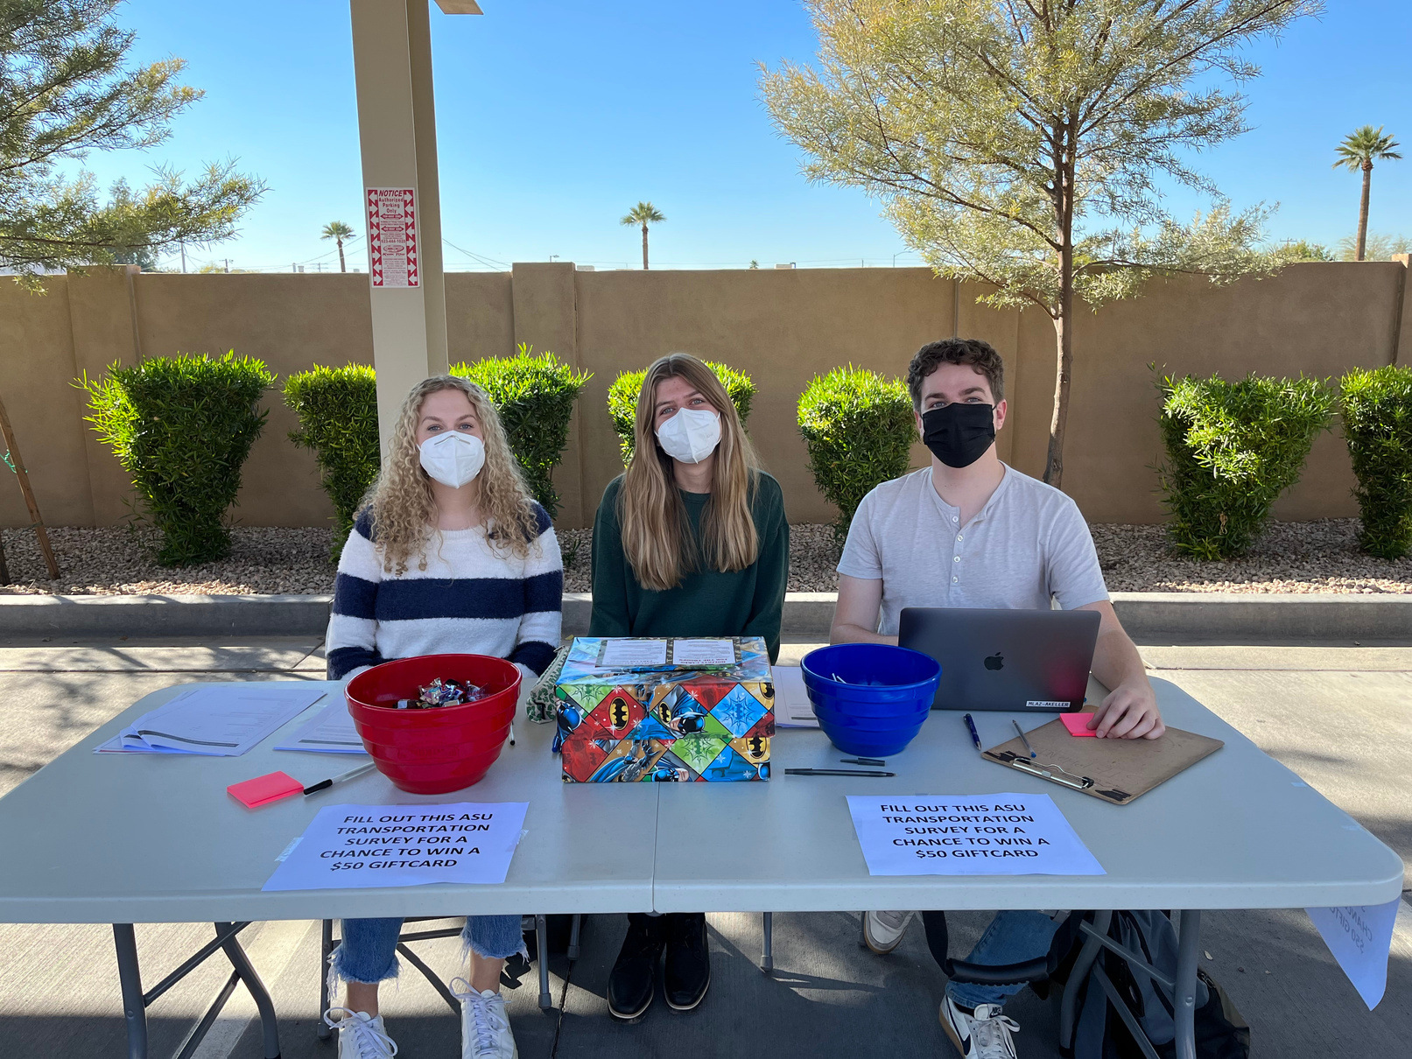
Survey Distribution
17 Questions about Transportation and EV's
Survey Monkey
Spanish and English
Email Notifications
Tabling Events
QR Code
Tablet Push Notifications
Newsletter Infographic
Notes:
Stephanie Davis:
Our survey consisted of 17 questions about transportation and electric vehicles. We used survey monkey, an online survey platform, to distribute our survey and made it available to residents in both spanish and english. We distributed it through email notifications, a QR code, a newsletter infographic, tablet push notifications through the tablets the housing department provided for residents, and tabling events outside of the EEC's monthly food bank. We found that attending tabling events was a super effective way to engage with residents in person and to get our survey filled out.

Slide 11
Survey Results
80%
55%
43%
Residents are somewhat or entirely unfamiliar with electric vehicles.
Residents felt owning an EV would positively impact their life.
Residents ride 10 miles or less per day in their personal vehicle.
Notes:
Stephanie Davis:
From our survey, we found out that 80% of residents were somewhat or entirely unfamiliar with electric vehicles. Even with the fact that 80% of residents aren't very familiar with EV's, 55% of residents still felt that owning an EV would positively impact their life - which we thought was incredibly interesting to point out! Imagine if the residents were knowledgable on EV's and how much that would change their responses. We also discovered that 43% of residents rode 10 miles or less, so we thought making recommendations surrounding micro mobility solutions would be most effective.

Slide 12
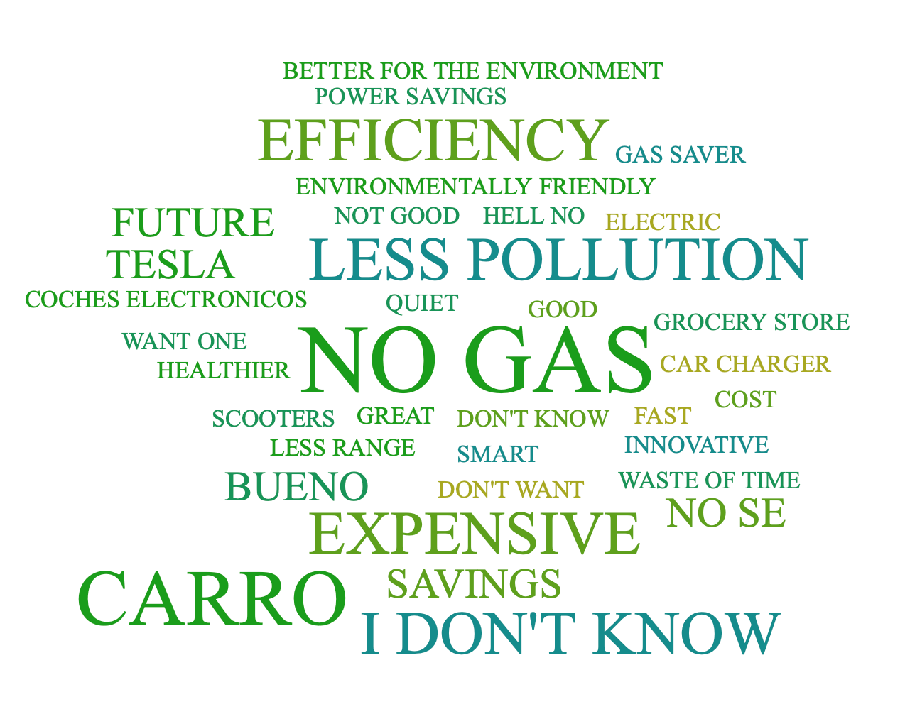
What's the first word/phrase that comes to mind when you think of Electric Vehicles?
Notes:
Stephanie Davis:
One of the questions we asked in our survey was what comes to mind when you think of Electric Vehicles? These are the results of that question, and as you can see there's a mix of answers and feelings.

Slide 13
Survey Results
56%
of residents indicated they would utilize public transit as their primary transportation method if it was expanded.
42%
of residents indicated rebates/vouchers as their first choice for city programs related to EVs.
78%
of residents indicated heat and long walks to destinations as being their primary public transit challenges.
Notes:
Izzy Tsark:
Furthermore, 42% of residents indicated that they would be most interested in EV rebate or voucher programs. This could be related to reducing the price of ride share programs, or even to help with the purchase of a personal electric car. 78% of residents cited heat and long walks as their primary challenge regarding public transportation (No surprise there). Interestingly, 56% of residents indicated they would utilize public transit as their primary mode of transportation if it were better connected, and expanded to go to more destinations.

Slide 14
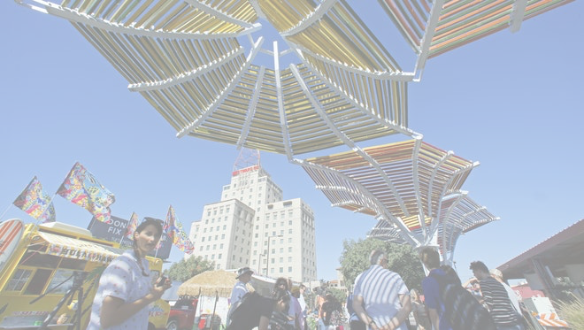
Recommendations (4 C's)
Short Term: 0-3 years, Mid Term: 3-6 years, and Long Term: 6-9 years
Cooling
Climate
Short Term:
Add shading at bus stops, on walking paths, and at docking stations for bikes and e-scooters
Mid Term:
Offer ride share discounts for EV or hybrid options.
Long Term:
Have interconnected system of cooling corridors in and around the EEC.
Short Term:
Increase number of publicly available AC plugs in EEC and surrounding areas
Mid Term:
Offer rebates and vouchers to residents to increase EV ownership to meet Phoenix Climate Action Plan goals
Long Term:
Install publicly available EV Charging Stations throughout EEC
Notes:
Izzy Tsark:
Once we closed our survey, we compiled our data to make our recommendations - which we are calling the 4 C's of EV's: Cooling, Climate, Connectivity, and Cost. We broke each of these categories into 3 parts: short term, which is 0-3 years, mid term, which is 3-6 years, and long term, which is 6-9 years.
As mentioned previously, 78% of our respondents cited heat as one of the primary challenges they face with transportation, so Cooling tactics are something we feel should be heavily invested in. We recommend that the City focus on adding shading at bus stops, walking paths, and docking stations for bikes and e-scooters as soon as possible. Any existing plans to integrate shading structures at existing public rest points should be expedited. For our mid-term goals, we recommend the city offer residents ride share discounts for EV options. Making EV ride shares accessible will keep residents out of the heat while also accelerating City climate goals. In the long term, the City should consider building out an interconnected system of cooling corridors within and around the EEC. The Cool Corridor project is ongoing in the City of Phoenix, and we recommend the EEC should be prioritized as a candidate for this project.
To create a climate positive environment that will help the City meet the emissions reduction goals outlined in the 2021 Climate Action Plan, we have outlined steps to decarbonizing transportation. To encourage the use of e-bikes and e-scooters, we recommend the City increase the number of publicly available AC plugs in the community. Next, rebate and vouchers should be made available to increase EV ownership. Once demand has increased for EV charging infrastructure, the installation of publicly available EV charging stations throughout the EEC should be prioritized.

Slide 15
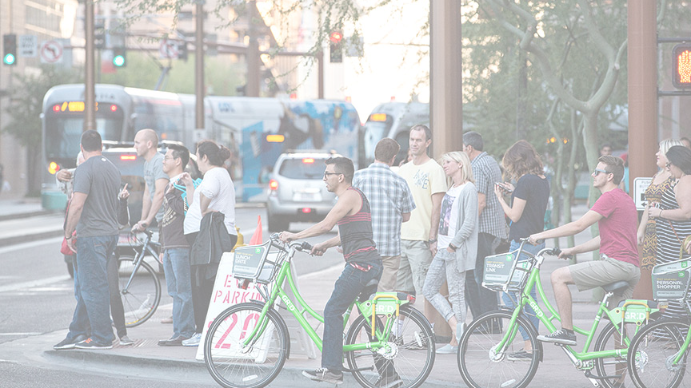
Recommendations (4 C's)
Short Term: 0-3 years, Mid Term: 3-6 years, and Long Term: 6-9 years
Connectivity
Cost
Short Term:
Advertise the number for PHX CARES program at transit stops
Mid Term:
Partner with a local bike co-op and offer courses about bike use/care
Long Term:
Increase micro-mobility solutions (including e-bike share, frequent circulator bus, or e-scooter share)
Short Term:
Sell or donate existing Grid Bikes leftover in EEC and invest in cool infrastructure
Mid Term:
EV car share option (possibly with ENVOY)
Long Term:
Offer a low-cost monthly or yearly subscription plan to L2 charging stations
Notes:
Adrian Keller:
Connectivity:
In the short term, we want to improve the experience of existing public transportation systems by responding to complaints about safety.
Bicycles are an incredibly important low-carbon solution. A mid term goal could include betteA local bike co-op could educated folks about bike use and care, including how to use bikes on public transportation.
In the long-term, there is a clear need for comprehensive, sustainable micro mobility solutions that will connect residents from the bus stop to their final destination. This may come in the form of e-bike or e-scooter sharing programs, or even a circulator bus.
COST:
Currently, the housing department is in position of close to 50 grid bikes leftover from when the company went out of business. As these are rarely used, we recommend they be donated or sold at a deep discount to EEC residents and the money be invested in one of these longer term solutions, like car share.
Boston and LA currently have successful car share programs underway, in which only specific neighborhoods have access to rent electric vehicles for a few hours or the day at a discounted rate. This is particularly important for folks who need to travel longer distances infrequently and for which train and rail is insufficient.
In the long term, we anticipated personal ownership of EVs will grow in the EEC but also in the city as a whole, particularly as the used EV market grows. Phoenix currently owns and operates L2 chargers on public lands (like libraries and parks) and the plan is to steadily install more. What if folks under a certain income threshold had access to all of the public chargers in the city for a low annual rate of $10 or $15? What a difference that would make for families who would be able to slash their transportation fuel costs to almost nothing. This is similar to Austin's Plug in Austin program and would bring the benefits of EVs to so many people in Phoenix, particularly those living in apartments

Slide 16
Thank You
Notes:
Adrian Keller:
Thank you so much for your time and we open the floor to any questions you may have!

Slide 17
Roadmap Outreach
Facebook Boosts and Ads √
Twitter/Nextdoor Posts √
PHX Connect Employee Newsletter √
EV Survey (Spanish/English) √
EV Webpage √
Village Planning Committees √
Planning Commission √
Env Quality & Sustainability Cmte √
Green Chamber
Greater Phoenix Chamber
AZ Forward √
Local Housing Developers √
Social Media
Boards & Commissions
Chamber of Commerce/Business
Guest Ride n Drive Event √
Edison Eastlake Community –√ tabling events, listening session, EV needs assessment survey
Special Events
Employee Groups
Equity Focused Stakeholders
COP Asian League √
COP Hispanic Network √
National Forum for Black Public Administrators √
COP Employees for Christ √
COP ADA Liaison Group √
CHISPA
Local First
HS Student Council Sustainability Officers √
Notes:
Survey – 617 responses to date
Attendees – approximately 600 presentation attendees

Slide 18
Roadmap Outreach – April Summary
15
12
5
Number of Outreach Events
Community Partners
Employee Groups
Over 600
Outreach Attendees
Survey Responses
Social Media Posts
1,031
Over 50

Slide 19
Roadmap Outreach – Feedback
Positive/Supportive
Desire to learn more about EVs and EV charging
Good for the environment
Too expensive
Reduce upfront purchase costs
More understanding about charging and maintenance costs
Battery costs are too high
Rebates and incentives for vehicle purchases (new and used)
Incentivize developers - install EV chargers
Employee vehicle purchase incentives
General
Costs
Incentives
Define equity and equity areas in EV Roadmap
ADA accessible EV parking stalls
Range anxiety
Permitting process slows EV charger installs
Waiting times at EV chargers
Training needed to transition ICE mechanics to EV
Equity
Infrastructure and Workforce Dev
Education & Outreach
Less technical info on initial outreach
More targeted outreach
Battery replacements and env impacts “cradle to grave”
Discuss maintenance and repair
Increased developer facilitation
Notes:
Survey – 617 responses to date
Attendees – approximately 600 presentation attendees

Slide 20
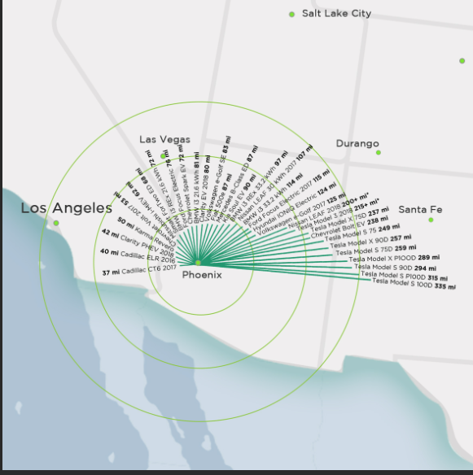
Draft EV Roadmap - Comment Discussion
1: EQUITY
American with Disabilities Act (ADA): Include space requirements to accommodate ADA EV owners
Ex. provide wider spaces at EV charger space locations/ADA compliant but not “marking”
Ex. 1 out of 10 charging stations – make 1 accessible
Program/pilot examples of Equity based projects implemented by other cities
Lack of EV chargers and strategy to install (charging deserts)
2: WORKFORCE DEVELOPMENT
Transition of ICE workforce and training required
3: EV CHARGING AND RANGE ANXIETY
EV ranges and distances (map or data)

Slide 21
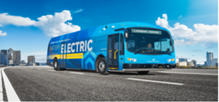
Draft EV Roadmap - Comment Discussion – con’t
4: FOCUS ON ALL TYPES OF ELECTRIC VEHICLES NOT JUST “CARS”
All electrified modes of transportation and document name change
Ex. Transportation Electrification Roadmap vs EV Roadmap
5: COSTS
Total cost of ownership information
Gas tax and revenues
Total cost of ownership
Comparable city program costs
6: DEVELOPERS
Incentive programs and permitting processes
POWER GRID AND AVAILABILITY OF ELECTRICITY
APS and SRP grid capacity, existing and future
Managed charging (daytime/nighttime– offpeak vs peak)
City’s use of solar for EV charging stations

Slide 22
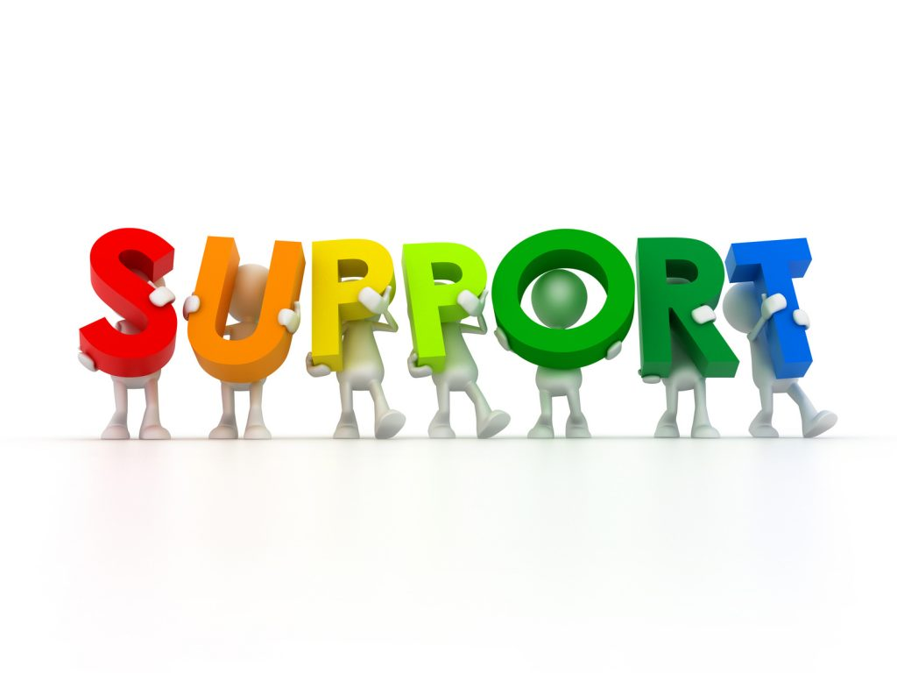
Key Take-Aways
Strong support
Equity focused EV education and outreach campaigns and initiatives
Public and Employee incentive programs to lower costs
Increase in Public and Employee EV charging locations
Equity focused pilot programs
Electrify all modes of City transportation

Slide 23
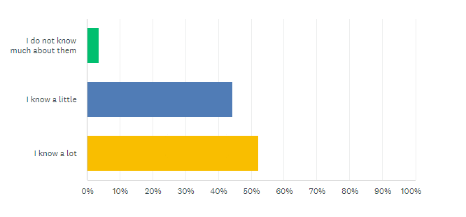
EV Survey – Results Overview – Q1
Opportunity to increase education and awareness
4%
44%
52%

Slide 24
EV Survey – Results Overview – Q2
Over 65% own 2-3 vehicles
4%
44%
52%

Slide 25
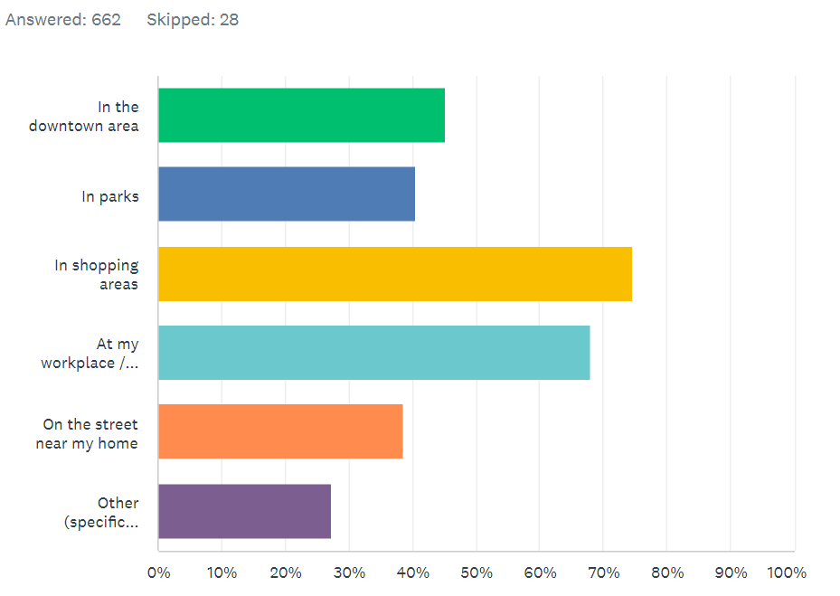
EV Survey – Results Overview – Q3
Top 3 Locations
Shopping Areas
Workplace
Downtown Phoenix
45%
40%
74%
67%
38%
27%

Slide 26
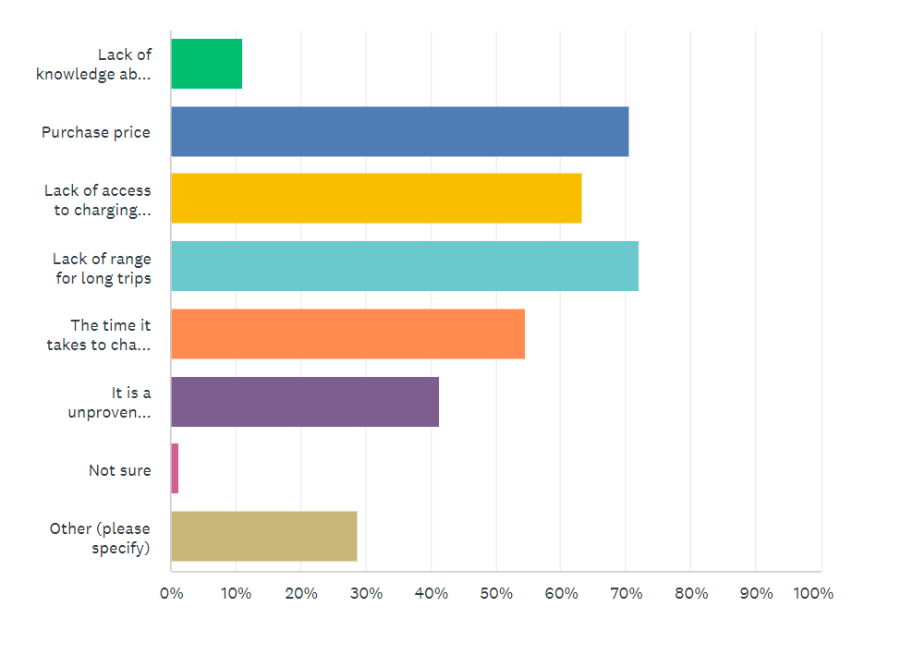
EV Survey – Results Overview – Q4
Top 5 Barriers
Lack of Range
Purchase Price
Lack of Access to Charging
Charging Time
Unproven Technology
11%
70%
63%
72%
54%
41%
1%
28%

Slide 27
EV Survey – Results Overview – Q5
Top 3 Locations
Shopping Areas
Workplace
Downtown Phoenix
45%
40%
74%
67%
38%
27%

Slide 28
EV Survey – Results Overview – Q6
Top 3 Locations
Shopping Areas
Workplace
Downtown Phoenix
45%
40%
74%
67%
38%
27%

Slide 29
EV Survey – Results Overview – Q7
If you owned an EV and your employer or school offered free charging, would that encourage you to do the majority of your EV charging on days you drive in?
Top 3 Locations
Shopping Areas
Workplace
Downtown Phoenix
45%
40%
74%
67%
38%
27%

Slide 30
EV Survey – Results Overview – Q8
Top 3 Locations
Shopping Areas
Workplace
Downtown Phoenix
45%
40%
74%
67%
38%
27%

Slide 31
EV Survey – Results Overview – Q9
Top 3 Locations
Shopping Areas
Workplace
Downtown Phoenix
45%
40%
74%
67%
38%
27%

Slide 32
EV Survey – Results Overview – Q10
Top 3 Locations
Shopping Areas
Workplace
Downtown Phoenix
45%
40%
74%
67%
38%
27%

Slide 33
EV Survey – Results Overview – Q11
Top 3 Locations
Shopping Areas
Workplace
Downtown Phoenix
45%
40%
74%
67%
38%
27%

Slide 34
EV Survey – Results Overview – Q12
Top 3 Locations
Shopping Areas
Workplace
Downtown Phoenix
45%
40%
74%
67%
38%
27%

Slide 35
EV Survey – Results Overview – Q13
Top 3 Locations
Shopping Areas
Workplace
Downtown Phoenix

Slide 36
EV Survey – Results Overview – Q14
Top 3 Locations
Shopping Areas
Workplace
Downtown Phoenix
45%
40%
74%
67%
38%
27%

Slide 37
EV Survey – Results Overview – Q15
Top 3 Locations
Shopping Areas
Workplace
Downtown Phoenix
45%
40%
74%
67%
38%
27%

Slide 38
EV Survey – Results Overview – Q16
Top 3 Locations
Shopping Areas
Workplace
Downtown Phoenix
27%

Slide 39
EV Survey – Results Overview – Q17
Top 3 Locations
Shopping Areas
Workplace
Downtown Phoenix

Slide 40
Timeline: April to June
EV Roadmap Outreach Activities
Comment Review and Consolidation – Revise EV RM
Spanish Translation of EVRM
City Council Mtg
Post Final EVRM and Survey Results
April - May
Early – Mid May
Late May – Early June
Late June

