Slide 1
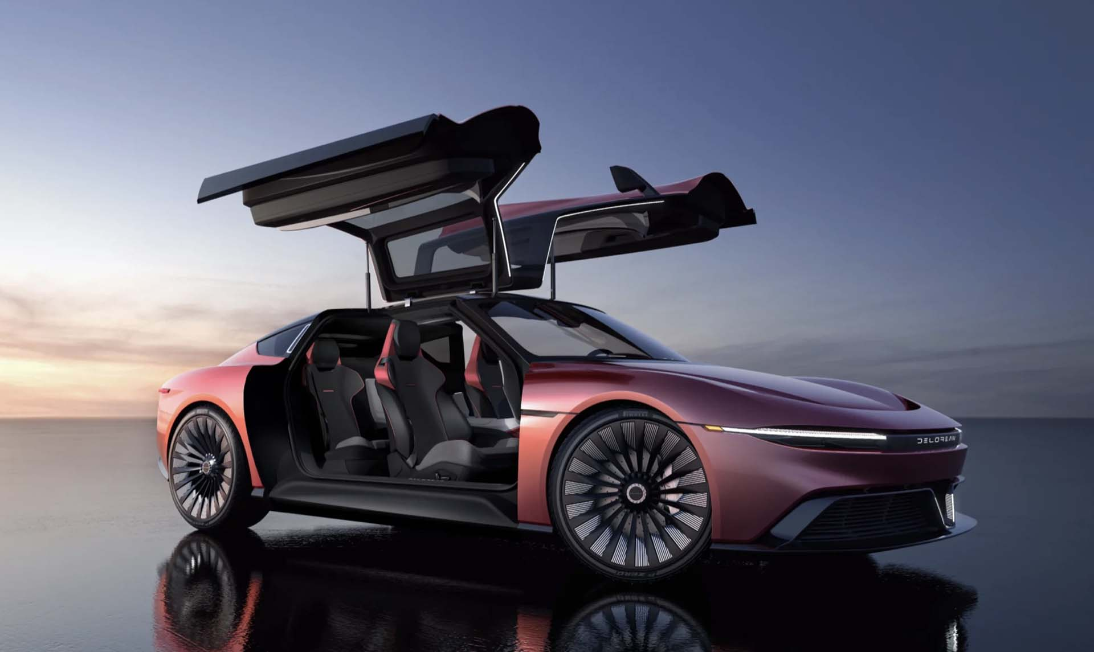
City of Phoenix – Friday June 3, 2022
Electric Vehicle Ad Hoc Committee Meeting
BACK TO THE FUTURE: DeLorean Alpha5 EV: 100 kWh battery pack, 60 mph in 3.0 seconds, 300+ miles of range

Slide 2
Community Outreach Overview
40
1,565
25,931
Community
Meetings
Community Survey Responses
Social Media Engagements
Village Planning Committees
Boards & Commissions
Employee Groups
Community Partners
Events
Spanish and English
759
Written Comments
English and Spanish
Likes
Comments
Shares

Slide 3
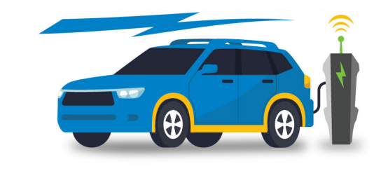
City Council Action – June 15

Slide 4
Key Recommendations
1: ADDING A FULL TIME ELECTRIC VEHICLE PROGRAM MANAGER
Staff Recommendation: Now included in the proposed 2023-2024 budget
2: LAUNCH A ROBUST EDUCATION & AWARENESS CAMPAIGN
Staff Recommendation: Coordinate this campaign through the City’s EV Program Manager
3: CONDUCT LISTENING SESSIONS IN UNDERSERVED COMMUNITIES AND LAUNCH A MOBILITY PILOT
Staff Recommendation: The City will be hiring an AmeriCorps Vista starting this summer. Specific mobility solutions will depend on community input but could be met through potential City programs such as cool corridors, bike/scooter share, and a low-income carshare program.
4: EXPAND ACCESS TO PUBLIC EV CHARGING in line with Climate Action Plan Goals
Staff Recommendation: Apply for federal Infrastructure Bill Funding

Slide 5
Key Recommendations
5: ADD 200 ELECTRIC VEHICLES TO THE CITY FLEET BY 2030 in line with the Climate Action Plan Goals
Staff Recommendation: Include EVs as part of the fleet replacement cycle provided, they meet business needs and are cost-competitive—i.e., will result in fuel and maintenance savings
6: PILOT THE ELECTRIFICATION OF HEAVY-DUTY VEHICLES IN THE CITY FLEET
Staff Recommendation: Utilize federal funding opportunities to pilot solutions
7: CONDUCT A CITYWIDE EV INFRASTRUCTURE ANALYSIS TO DETERMINE INFRASTRUCTURE NEEDS
Staff Recommendation: Now included in the proposed 2023-2024 budget

Slide 6
Other Recommendations
Streamline permitting process for EV Charging Station Installations
Encourage businesses to promote employee and customer “daytime EV charging” to reduce impact on utility peak times (4pm – 7pm)
Develop draft EV-ready building codes for industry consultation
Support trades training for EV maintenance

Slide 7
Timeline
Spanish Translation of TEAP
City Council Mtg
“Adoption”
Post and Distribute Final TEAP
Media Event
May 21 – June 13
June 15
June 15
June 16

Slide 8
THANK YOU!

