Slide 1
City of Phoenix
Electric Vehicle Ad Hoc Committee Meeting
February 4, 2022
2022 Kia EV6 – Starting price of $40,900, 167 HP motor and 58 kWh battery pack delivering a 232-mile EPA range. Eligible for full federal tax credit of $7500. Available in early spring 2022

Slide 2
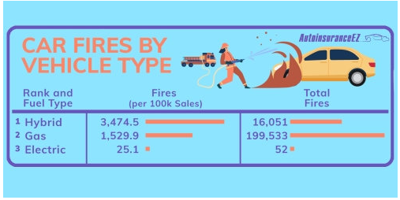
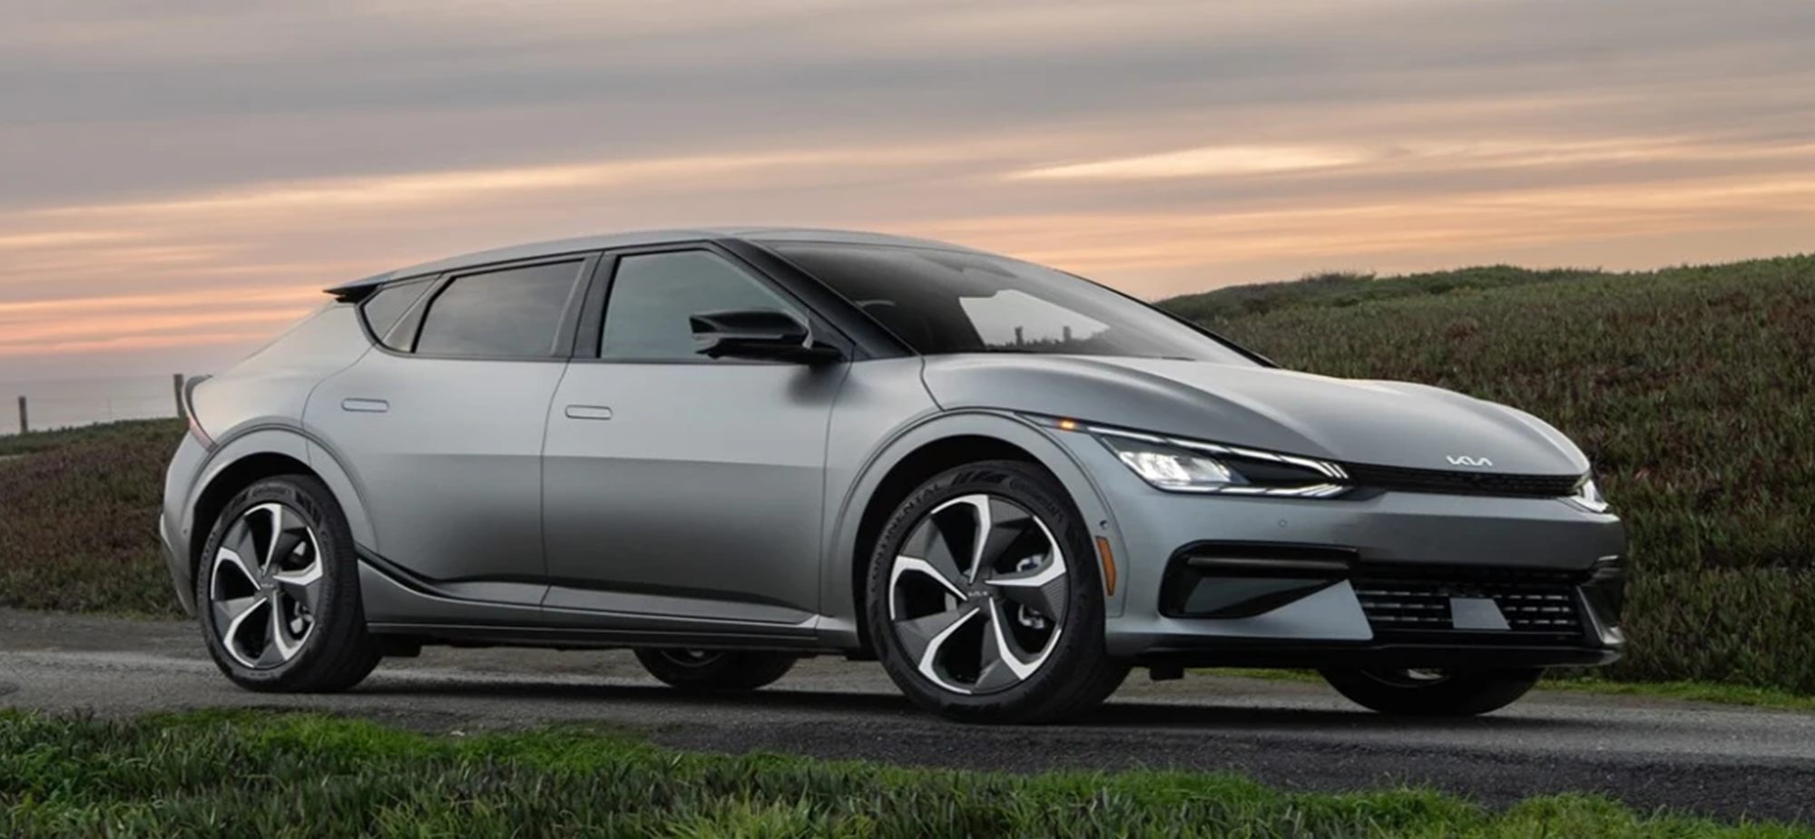
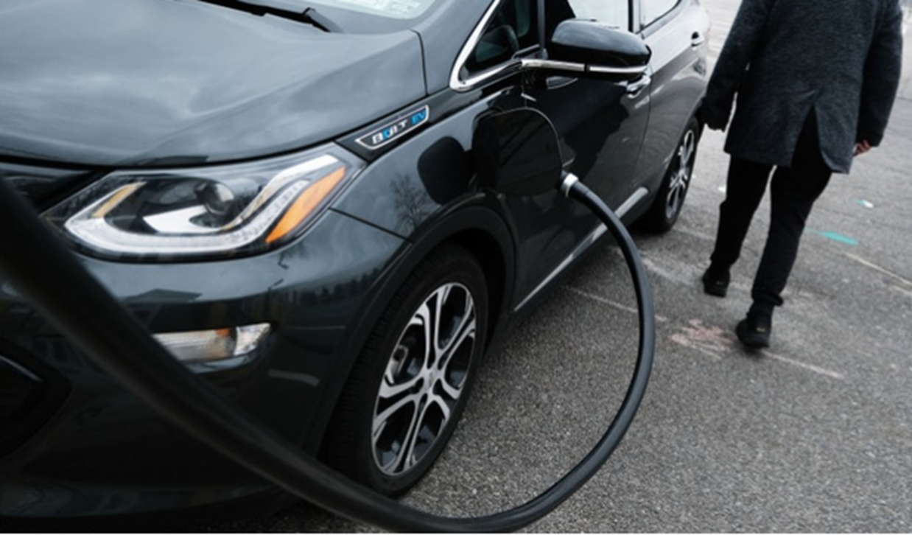
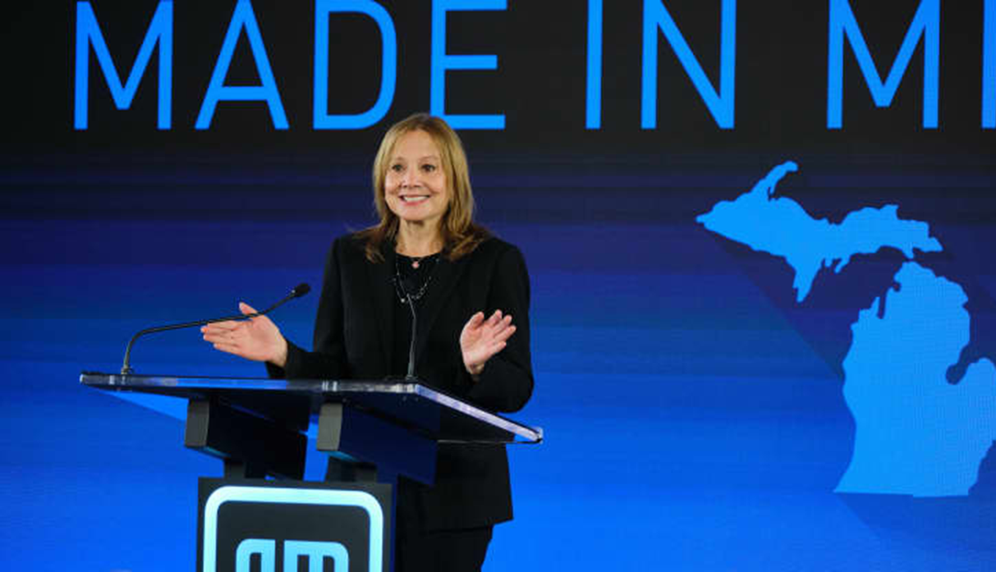
EV Fires Less Common Than ICE Fires
AutoInsuranceEV compared data from NTSB, BTS and gov’t recalls
ICE vehicles 10x more likely to catch fire compared to BEVs
Increased Hybrid fires as they use 100% of energy directly from gas

Slide 3
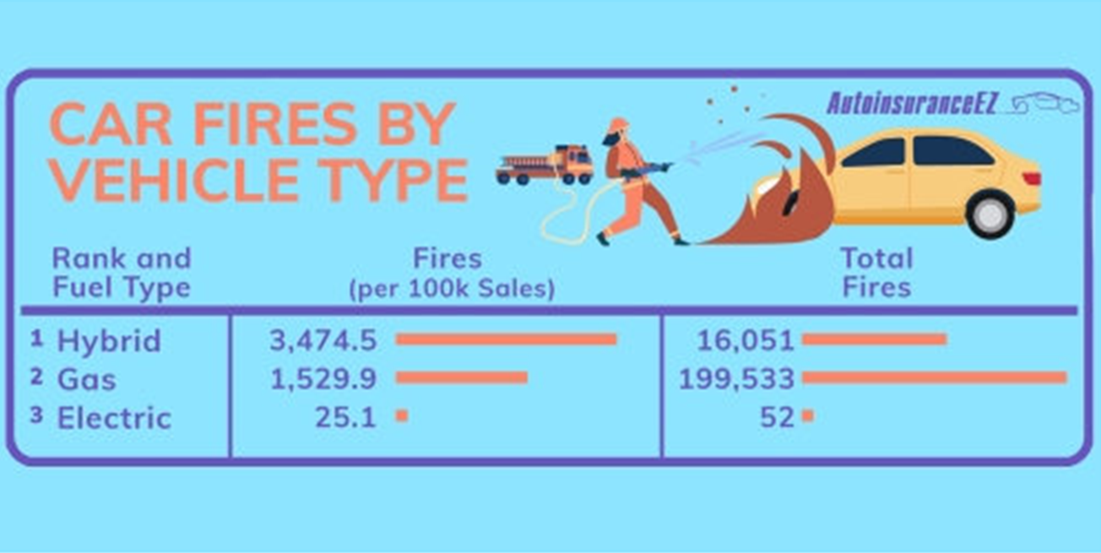
In the News
Electric School Buses
CALSTART has released a new report, Zeroing in on Electric School Buses
September 2021 = 1,738 ESBs in US/Total 480,000 SBs and over 95% powered by diesel
SBs prime candidates for electrification:
Sit idle for long periods, can provide V2G applications;
Minimizing schoolchildren from breathing diesel fumes

Slide 4
In the News
Bentley
Invest over $3.3M as it shifts to EV production
Release three EVs in the next three years
After 2025 new model announced every year
Exclusively produce EVs and be carbon neutral by 2030

Slide 5
In the News
Washington DC
EV Parking Requirements
Joins growing list of cities requiring new buildings to include EV parking
New and refurbished commercial and multi-unit buildings with at least 3 off road parking spaces, must make at least 20% of those spaces available for EVSEs
In response to MF concerns
Approved in Nov 2020, part of city’s goal to have at least 25% of new BEVs registered by 2035

Slide 6
In the News
GM Announcements
On Jan 25, 2022 – CEO Mary Barra announced:
$2.6B to build a new joint venture battery cell plant with LG Energy Solution (3rd battery plant)
$4B to convert a Michigan assembly plant to produce electric pick-up trucks
Increase capacity to build 1M EVs by 2025
Sell more than 1M EVs globally by mid decade to overtake Tesla as top seller

Slide 7
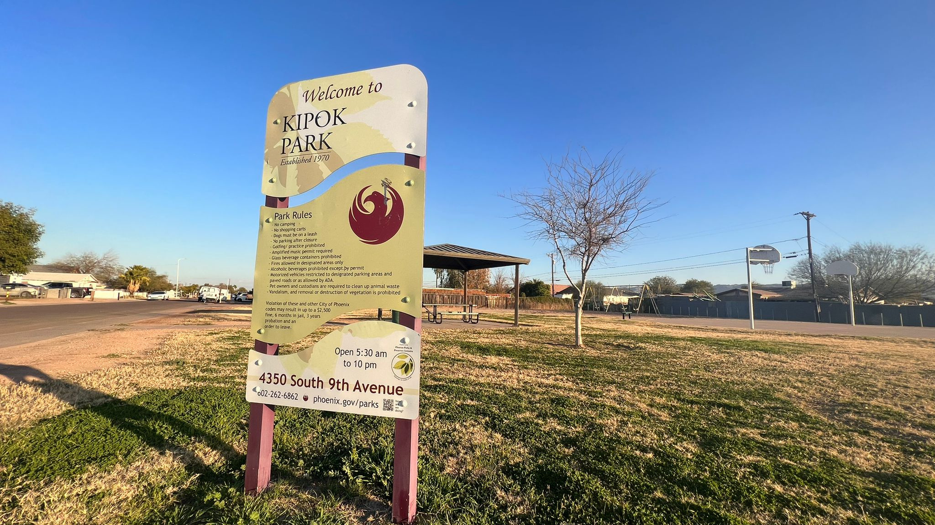
City of Phoenix
EV Ad Hoc Full Committee
Justice40 Initiatives Overview
February 4, 2022

Slide 8
Overarching guiding Justice 40 goals and principles
01
02
03
Maximize restorative investments in underserved communities.
Achieve transformational change with bottom-up decision-making.
Help institutionalize equity and justice from the inside.

Slide 9
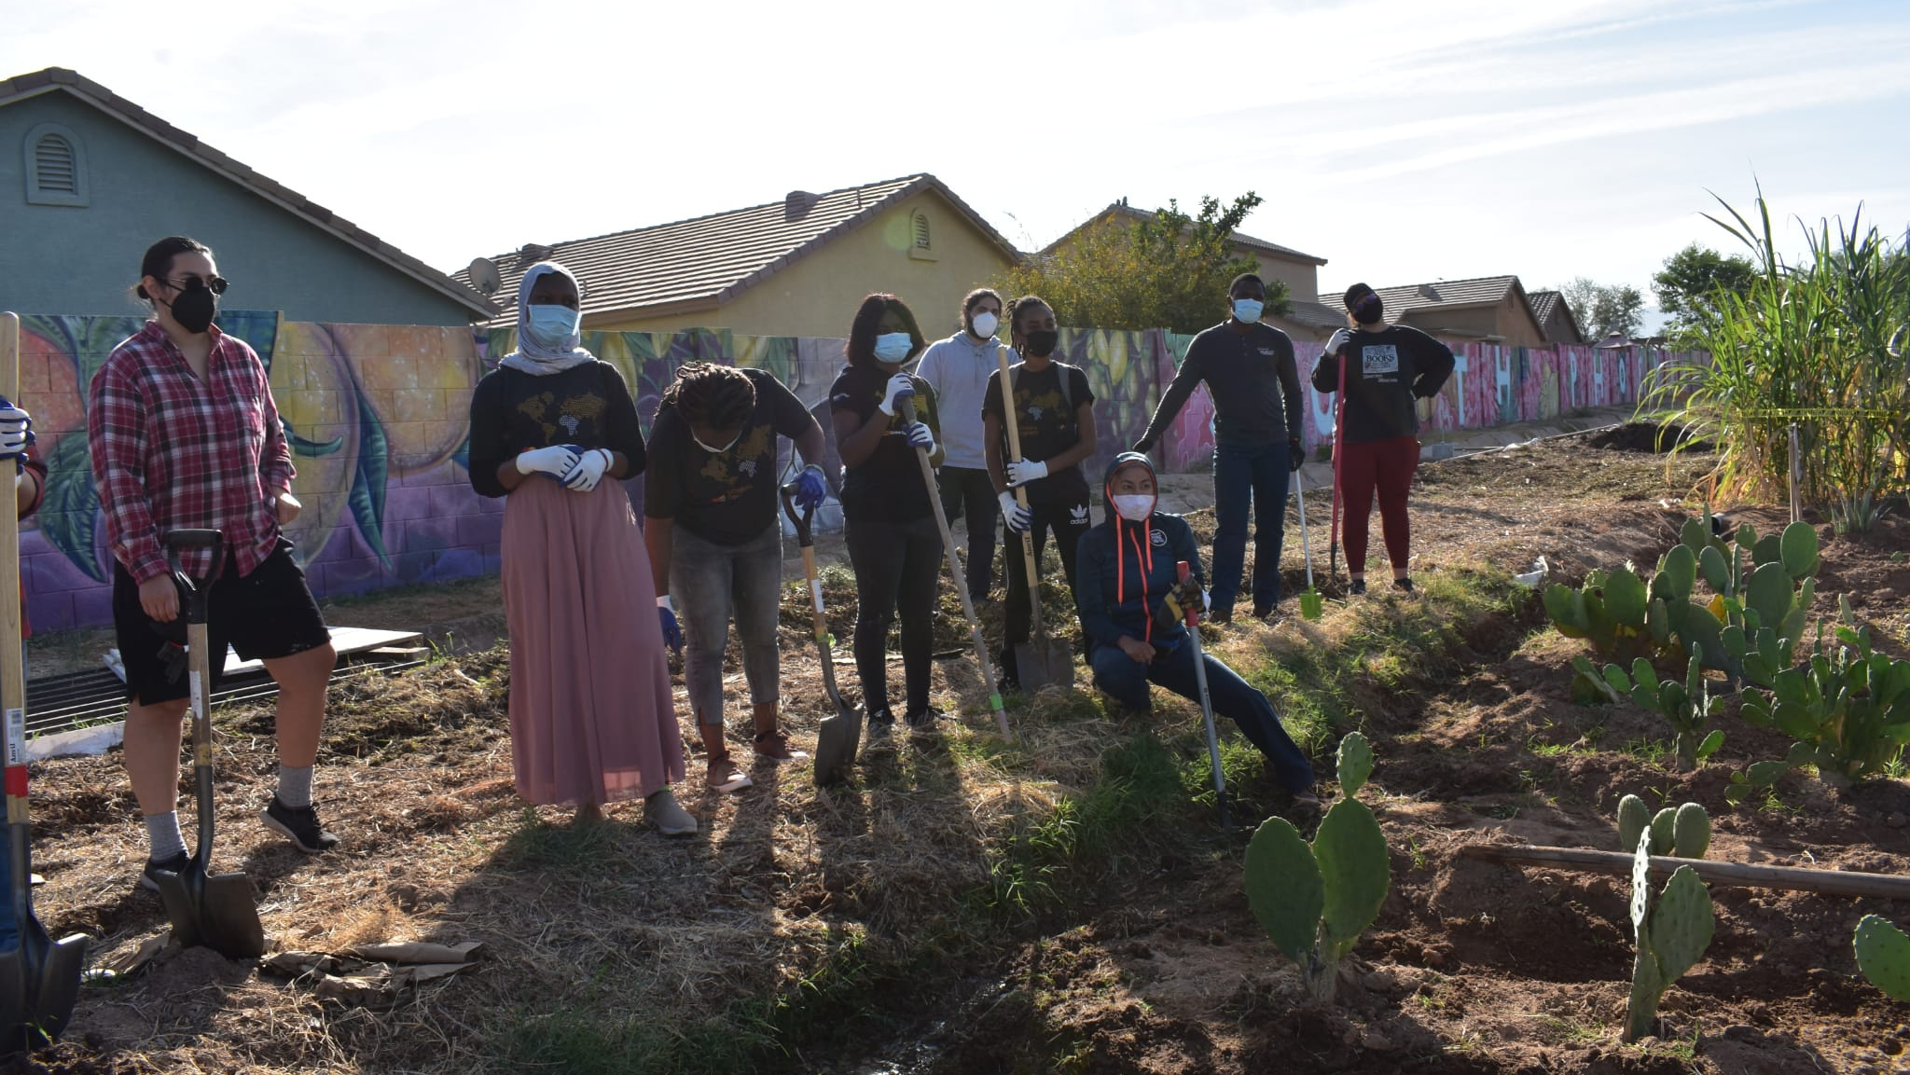
Equity, in its simplest terms as it relates to racial and social justice, means meeting communities where they are and allocating resources and opportunities as needed to create equal outcomes for all community members.

Slide 10
Identify frontline communities, existing disparities in Phoenix, and equity metrics; Justice 40 should correct historical oppression and lack of resources. This is a restorative justice approach
Year 1:
Identify funding sources - when funding for all EV programs, in principle 40% is invested in frontline communities
Create and develop a framework with guiding principles to center justice
Identify co-governing opportunities with frontline communities; rely on the lived experience of these communities and go beyond resourcing to empowering
Identify progress metrics to identify needs and opportunities and value-added to communities
Plan for Phx EJ Screening tool to be part of conversations with stakeholders and communities, integrate into marketing, workshops, forums, etc

Slide 11
Develop Phx EJScreening tool to identify key communities and investment priorities:
Model of community collaboration and accountability; Integrate progress metrics. Must be multilingual, user-friendly, and accessible. Must be receptive to feedback from the community, ready to change tool as needed
Year 2:
Identify measurable metrics and manner of reporting for clear reporting and evaluating processes to ensure accountability and transparency
Develop models of community collaboration, accountability and Launch Justice Framework
Develop guiding investment principles & announce the framework of justice
Continue development of a localized small model in a targeted community

Slide 12
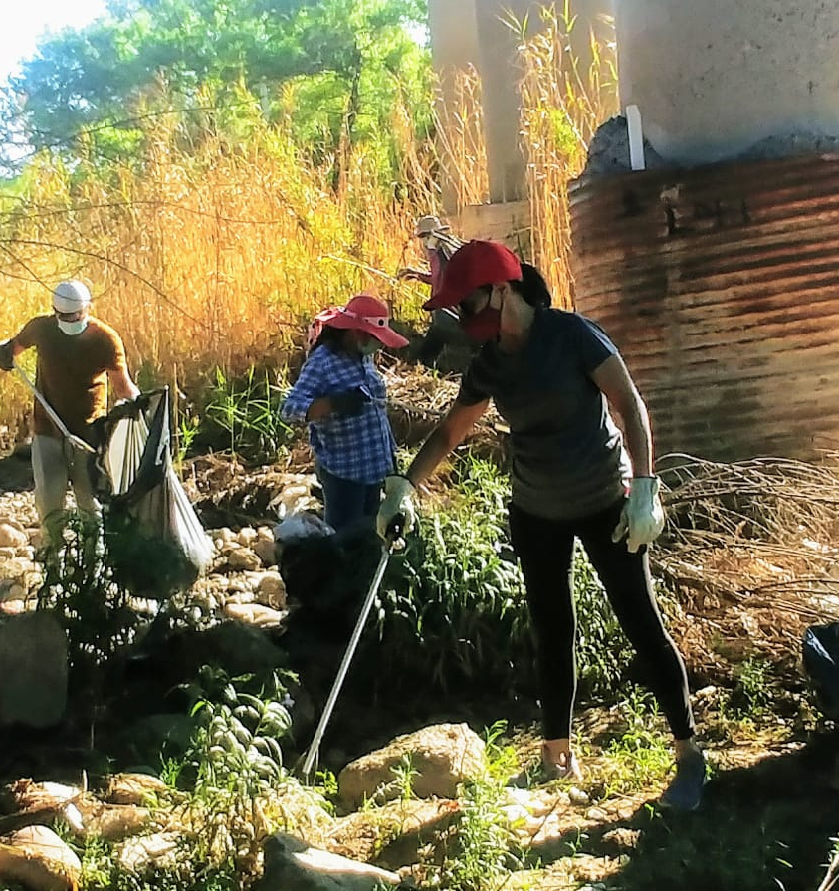
California samples for Justice framework:
Target investments in and benefiting priority populations, with a focus on maximizing disadvantaged community** benefits. Requirement
Maximize economic, environmental, and public health co-benefits to the state. Requirement
Foster job creation and job training, wherever possible. Requirement
Encourage projects that contribute to other state climate goals. Recommendation
Coordinate investments and leverage funds where possible to provide multiple benefits and to maximize benefits. Recommendation
Avoid potential substantial burdens to disadvantaged communities and low-income communities. Requirement
Ensure transparency and accountability and provide public access to program information. Requirement
Conduct outreach to help potential applicants access funding, particularly for priority populations.

Slide 13
Launch Phx EJ Screening tool
Launch investment with requirements to target priority communities:
25% to projects located within the boundaries of, and benefiting individuals living in, disadvantaged communities.
Year 3:
Launch EJ Screening tool, and principles for direct investments
Recommendations: Focus on direct, intentional benefit
Use investment to create strong community collaborative partnership
Use investment to provide capacity and assistance
Clear process to definite benefits for priority communities:
Identification of the priority population(s) the program is intended to benefit
Identification of a need specific to the community served that the program addresses
Provision of a “direct, meaningful, and assured” benefit aligning with the program’s focus that addresses the identified community need.

Slide 14
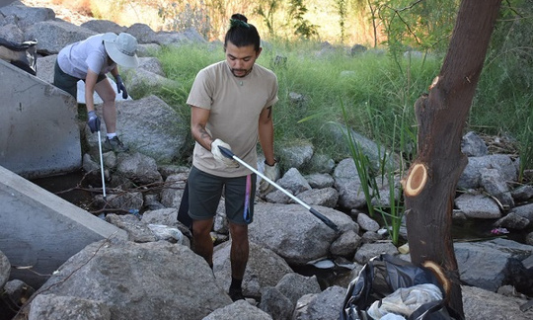
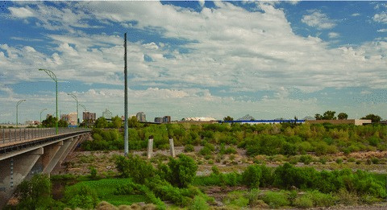
Small Scale Model Proposal
YEAR 1
YEAR 2
YEAR 3
Beginning planning for a local small model to recreate citywide; for example a park, neighborhood, a street
Continue development of a localized small model in a targeted community
Launch localized small-scaled model in a targeted community

Slide 15
References:
JUSTICE PEOPLE POWER PROSPERITY at www.thejustice40.com
Making Justice40 A Reality for Frontline Communities
Lessons From State Approaches to Climate and Clean Energy Investments by UCLA's Luskin Center for Innovation

Slide 16
Council Information Packet – Feb 17
Update on the Ad Hoc Committee
Next Steps
1. Draft EV Roadmap for City Council initial input in March 29, 2022.
2. Conduct extensive outreach in English and Spanish on the draft EV Roadmap in April-May, 2022 including:
Direct outreach to disadvantaged communities;
Village Planning Committee meetings;
Online and in person surveys to residents and businesses (English/Spanish);
Engagement with City employee affinity groups and forums;
EV webpage information;
Social media; and
City communication channels such as PHX At Your Service: Monthly Newsletter and City Services Bill inserts.
3. Submit a final proposed EV Roadmap June, 2022

