Slide 1
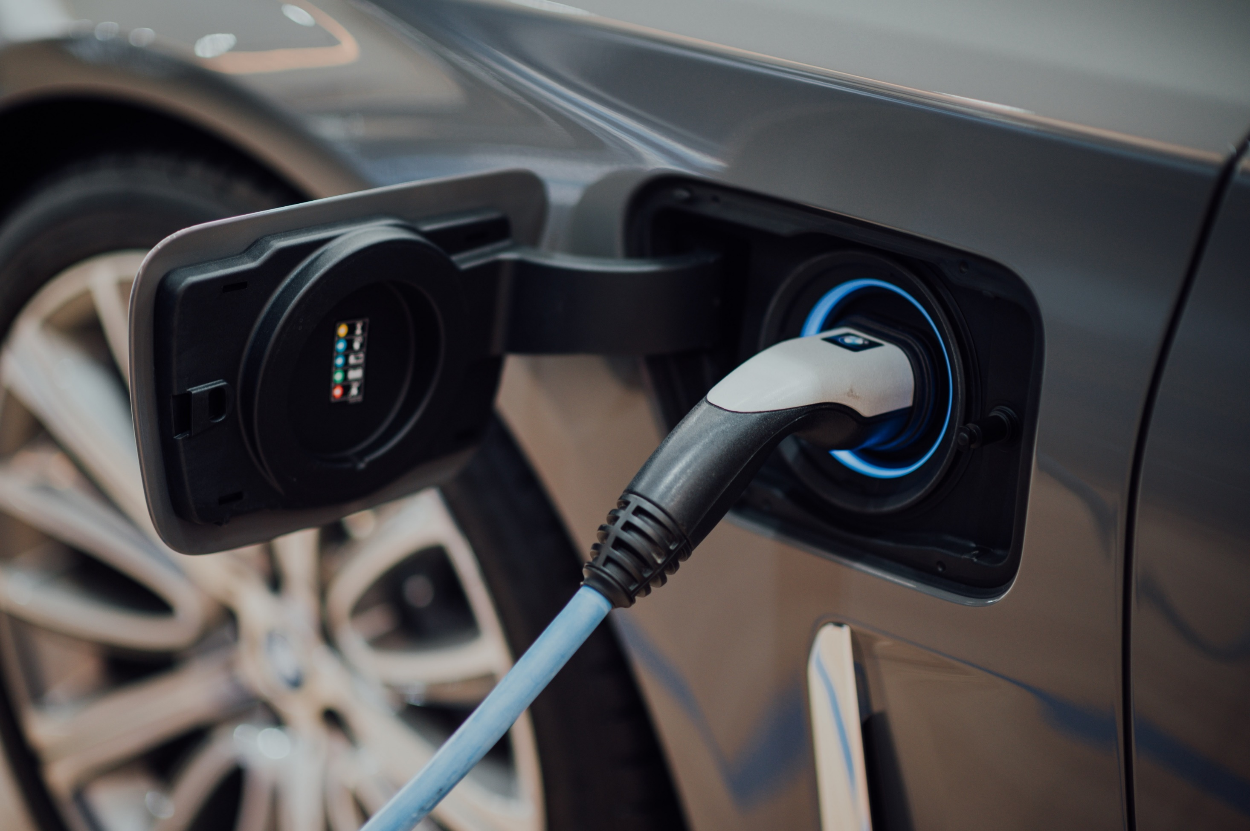
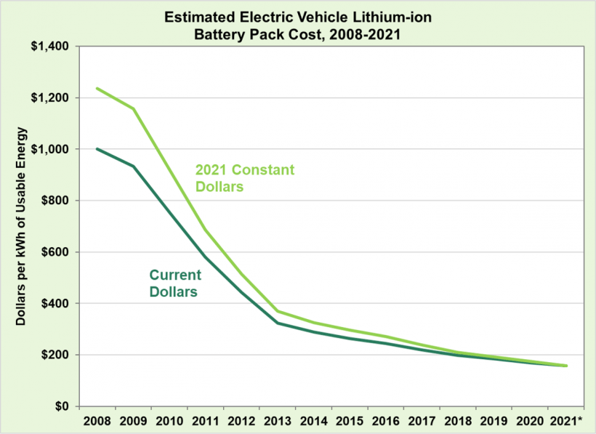
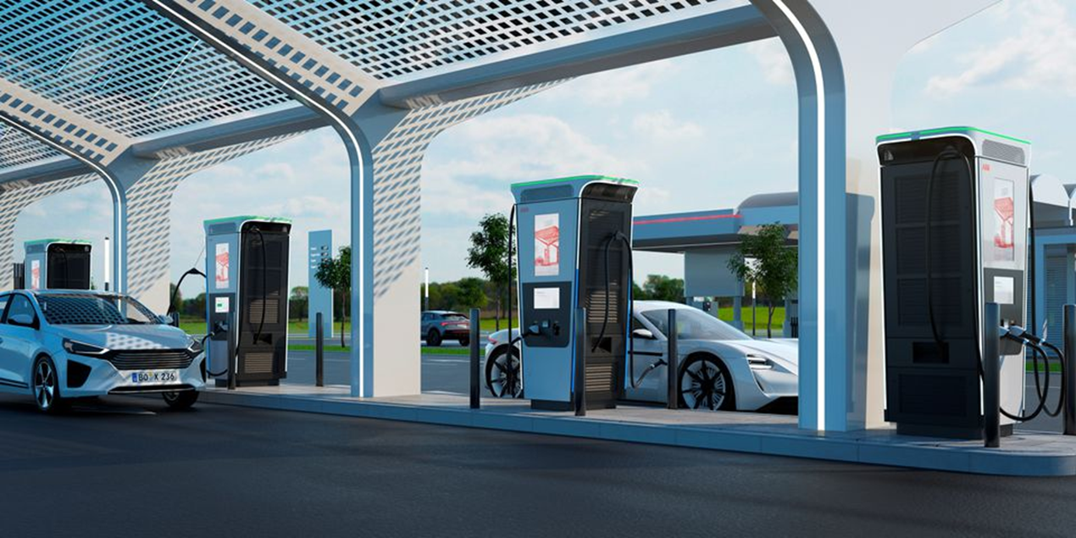
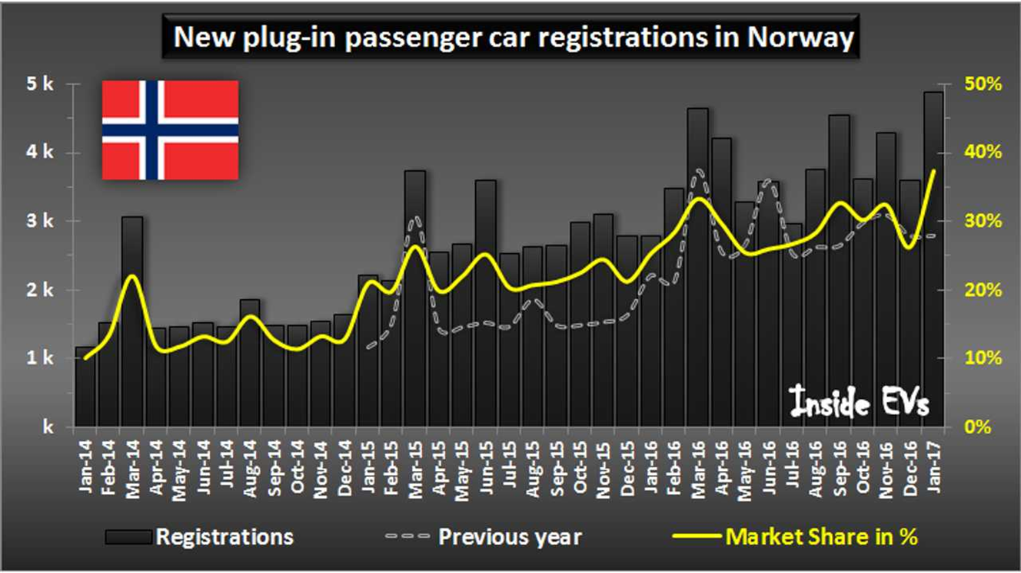
CITY OF PHOENIX
Ad Hoc Committee on Electric Vehicles
Public, Workplace and Home Charging Infrastructure
Sub-Committee
October 15, 2021

Slide 2
In the News
DOE Estimates That Electric Vehicle Battery Pack Costs in 2021 Are 87% Lower Than in 2008

Slide 3
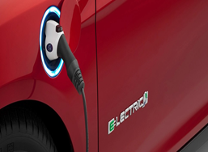
In the News
The auto industry (as a whole) will pump more than $500 billion into EV investment by 2030
Ford: $30 billion
Volkswagen: $60 billion
Honda: $46 billion

Slide 4
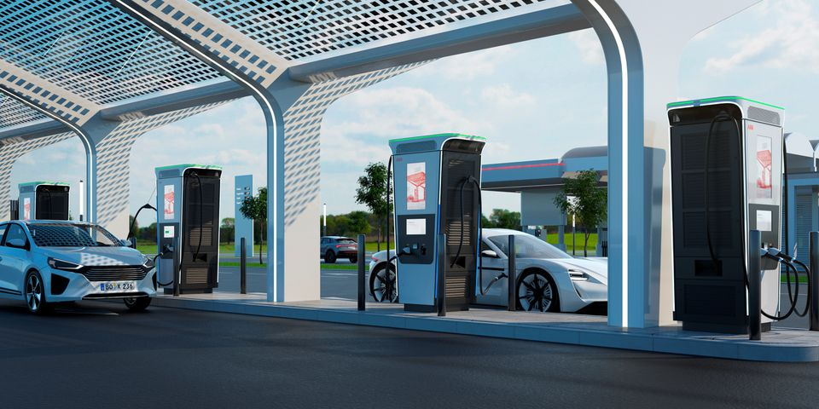
In the News
ABB launches world’s fastest charger to plug into the surging EV market
Zero to full in 15 minutes
Charges 4 cars at once

Slide 5
In the News
Norway could phase out gasoline-powered cars ahead of 2025 schedule

Slide 6
In the News
Nine percent of new cars sold globally this year will be EVs or plug-in hybrids
Triple the rate from 2 years prior

Slide 7
City ROADMAPS:
Public, Workplace & Home Charging

Slide 8
City Roadmaps - Sharepoint
Cities
Cities
Boston, MA
Denver, CO
Fort Collins, CO
Houston, TX
Los Angeles, CA
2020
2020
2018
2019
2018, 2019
Portland, OR 2016
Sacramento, CA 2019
Seattle, WA 2017
Tucson, AZ 2021
Notes:
*Selected these cities to highlight because they had more recent roadmaps; located in the West/Southwest; Boston represents an East Coast perspective.
-Los Angeles has issued two versions.
-Tucson has issued a “working draft”

Slide 9
City Roadmaps - PUBLIC
Cities Highlighted
Common Themes…
Equity focus on deployment of charging infrastructure
Leveraged right-of-way/on-street charging options
Conducted EVSE siting studies to identify locations for L1/L2/DCFC
Implemented EV ready building codes/standards to require EVSE % for city owned public garages AND ensure adequate panel capacity
Implemented pilot EVSE programs and demo’d new EVSE providers
Created incentives for customers and public for EVSE installs
Boston, MA
Denver, CO
Fort Collins, CO
Houston, TX
Los Angeles, CA
Portland, OR
Sacramento, CA
Seattle, WA
Tucson, AZ
2020
2020
2018
2019
2018; 2019
2016
2019
2017
2021

Slide 10
City Roadmaps – WORKPLACE
Cities Highlighted
Common Themes...
Conducted employee surveys to identify EV ownership and charging habits
Conducted needs assessment to determine EVSE L1/L2/DCFC deployment strategies
Designated dedicated employee charging access in co-use public facilities
Employee EV charging education programs
Workplace charging programs to increase awareness and access
Incentives to install employee charging
Boston, MA
Denver, CO
Fort Collins, CO
Houston, TX
Los Angeles, CA
Portland, OR
Sacramento, CA
Seattle, WA
Tucson, AZ
2020
2020
2018
2019
2018; 2019
2016
2019
2017
2021

Slide 11
City Roadmaps – HOME
Cities Highlighted
Common Themes...
Developed EV ready building codes for new construction of single-family, multi-family properties
Provided incentives to home builders/electricians to decrease cost of EVSE installs
Provided incentives for residents to purchase EV chargers
Streamlined EVSE permitting process for residential properties
Continued coordination with stakeholders and utilities to provide residential EV charging programs and awareness campaigns
Boston, MA
Denver, CO
Fort Collins, CO
Houston, TX
Los Angeles, CA
Portland, OR
Sacramento, CA
Seattle, WA
Tucson, AZ
2020
2020
2018
2019
2018; 2019
2016
2019
2017
2021

Slide 12
RECOMMENDATIONS - PUBLIC
EQUITY has to be embedded in EVSE siting and deployment decisions
Develop EVSE siting criteria and deployment strategies
Identify targets for EVSE installs (L1/L2/DCFC) to coincide with 2030 EV growth projections
Expand curbside/on-street parking EVSE installations
Offer targeted incentives for customer/public EVSE and installs
Implement pilot EVSE programs to demo new EVSE providers

Slide 13
RECOMMENDATIONS - WORKPLACE
Develop employee survey to identify EV ownership and charging needs
Create EVSE installation guide for use by business owners
Launch an employee and business workplace EVSE awareness and education program
Designate dedicated employee/workplace charging areas
Provide incentives to business for EVSE and installations to offset the costs

Slide 14
RECOMMENDATIONS - HOME
Develop EV Ready Building Codes for new construction at single-family and multi-family buildings
Provide incentives to home builders and/or electricians to offset the cost of electrical conduits on new single-family and multi-family developments
Provide incentives to homeowners for the purchase of EVSE and assist in offsetting installation costs
Streamline the EVSE installation permitting process
Produce an EVSE installation guide identifying the process

Slide 15
Demographic and Survey Data:

Slide 17
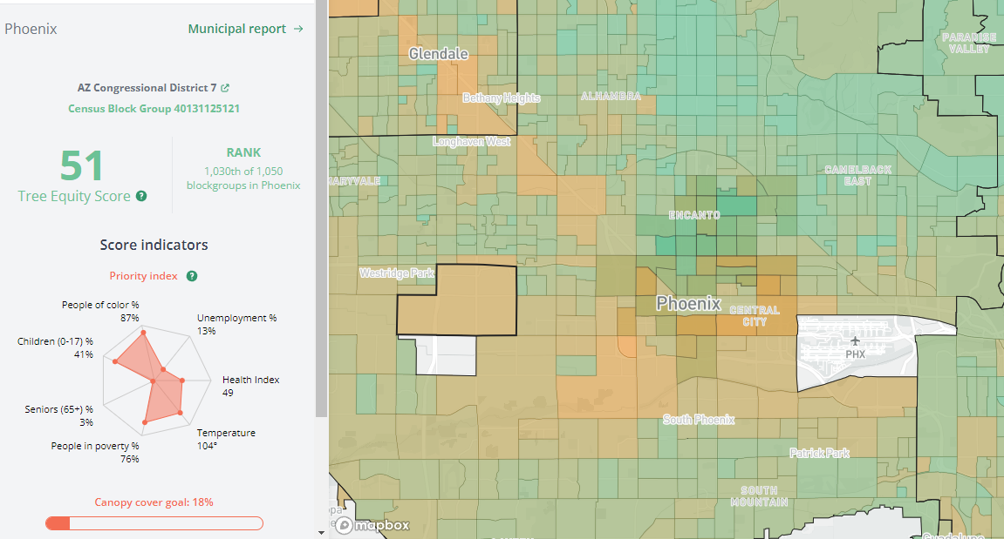
AMERICAN FORESTS
treeequityscore.org

Slide 18
Cooler Phoenix Public Survey (2017)

Slide 19
Electric Vehicle Charging Building Codes & Zoning Ordinance October 15, 2021
EV Ad Hoc – Public, Workplace and Home Charging Infrastructure Subcommittee

Slide 20
Electric Vehicle Charging Building Codes & Zoning Ordinance
Building Codes
Regulate the construction of buildings, structures and equipment
Address life safety, structural strength, fire safety, electrical safety, sanitation and energy conservation
Zoning Ordinance
Regulates land use and building development
Preserve and enhance aesthetic values
Regulates site development, including parking and landscaping

Slide 21
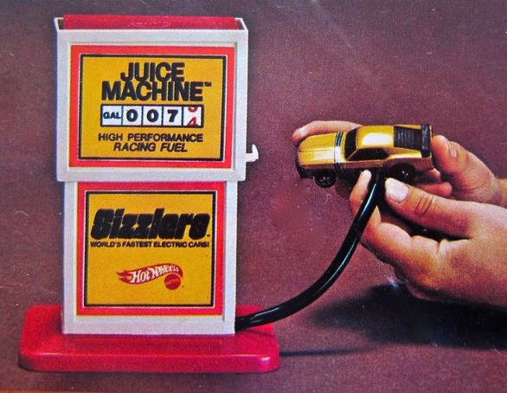
Current EV Building Codes
Current adopted relevant building codes: 2018 International Residential Code, 2018 International Building Code, 2018 International Energy Conservation Code and 2017 National Electrical Code
Voluntary to install “EV-capable,” “EV-ready” or “EV-installed” system in single-family homes, multifamily, commercial and industrial projects
2017 National Electrical Code regulates HOW to install EV chargers, but does not mandate their provision
ICC Executive Committee chose not to adopt EV mandates in the 2021 I-codes

Slide 22
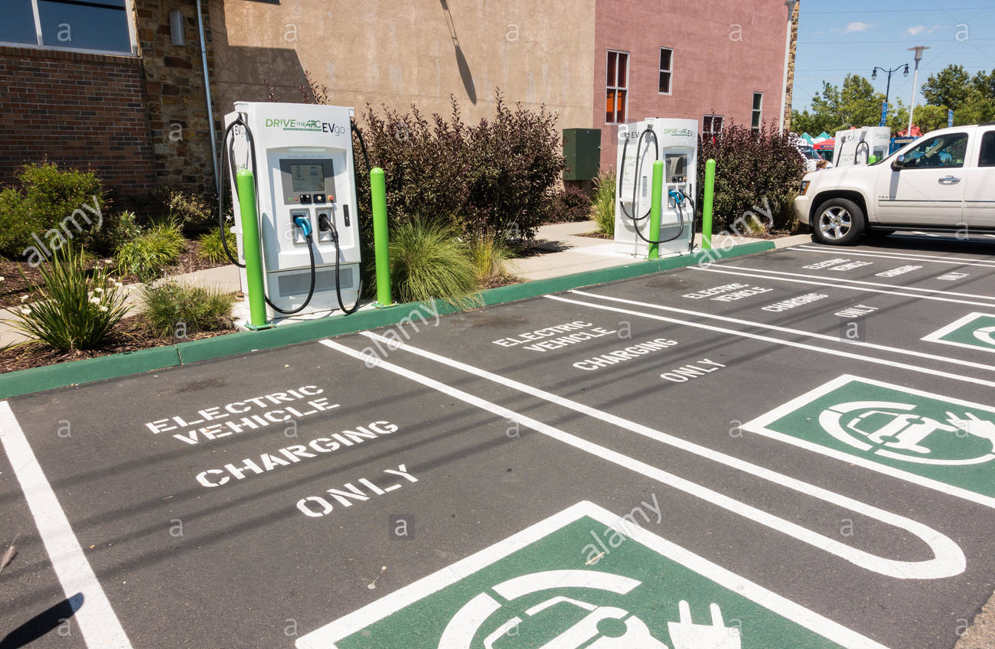
EV Charging Plan Review
New buildings/ interior installations
Major new commercial project: 25 to 45 days
New residential SF home: 30 days
Remodels/ retrofit: 14 to 30 days
Exterior installation: EV in parking lot Site plan/ landscape review required prior to building plan review Timeframe: 5 to 30 days

Slide 23
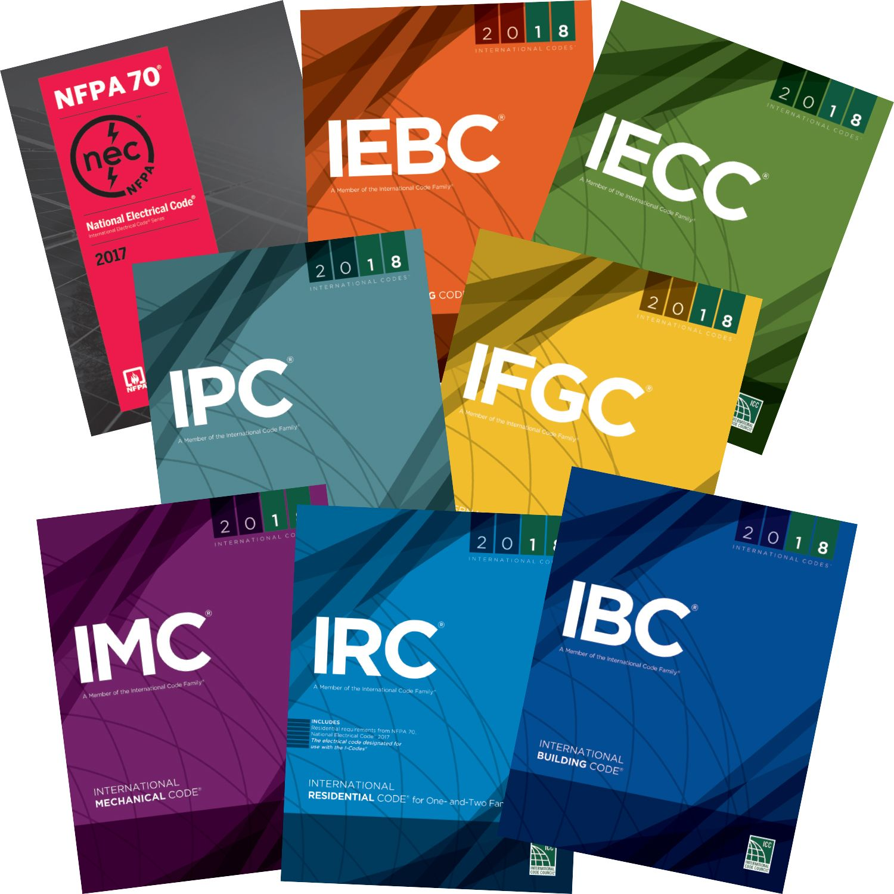
Adopt new EV Building Code Amendments
Draft text amendment to building codes
Review by:
City staff
Stakeholders: design professionals, developers, public
Development Advisory Board
Adoption by City Council
Timeframe: 6 to 8 months (Only EV charging amendments, not all building codes)

Slide 24
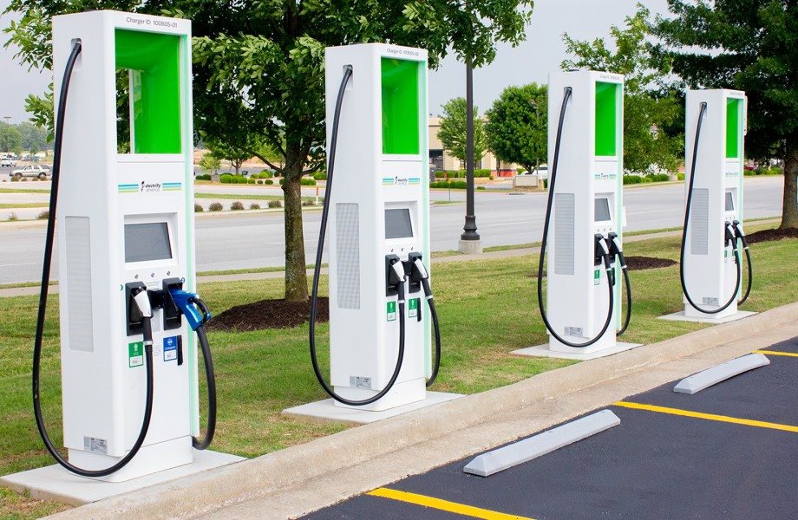
Current Zoning Ordinance
Regulates number of parking spaces required for single-family, multifamily, commercial (retail/ office) and industrial
Setbacks are required from property line for parking in commercial/ industrial zoning
Length of time vehicles can remain parked and not be considered as vehicle storage
Screening required for mechanical and electrical equipment from off-site visibility

Slide 25
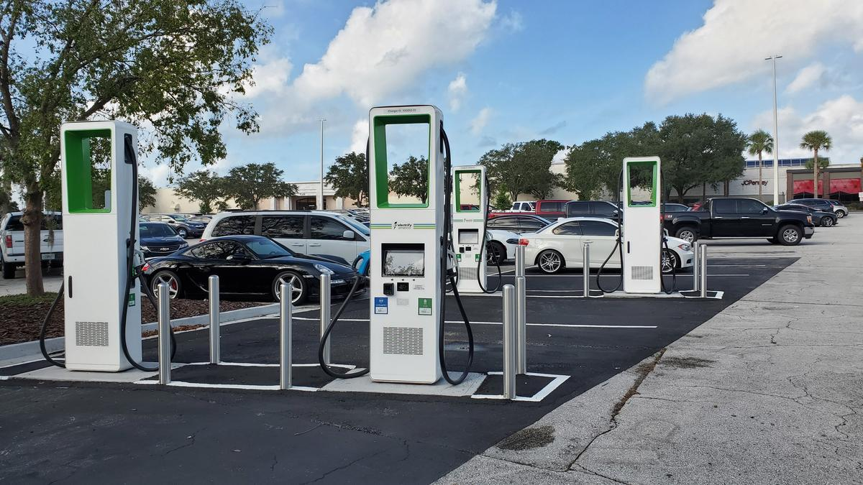
Potential Zoning Ordinance Updates
Addition of Electric Vehicle Charging terminology
Clarification of applicability of parking standards
Any amendments will need to include an analysis of how the change impacts the affordability of the home pursuant to state law.

Slide 26
Adopt New Zoning Ordinance Regulations
Draft text amendment to Zoning Ordinance
Review by:
City staff
Stakeholders: design professionals, developers, public
Village Planning Committees: 15 different committees; each hear it twice
Planning Commission
Adoption by City Council
Timeframe: 12 to 18 months Outreach and public hearing process involved

Slide 27
Electric Vehicle Charging
Questions?

